Slide 1


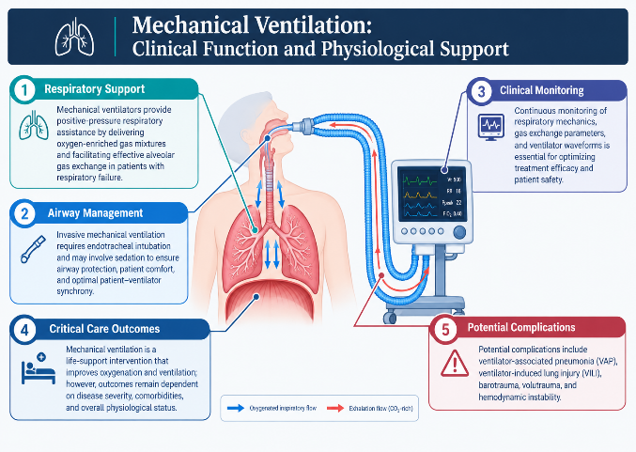
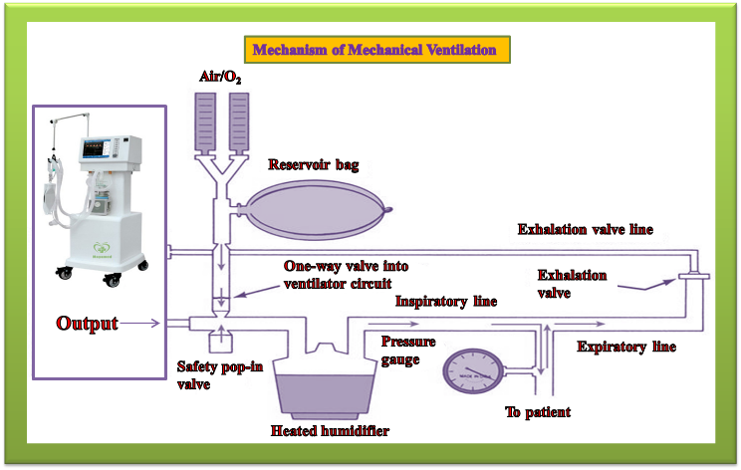
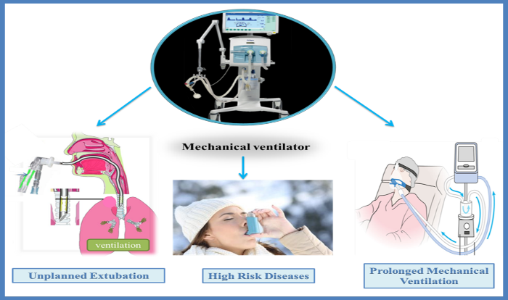
if available
Mechanical Ventilation: MECHANISM AND CLINICAL RISKS
Clinical Function and Physiological Support
Respiratory support • airway management • monitoring • outcomes • complications
Hiva Nargesi Khoramabadi (1), Faezeh Kafi (2)
Department of Biomedical Engineering, Faculty of Engineering, Payame Noor University (PNU), Karaj, Iran
Department of Animal Sciences, Faculty of Biological Sciences, Kharazmi University, Tehran, Iran
1. Respiratory Support
3. Clinical Monitoring
4. Critical Care Outcomes
Mechanical ventilators provide positive-pressure respiratory assistance by delivering oxygen-enriched gas mixtures and facilitating effective alveolar gas exchange in patients with respiratory failure.
Continuous monitoring of respiratory mechanics, gas exchange parameters, and ventilator waveforms is essential for optimizing treatment efficacy and patient safety.
Mechanical ventilation is a life-support intervention that improves oxygenation and ventilation; however, outcomes remain dependent on disease severity, comorbidities, and overall physiological status.
2. Airway Management
Flow legend: Oxygenated inspiratory flow; Exhalation flow (CO2-rich)
5. Potential Complications
Invasive mechanical ventilation requires endotracheal intubation and may involve sedation to ensure airway protection, patient comfort, and optimal patient-ventilator synchrony.
Potential complications include ventilator-associated pneumonia (VAP), ventilator-induced lung injury (VILI), barotrauma, volutrauma, and hemodynamic instability.
Ventilator circuit and gas-flow mechanism
Complications and challenges during ventilatory support

