Slide 1

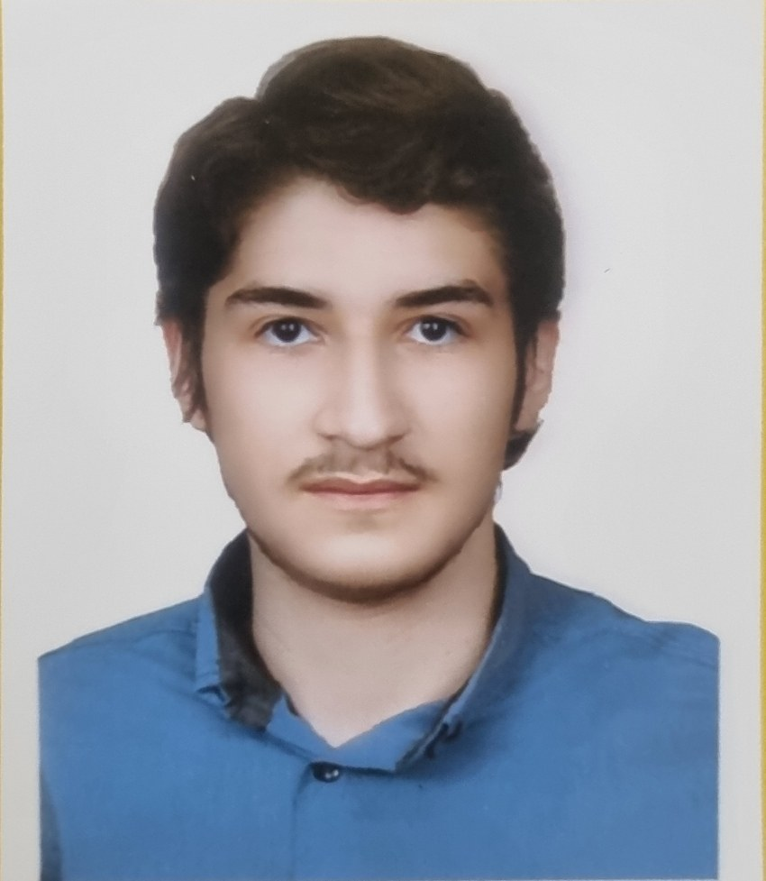
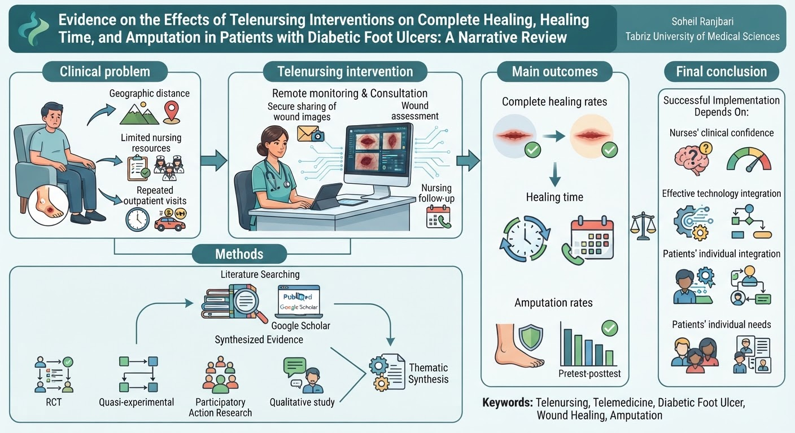
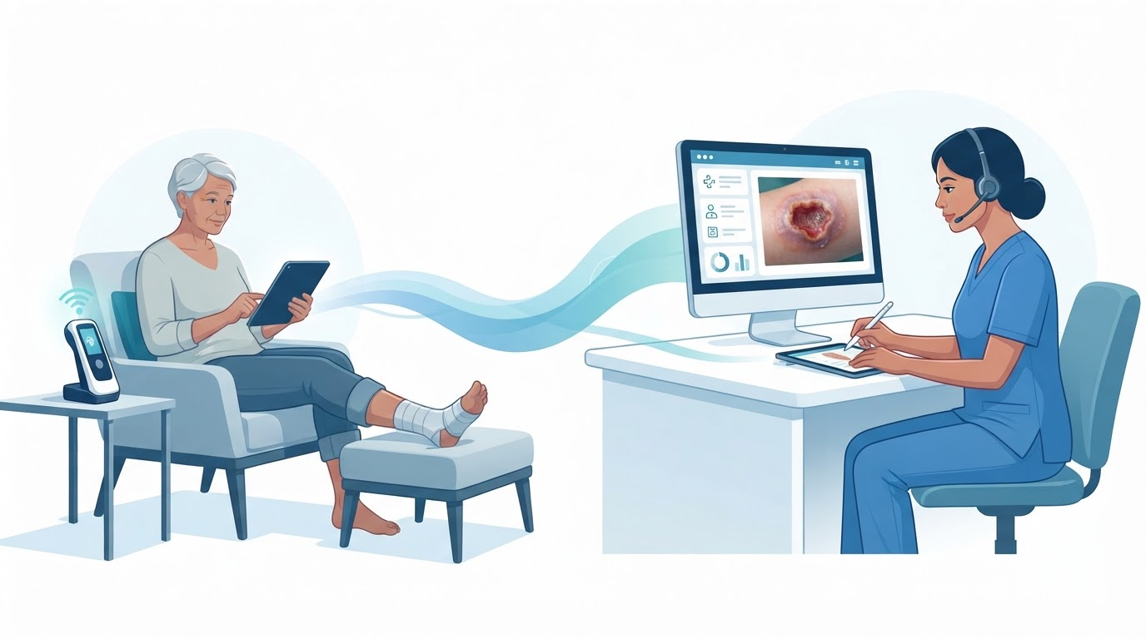
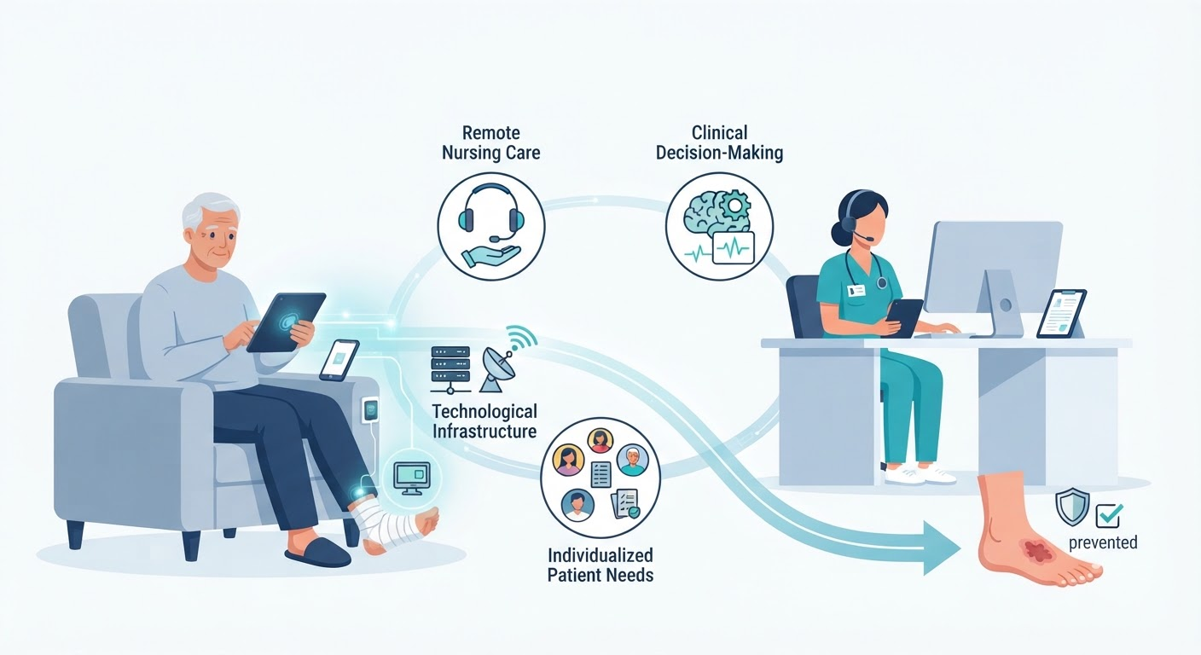
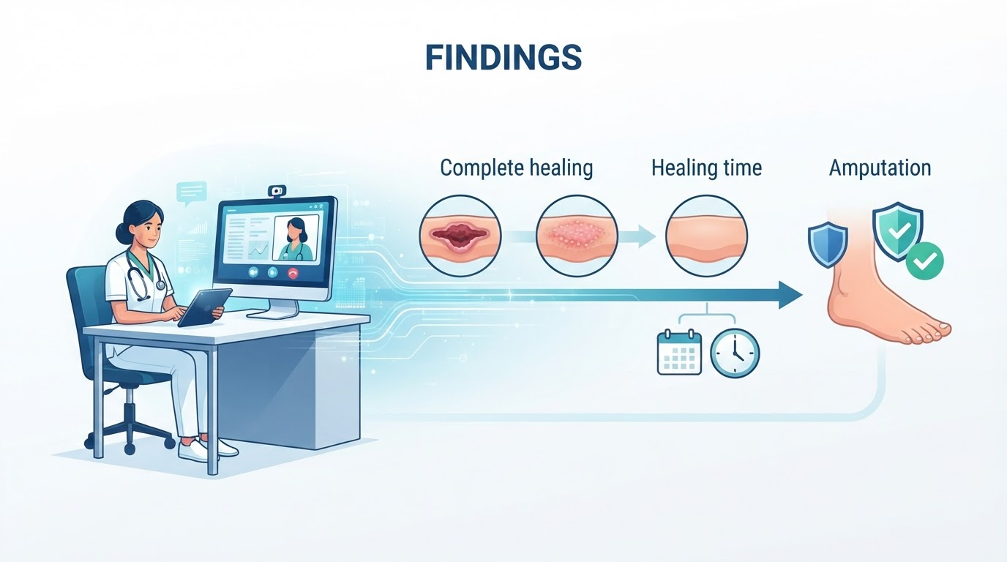
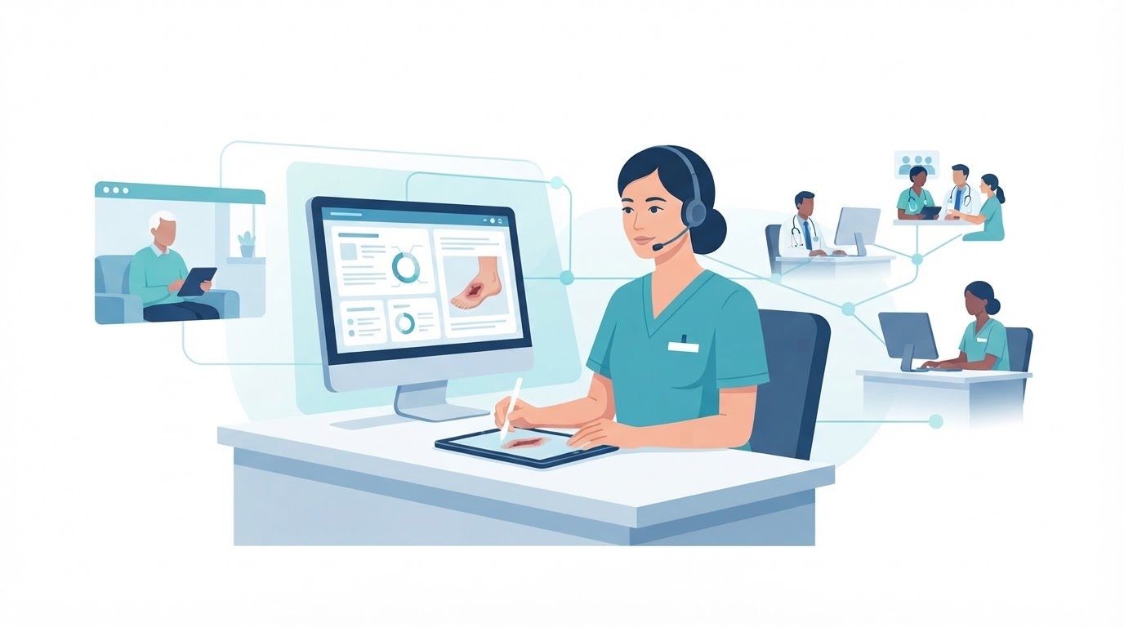
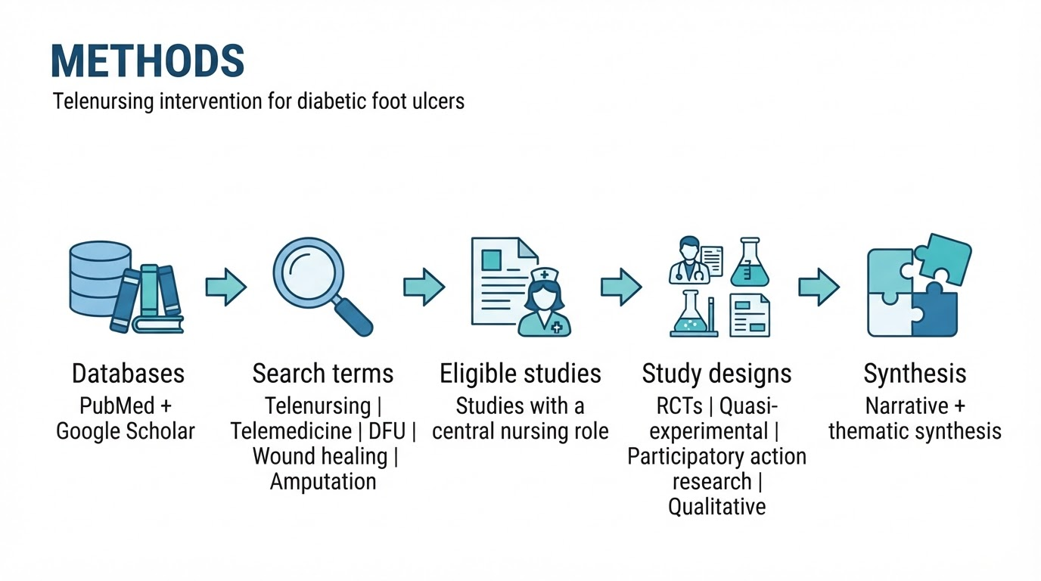
Code:1501
Author’s photo
Evidence on the Effects of Telenursing Interventions on Complete Healing, Healing Time, and Amputation in Patients with Diabetic Foot Ulcers: A Narrative Review
Soheil Ranjbari
MSc Student in Medical-Surgical Nursing, Faculty of Nursing and Midwifery, Tabriz University of Medical Sciences, Tabriz, Iran
Backgrounds
Findings
Conclusion
Diabetic foot ulcer (DFU) is a common, disabling, and costly complication of diabetes. Continuous wound monitoring and specialized care are essential for effective management. Telenursing may help overcome geographical and access barriers to wound care. Evidence regarding its effects on wound healing and amputation remains heterogeneous. This narrative review aimed to summarize the available evidence on the effects of telenursing interventions on complete wound healing, healing time, and amputation in patients with diabetic foot ulcers.
HEALING TIME
Healing was generally comparable between remote and standard care.
AMPUTATION
No significant overall difference in amputation rates was identified. One pretest–posttest study reported no amputations.
.
Telenursing may provide an effective approach comparable to standard care for diabetic foot ulcer management. Successful implementation requires appropriate technological infrastructure and attention to nurses’ and patients’ needs. Further high-quality studies with longer follow-up are needed.
Methods
References
1. Rasmussen BS, Froekjaer J, Bjerregaard MR, Lauritsen J, Hangaard J, Henriksen CW, et al. A randomized controlled trial comparing telemedical and standard outpatient monitoring of diabetic foot ulcers. Diabetes care. 2015;38(9):1723–9 .
COMPLETE HEALING
Remote monitoring showed outcomes comparable to conventional outpatient care.
Nurse confidence, integration of technology into clinical workflows, and patients’ individual needs and preferences influenced implementation and acceptance.

