Slide 1



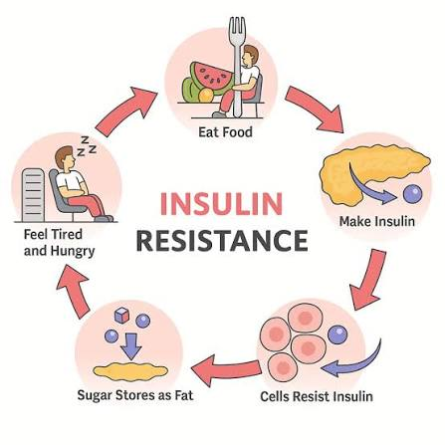


if available
Code:1057
Artificial Intelligence in Hospital Nutrition: Designing Smart Blood Sugar-Based Nutrition Protocols for Diabetic Patients
Azadehalsadat Hosseini dastgerdi
1.Department of Preclinical Medical, Najafabad Branch, Islamic Azad University, Najafabad, Iran
2.Clinical Research Development Center, Najafabad Branch, Islamic Azad University, Najafabad, Iran
Backgrounds
Findings
Conclusion
Diabetes is a global health challenge with an increasing prevalence, and hospitalized diabetic patients face the dual challenge of blood sugar control and malnutrition. Traditional hospital nutrition protocols based on “one-size-fits-all” approaches are not only ineffective, but also potentially harmful. Artificial Intelligence (AI) has opened a new horizon in clinical nutrition with its multimodal data processing, adaptive learning, and real-time personalization capabilities..
.
Technological advances can be categorized into four main areas: 1. Intelligent food recommendation systems 2. Dynamic insulin regulation algorithms 3. Advanced artificial pancreas systems 4. Virtual nutrition assistants . Clinical studies show that the use of these systems reduces the need for in-person visits, the need for human resources, hypoglycemia and hyperglycemia in diabetic patients. However, there is a deep research gap in the use of these technologies in the intensive care unit and intravenous/tube feeding of hospitalized diabetic patients.
Integrating artificial intelligence into hospital nutrition protocols enables the transition from “standard nutrition” to “precision nutrition”. The design of smart nutrition protocols based on blood glucose requires the integration of continuous glucose monitoring (CGM), reinforcement learning algorithms for real-time adaptation, and personalized food recommendation systems. This development, with metabolic rehabilitation and reduction of complications, paints a promising horizon for hospitalized diabetic patients.
Methods
The present study is a narrative review conducted by systematically searching PubMed, IEEE Xplore, Scopus, and ClinicalTrials.gov databases.
References
1. Marian CV, editor Artificial Intelligence Expert System Based on Continuous Glucose Monitoring (CGM) Data for Auto-Adaptive Adjustment Therapy Protocol–How to Make Sensors and Patients to Think Forward and Work Together? 2021 International Conference on e-Health and Bioengineering (EHB); 2021: IEEE.
2. Mahdavi S, Anthony NM, Sikaneta T, Tam PY. Perspective: Multiomics and Artificial Intelligence for Personalized Nutritional Management of Diabetes in Patients Undergoing Peritoneal Dialysis. Advances in Nutrition. 2025;16(3):100378.
.

