Slide 1


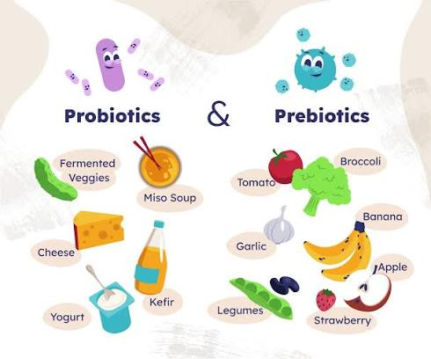
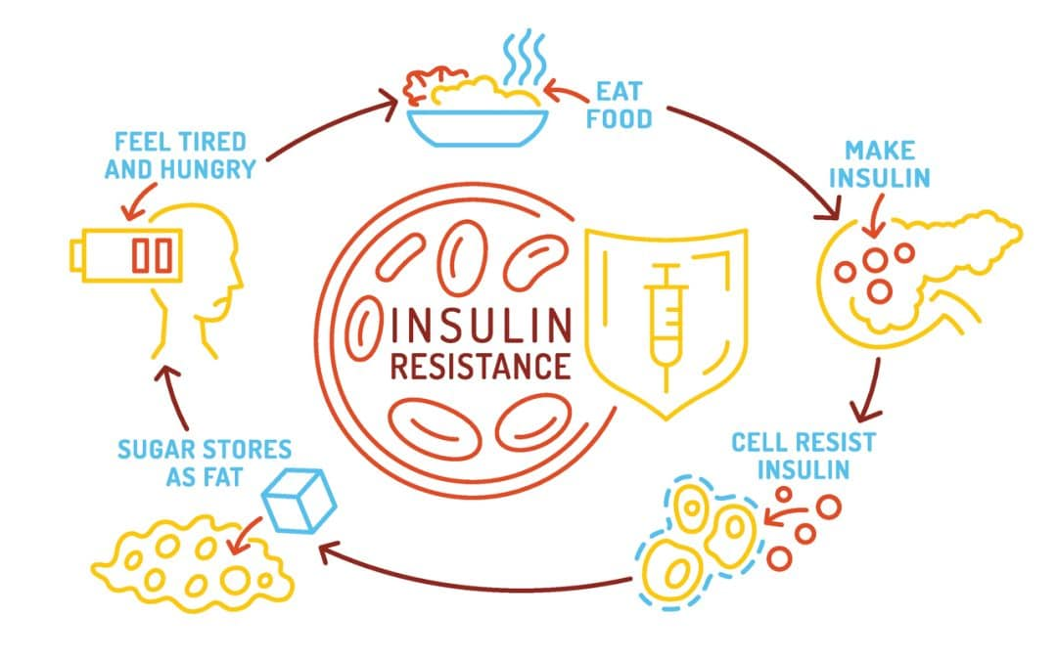
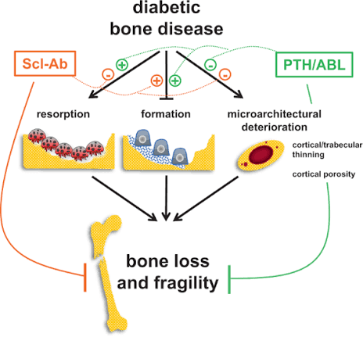
if available
Microbiome-mediated metabolic rehabilitation: The role of prebiotics and probiotics in improving insulin resistance and preventing diabetic osteoporosis
Code:1058
Azadehalsadat Hosseini dastgerdi
1.Department of Preclinical Medical, Najafabad Branch, Islamic Azad University, Najafabad, Iran
2.Clinical Research Development Center, Najafabad Branch, Islamic Azad University, Najafabad, Iran
Backgrounds
Findings
Conclusion
Type 2 diabetes mellitus (T2DM) is associated with two major challenges: 1. Insulin resistance (the axis of metabolic dysfunction), 2. Diabetic osteoporosis (a silent but debilitating complication). One of the new targets proposed for metabolic rehabilitation is the “microbiome-gut-bone” axis...
.
Regarding insulin resistance, relatively strong clinical evidence supports the efficacy of Acremantia musciniphila and inulin-like fructo-oligosaccharides, although contradictory results and conflicts of interest are evident in some studies. On the other hand, regarding diabetic osteoporosis, some studies, including a clinical trial (Birkland et al., 2025, University of Oslo), showed no significant effect on calcium, magnesium, vitamin D, P1NP, and CTX-1 with a 6-week course of inulin supplementation. This contradiction indicates a deep gap in the understanding of the effect of probiotics on insulin resistance and osteoporosis.
.
Microbiome therapy in metabolic rehabilitation of diabetes is recommended for glucose control and inflammation, but its prescription for the prevention or treatment of diabetic osteoporosis lacks clinical evidence and is considered a “premature leap from animal evidence to clinical recommendation”. Clinical trial designs with an intervention period of ≥12 weeks, selection of populations with confirmed osteopenia/osteoporosis, and use of synbiotic combinations are essential.
Methods
This review study critically compares the available clinical evidence in the two areas of “microbiome-insulin” and “microbiome-diabetic bone”..
References
1. Birkeland E, Bamigbetan WA, Molven KD, Thorsby PM, Gulseth HL, Aas A-M, et al. Can supplements with prebiotic fibres positively influence bone health in type 2 diabetes? Insights from a randomised controlled crossover trial. Archives of Osteoporosis. 2025;20(1):71.
.

