Slide 1

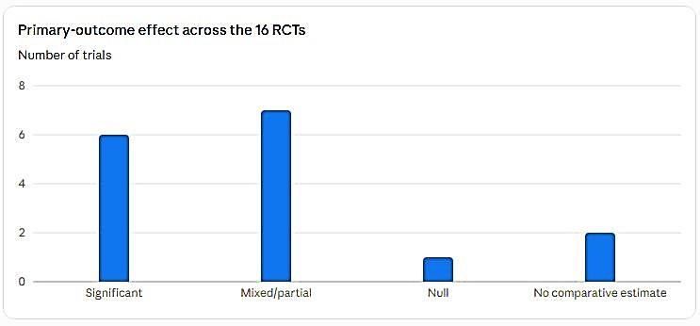
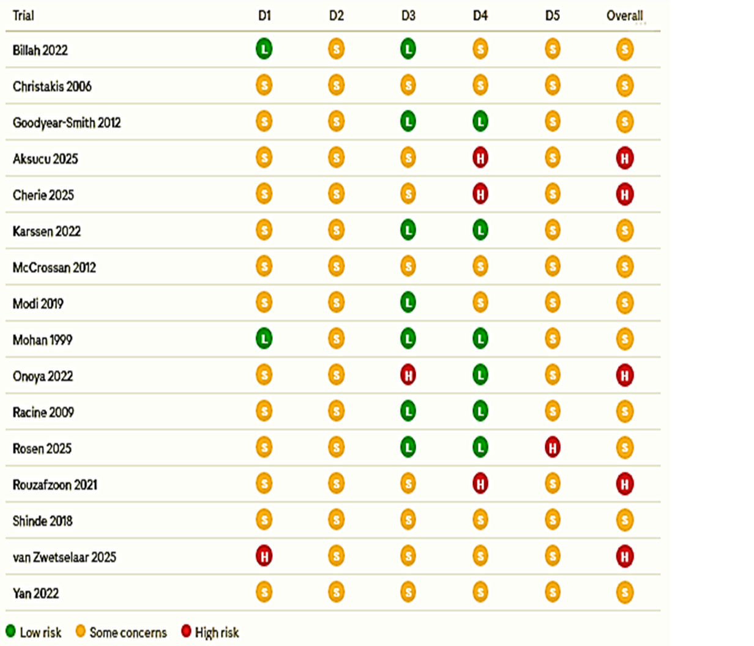
if available
The Role of Remote Communication Technologies in Integrating ‎Continuous Care from Pregnancy through Infancy: A ‎Systematic ‎Review
Code: 1482
Nafiseh Jamal(1), Reza Abbasi(2), Reihane Sharif(3), Seyedamirabbas Sharif(4‎)
‎Health Information Management Research Center, Kashan University of ‎Medical Sciences, ‎Kashan, Iran.‎‏ ‏Email: jamal.nafiseh69@gmail.com
‎Department of Health Information Technology, School of Paramedical ‎Sciences, Torbat ‎Heydariyeh University of Medical Sciences, Torbat ‎Heydariyeh, Iran. Email: rezaabbasi2001@gmail.com
‎Health Information Management Research Center, Kashan University of ‎Medical Sciences, ‎Kashan, Iran.‎‏ ‏Email: Fr.sharif@yahoo.com
‎Department of Pediatrics, Kashan University of Medical Sciences, Kashan, ‎Iran.‎‏ ‏Email: amirsharif.md@gmail.com
Backgrounds
Findings
Conclusion
Continuity of care from pregnancy through infancy is a core pillar of the transformation of ‎maternal-infant health services. Remote communication technologies (telephone, SMS, ‎mobile applications, video-conferencing) have emerged as tools for integrating this ‎continuum of care. This study aimed to systematically review randomized controlled trials ‎and appraise their quality.‎
Risk of bias assessment (Cochrane RoB2)
Remote communication technologies can meaningfully support integrated, continuous, and ‎hope-instilling care for mothers and infants; however, the absence of any trial at low risk ‎of bias underscores the need for more rigorous trials.‎
References
Methods
Of 16 RCTs (11 individual, 4 cluster, 1 quasi-randomized) across 12 countries, none reached overall low risk of bias (RoB2): 68.75% some concerns, 31.25% high risk; mainly from unblinded, self-reported outcomes. Of 14 trials reporting a comparative effect: 6 significant, 7 mixed, 1 null. Technology-based interventions were linked to a 10.5% reduction in jaundice-related readmission, reduced maternal anxiety, improved newborn care and sleep/mood, and less healthcare resource use in congenital heart disease; but immunization effects were limited to attitudes, not timeliness.
Page MJ, McKenzie JE, Bossuyt PM, et al. The PRISMA 2020 statement: an updated guideline for ‎reporting systematic reviews. BMJ. 2021;372:n71.‎
Sterne JAC, Savović J, Page MJ, et al. RoB 2: a revised tool for assessing risk of bias in randomised ‎trials. BMJ. 2019;366:l4898.‎
Modi D, Dholakia N, Gopalan R, et al. mHealth intervention "ImTeCHO" to improve delivery of ‎maternal, neonatal, and child care services - a cluster-randomized trial in tribal areas of Gujarat, India. ‎PLoS Med. 2019;16(10):e1002939.‎
A systematic PRISMA 2020-guided search was conducted in Scopus, PubMed, and Web ‎of Science using terms for infant/neonate, digital health/telemedicine, and continuity of ‎care. Eligible studies were randomized controlled trials evaluating a remote ‎communication intervention across the pregnancy-to-infancy continuum against usual care, ‎excluding protocols without outcomes and non-randomized designs. Quality was ‎appraised using the Cochrane RoB2 tool.‎

