Slide 1
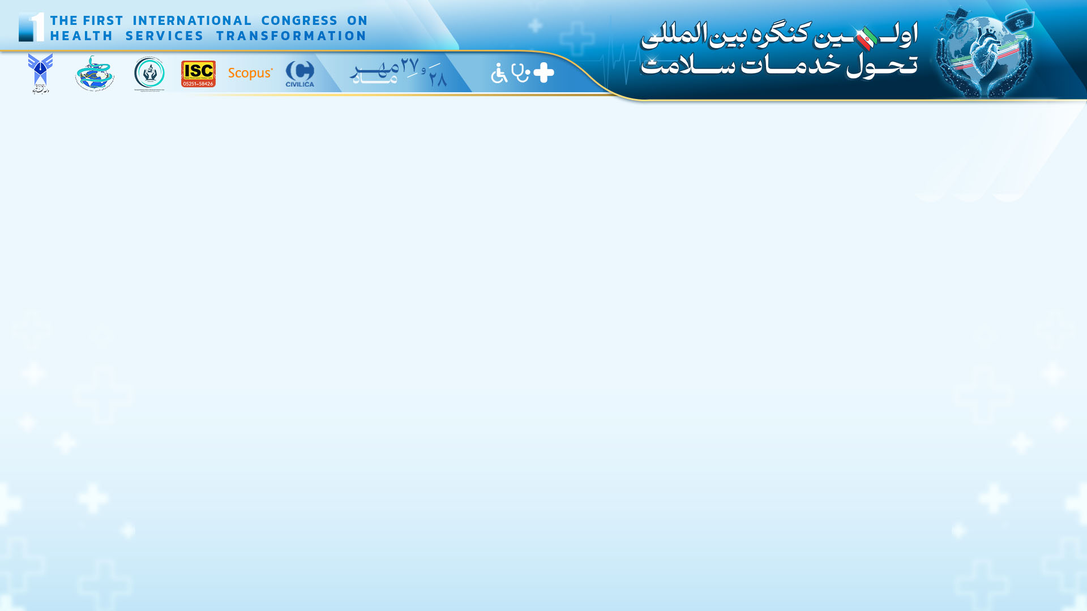
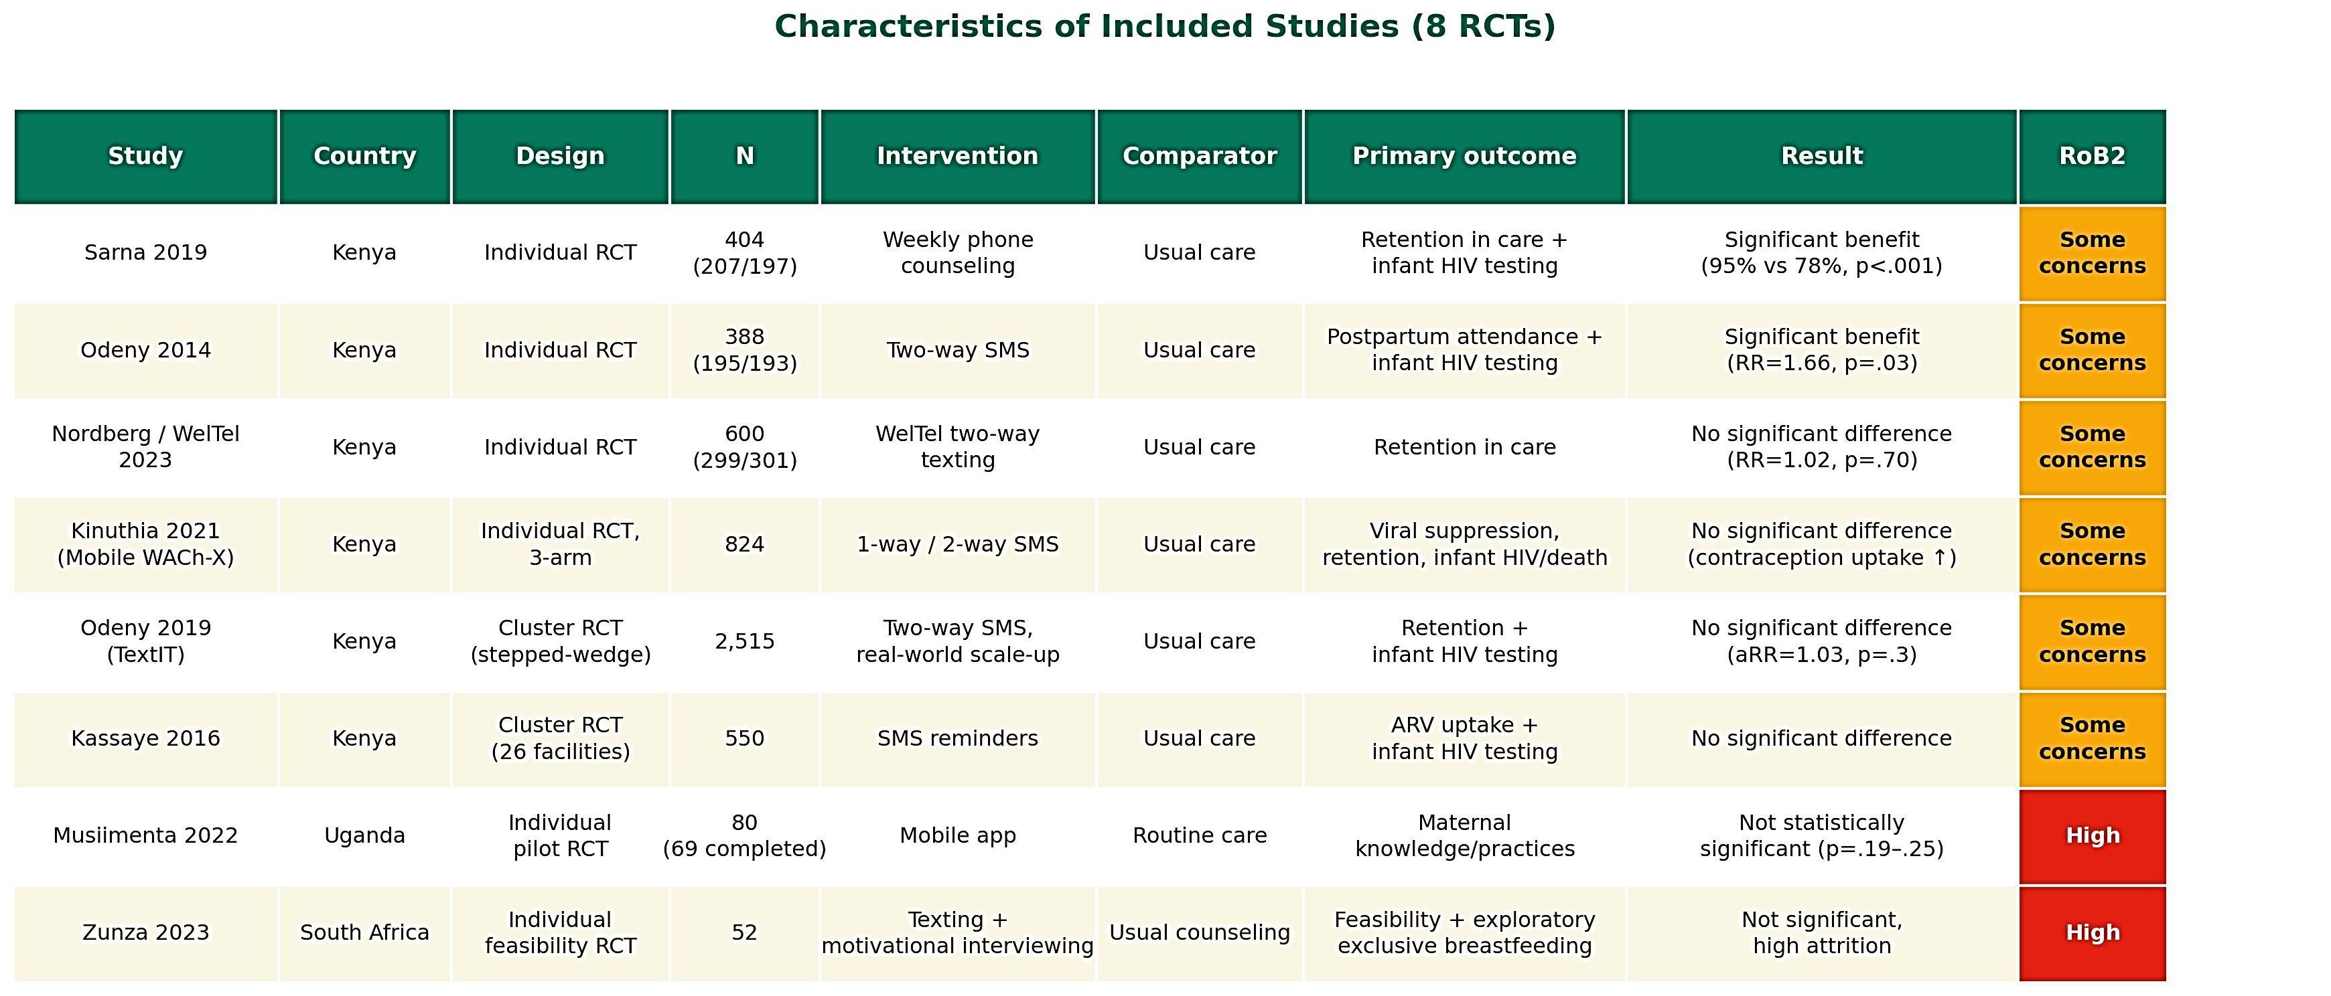
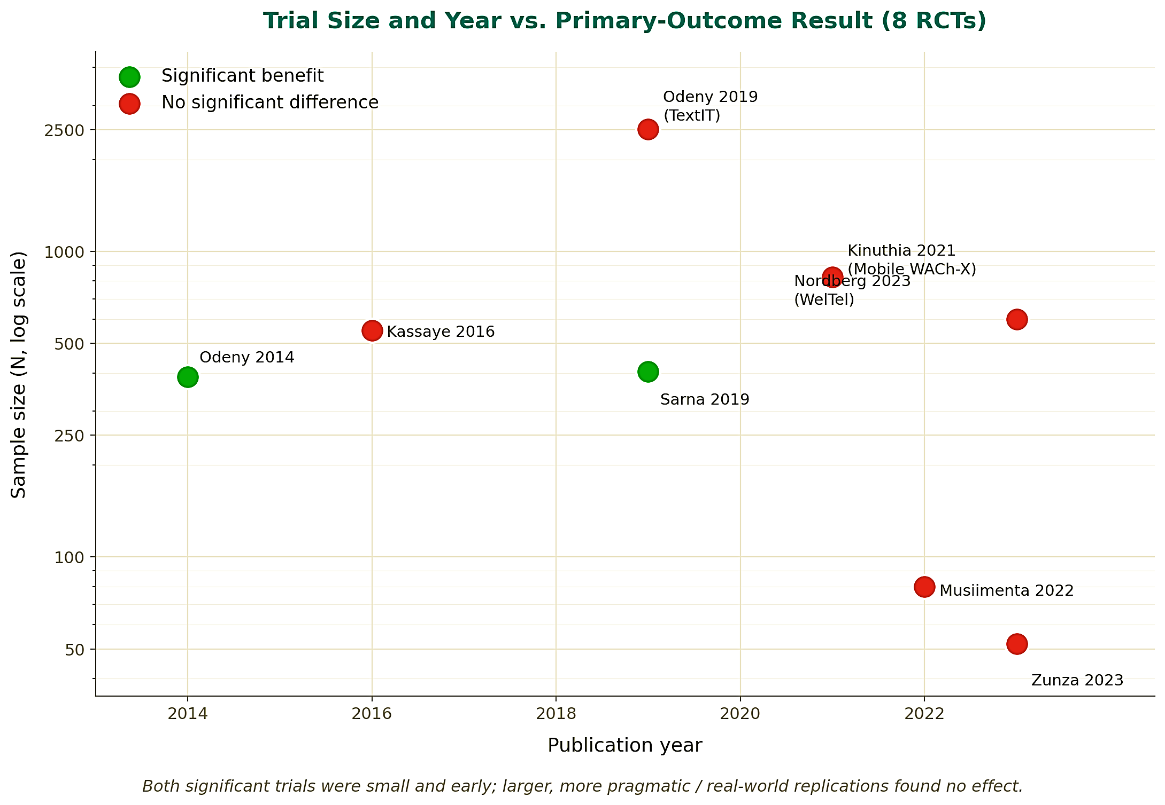
if available
The Role of Text Messaging and Remote Communication Technologies ‎in Improving Retention in Prevention of Mother-to-Child HIV ‎Transmission Care: A Systematic Review
Code: 1534
Reihane Sharif(1), Reza Abbasi(2), Nafiseh Jamal(3), Shima Anvari(4‎)
‎Health Information Management Research Center, Kashan University of ‎Medical Sciences, ‎Kashan, Iran.‎‏ ‏Email: Fr.sharif@yahoo.com
‎Department of Health Information Technology, School of Paramedical ‎Sciences, Torbat ‎Heydariyeh University of Medical Sciences, Torbat ‎Heydariyeh, Iran. Email: rezaabbasi2001@gmail.com
‎Health Information Management Research Center, Kashan University of ‎Medical Sciences, ‎Kashan, Iran.‎‏ ‏Email: jamal.nafiseh69@gmail.com
‎Health Information Management Research Center, Kashan University of ‎Medical Sciences, ‎Kashan, Iran.‎‏ ‏Email: anvari_shima@yahoo.com
Backgrounds
Findings
Conclusion
Retention of women living with HIV in prevention of mother-to-child transmission ‎‎(PMTCT) programs and timely infant HIV testing remain major challenges in high-burden ‎settings. Remote communication technologies, including SMS and phone calls, have been ‎proposed to improve retention. This study aimed to systematically review randomized ‎controlled trials.‎
Available evidence does not demonstrate consistent effectiveness of remote ‎communication technologies for improving retention in PMTCT care. Caution is warranted ‎when generalizing findings from early trials, and targeted interventions for high-risk ‎subgroups should be further investigated.‎
References
Methods
A systematic search was conducted in PubMed, Scopus, and Web of Science using terms ‎related to HIV/PMTCT, remote communication technologies, and retention/adherence. ‎Eligible studies were randomized controlled trials evaluating remote communication ‎interventions among pregnant or postpartum women living with HIV compared with usual ‎care‎; secondary reviews, qualitative studies, non-randomized designs, and ‎unrelated ‎populations were excluded. Study quality was assessed using the Cochrane Risk ‎of Bias 2 (RoB 2) tool.‎
Odeny TA, Hughes JP, Bukusi EA, et al. Text messaging for maternal and infant retention in prevention of ‎mother-to-child HIV transmission services: a pragmatic stepped-wedge cluster-randomized trial in Kenya. PLoS ‎Med. 2019;16(10):e1002924.‎
Kinuthia J, Ronen K, Unger JA, et al. SMS messaging to improve retention and viral suppression in prevention ‎of mother-to-child HIV transmission (PMTCT) programs in Kenya: a 3-arm randomized clinical trial. PLoS ‎Med. 2021;18(5):e1003650.‎
Sterne JAC, Savović J, Page MJ, et al. RoB 2: a revised tool for assessing risk of bias in randomised trials. BMJ. ‎‎2019;366:l4898.‎
Of 8 RCTs (6 individual, 2 cluster) across Kenya, Uganda, and South Africa, none reached low risk of bias: 75% some concerns, 25% high risk. Only the 2 earliest trials (25%) showed a significant improvement in retention or infant HIV testing; 4 larger, more pragmatic replications (50%) found no significant difference; 2 small pilots (25%) were underpowered. Most strikingly, a 6.5× larger real-world replication (Odeny 2019) of an initially effective SMS intervention (Odeny 2014) failed to reproduce the original effect; a textbook efficacy-to-effectiveness gap.

