Slide 1


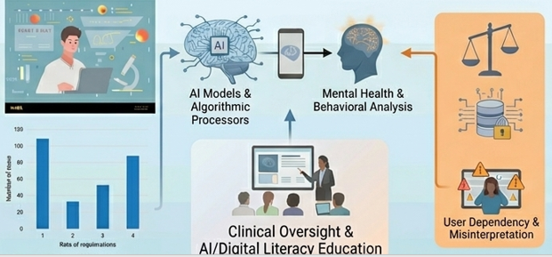


if available
Code:1433
Author’s photo
Critical Review of the Intersection of AI, Lifestyle, and Mental Health: Opportunities, Challenges, and the Need for a Conscious Approach
Seyyed Mohmmad Shayan Izadi¹, Samira Shariati Najafabadi¹,²*
(1) Department of Medicine, Na.C., Islamic Azad University, Najafabad, Iran
(2) Clinical Research Development Center, Na.C., Islamic Azad University, Najafabad, Iran
Backgrounds
Findings
Conclusion
Although Artificial intelligence (AI) integration into lifestyle medicine and mental health holds great promise for improving people's nutrition and preventing diseases, the blind use of algorithmic recommendations carries hidden dangers (1). People with poor AI literacy might misunderstand AI recommendations and become overly dependent on them, leading to unhealthy decisions (1-3). The purpose of this study is to go beyond the optimistic viewpoint and critically evaluate the drawbacks and limitations of this trend..
Finding: Results show that, besides the benefits of digital technologies, AI literacy has become a crucial determinant affecting healthy behavior (2). People with high AI literacy are more likely to think and behave positively, while those with low AI literacy are more vulnerable to misunderstanding (2). Moreover, structural problems such as algorithmic bias, data privacy, and regulatory issues must be considered (1, 4). Special attention should be paid to education and user-centered design among digitally disadvantaged groups (2, 5).
Conclusion: AI cannot be considered a perfect solution. It is necessary to use AI critically and improve digital literacy in order to make autonomous and informed health decisions.
Methods
A narrative review was conducted by searching major scientific databases, such as PubMed. The search was performed using keywords related to artificial intelligence, healthy lifestyle, mental health, digital health, and health literacy.
References
1. Lee Y, et al. Exploring artificial intelligence literacy's role in healthy behaviors and mental health. World Journal of Psychiatry. 2026;16(1):110249.
2. Yousefi M, et al. Artificial intelligence in health promotion and disease reduction: A rapid review. 2025.
3. Saeed A, Nashwan AJ. Artificial intelligence in lifestyle medicine: Enhancing

