Slide 1


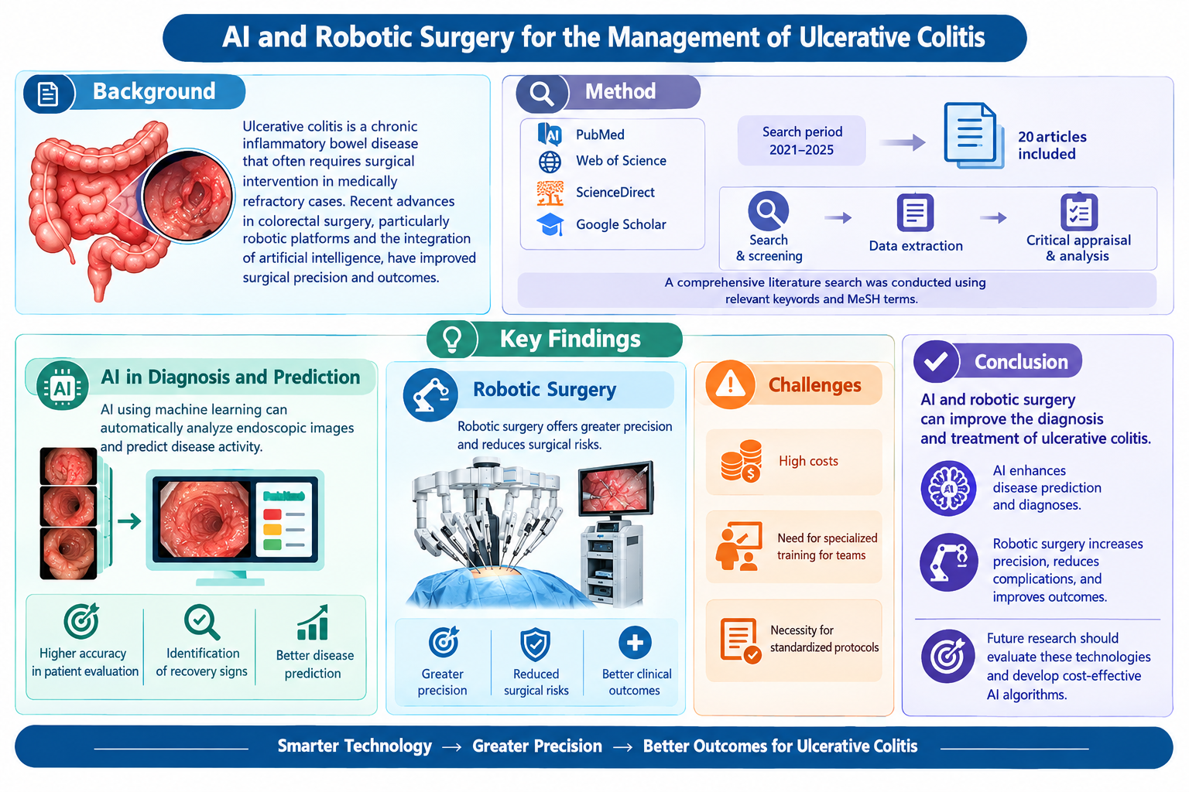
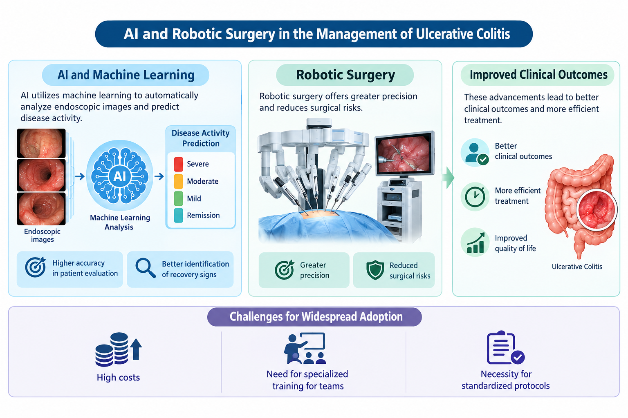
if available
عکس نویسنده
Code: 1140
The Role of Artificial Intelligence and Robotic Surgery in the Management of Ulcerative Colitis: A Review of Recent Advances
Ahmad Eshaghi Hassanabadi (1)- Zahra Alemi (2)- Nayereh Naseri (3)
(1, 2) MSc Student of Operating Room, Nursing and Midwife care Research Center, Isfahan University of Medical Sciences, Isfahan, Iran
(3) Assistant Professor of Nursing, Department of Nursing, Nursing and Midwifery Sciences Development Research Center, Na.C., Islamic Azad University, Najafabad, Iran.
Backgrounds
Findings
Conclusion
Ulcerative colitis is a chronic inflammatory bowel disease that often requires surgical intervention in medically refractory cases. Recent advances in colorectal surgery, particularly robotic platforms and the integration of artificial intelligence, have improved surgical precision and outcomes. The aim of this study is to examine recent advances in the use of artificial intelligence (AI) and robotic surgery for the management of ulcerative colitis.
AI and robotic surgery can improve the diagnosis and treatment of ulcerative colitis. AI enhances disease prediction and diagnoses. Robotic surgery also increases precision, reduces complications, and improves outcomes. It is recommended that future research evaluate these technologies and develop cost-effective AI algorithms.
AI and robotic surgery are increasingly improving the management of ulcerative colitis. AI utilizing machine learning, can automatically analyze endoscopic images and predict disease activity, which enhances the accuracy of patient evaluation and the identification of recovery signs. Robotic surgery offers greater precision and reduces surgical risks, leading to better clinical outcomes and more efficient treatment. However, widespread adoption of these technologies faces challenges such as high costs, the need for specialized training for teams and the necessity for standardized protocols.
References
Methods
Ogata N, Maeda Y, Misawa M, Takenaka K, Takabayashi K, Iacucci M, et al. Artificial intelligence-assisted video colonoscopy for disease monitoring of ulcerative colitis: A prospective study. Journal of Crohn's and Colitis. 2025;19(1):jjae080.
Rimondi A, Gottlieb K, Despott EJ, Iacucci M, Murino A, Tontini GE. Can artificial intelligence replace endoscopists when assessing mucosal healing in ulcerative colitis? A systematic review and diagnostic test accuracy meta-analysis. Digestive and Liver Disease. 2024;56(7):1164-72.
Najdawi F, Sucipto K, Mistry P, Hennek S, Jayson CK, Lin M, et al. Artificial intelligence enables quantitative assessment of ulcerative colitis histology. Modern Pathology. 2023;36(6):100124.
In this narrative review, a comprehensive literature search of PubMed, Web of Science, Science Direct and Google Scholar was conducted for studies published between 2021 and 2025 using the related keywords with relevant MeSH terms. After applying the inclusion criteria, 20 articles were included in the final review. Data were extracted, critically appraised and analyzed to summarize current advances.

