Slide 1

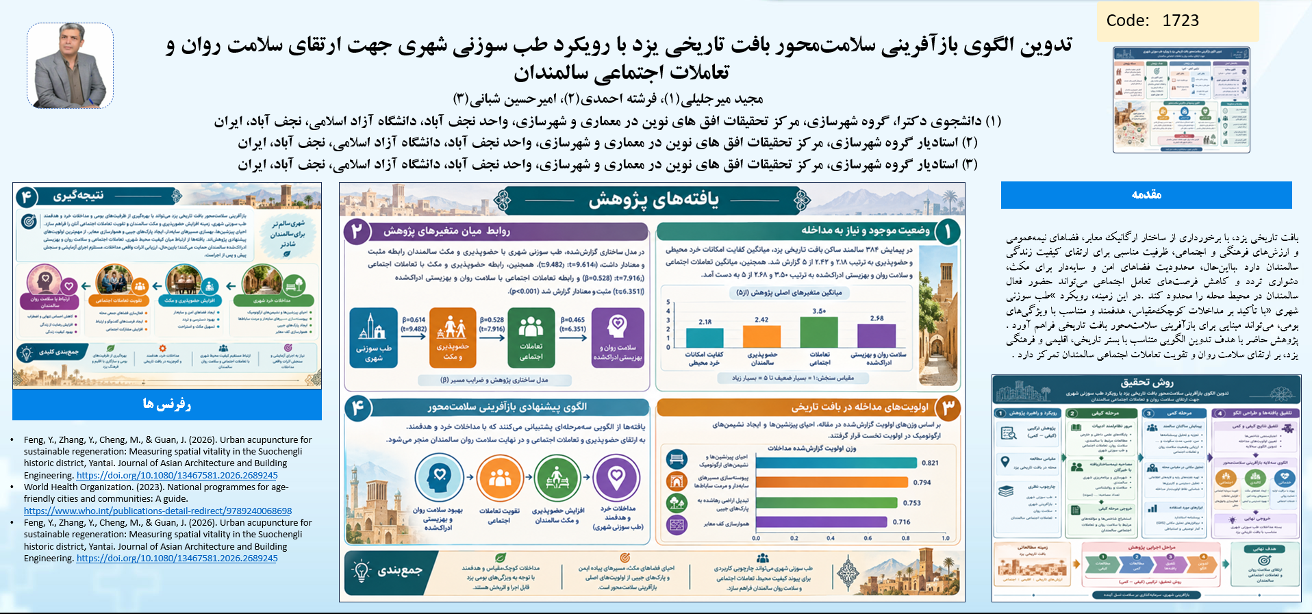
if available
Code: 1723

