Slide 1

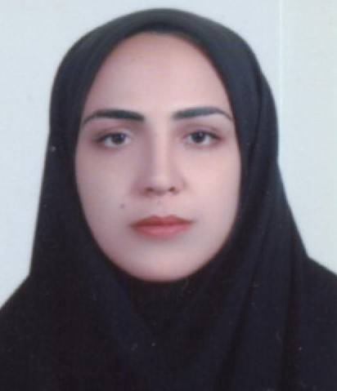
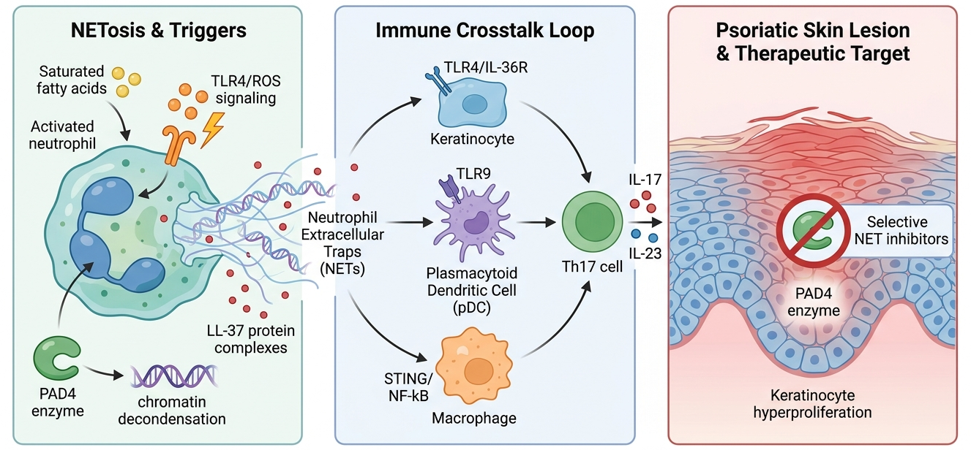
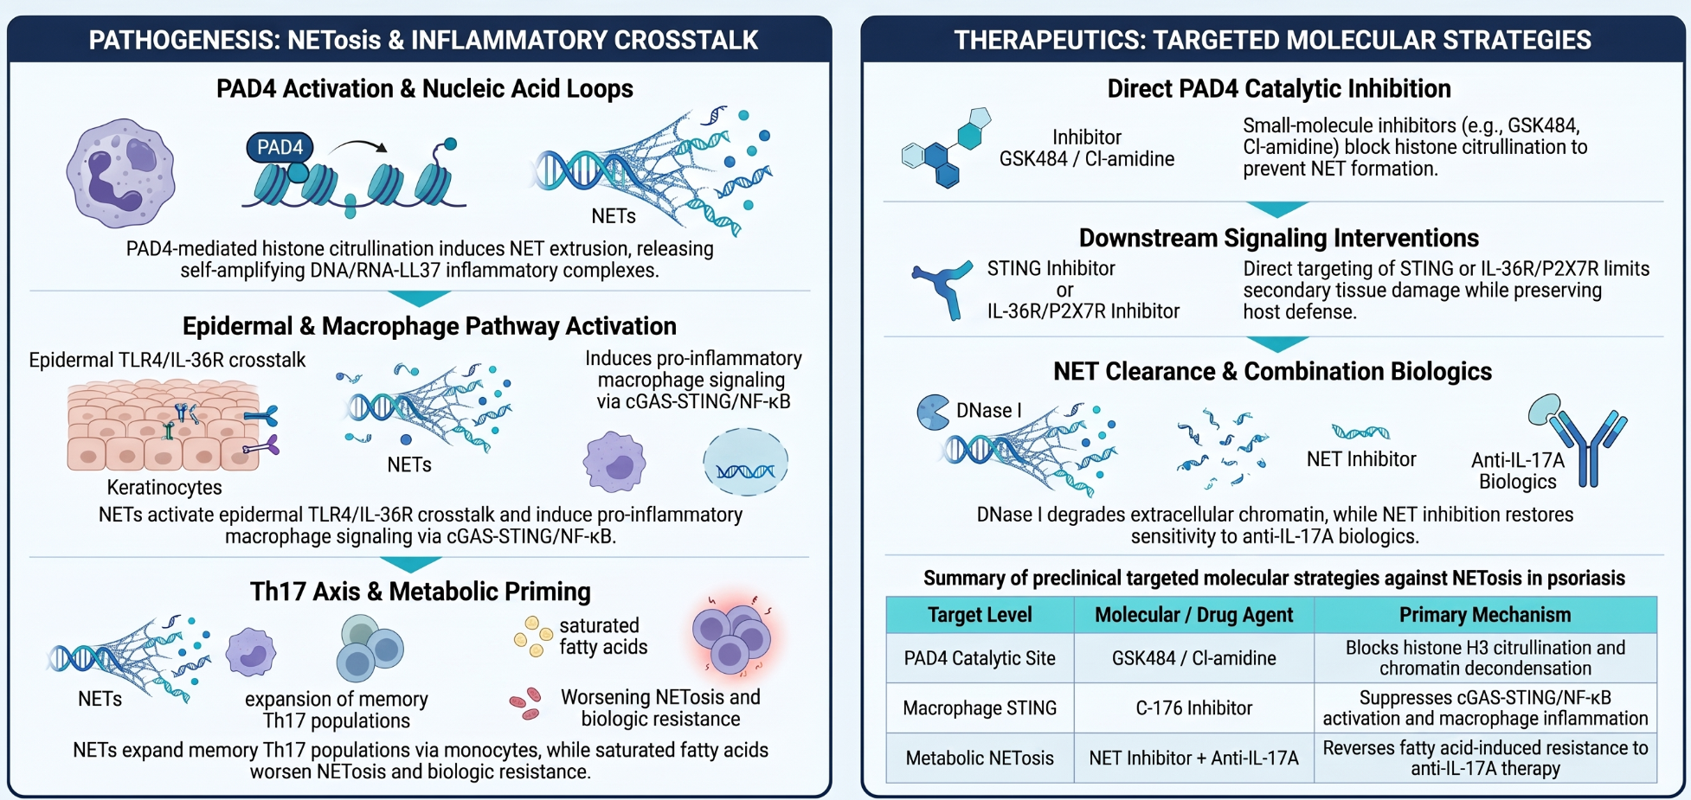
if available
Code: 1530
The Evolving Paradigm of Neutrophil Extracellular Traps (NETs) in Psoriasis Pathogenesis: From Cellular Mechanisms to Targeted Therapies
Nasrin zare*1,2
Clinical Research Development Center, Na.C., Islamic Azad University, Najafabad, Iran
Department of Medicine, Na.C., Islamic Azad University, Najafabad, Iran
Backgrounds
Findings
Conclusion
IL-23/IL-17 axis has a central role in the pathogenesis of psoriasis, which is a chronic immune-mediated inflammatory skin disorder. Emerging evidence indicates that neutrophils and neutrophil extracellular traps (NETs) play a role in the initiation and propagation of the psoriatic inflammation. This narrative review aims to review the current knowledge regarding the molecular mechanisms involved in NETosis and psoriasis, as well as the new treatment options that are under investigation for the inhibition of NETosis and NET-associated pathways.
In summary, emerging evidence establishes NETosis as a critical inflammatory amplifier in psoriasis, bridging innate and adaptive immune responses across keratinocytes, pDCs, macrophages, and Th17 cells through key cascades such as LL-37/DNA, TLR4/IL-36R, and STING/NF-κB signaling. Metabolic factors further aggravate this network: saturated fatty acids stimulate NET formation via the TLR4-MD2/ROS pathway, exacerbating IL-17-mediated inflammation. While targeting the NET machinery—particularly via PAD4 inhibition—shows strong preclinical promise, clinical translation requires selective suppression of pathogenic NETosis without compromising essential neutrophil host defense. Ultimately, NET-directed interventions represent promising adjunctive therapies to be used alongside existing IL-23/IL-17 biologics rather than replacing them.
Methods
PubMed/MEDLINE database was searched for combinations of the following terms: psoriasis, NETs, NETosis, Th17 response, and therapeutic target. Studies directly exploring the link between NETs and psoriasis were given highest priority, both experimentally and clinically.
References
1-Herster F, Bittner Z, Archer NK, et al. Neutrophil extracellular trap-associated RNA and LL37 enable self-amplifying inflammation in psoriasis. Nat Commun 2020; 11: 105.
2-Lambert S, Hambro CA, Johnston A, et al. Neutrophil Extracellular Traps Induce Human Th17 Cells: Effect of Psoriasis-Associated TRAF3IP2 Genotype. J Invest Dermatol; 139. Epub ahead of print 2019. DOI: 10.1016/j.jid.2018.11.021.
3-Shao S, Fang H, Dang E, et al. Neutrophil Extracellular Traps Promote Inflammatory Responses in Psoriasis via Activating Epidermal TLR4/IL-36R Crosstalk. Front Immunol; 10. Epub ahead of print 2019. DOI: 10.3389/FIMMU.2019.00746.
NET formation is higher in psoriatic blood and lesional skin and can activate keratinocytes and inflammatory responses. NET-associated RNA can trigger a self-amplifying inflammatory loop and additional NET release; NETs can promote Th17 responses; and epidermal NETs can activate epidermal TLR4/IL-36R signaling (4). Recent experimental evidence also suggests that NET formation through PAD4 and STING signaling is involved in macrophage inflammation. In the context of obesity-related psoriasis, saturated fatty acids lead to NET formation and to inflammation mediated by IL-17A, and they might decrease responsiveness to anti-IL-17A therapy.

