Slide 1


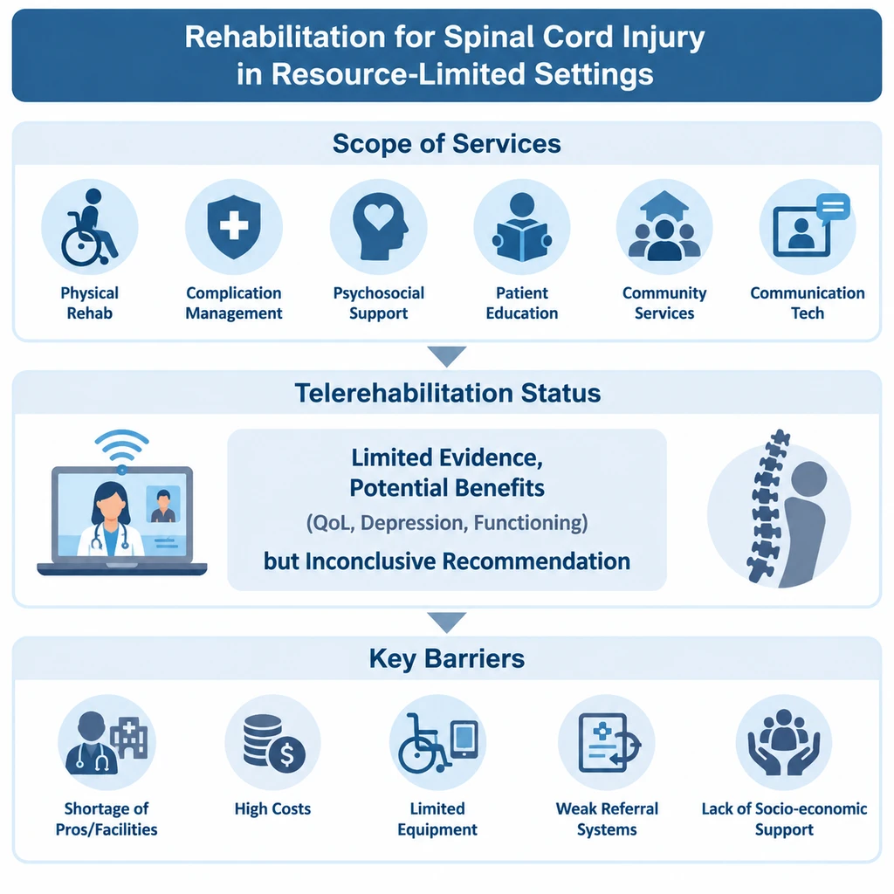
if available
Code: 1445
Author’s photo
An Overview of Rehabilitation Services Provided to Patients with Traumatic Spinal Cord Injury in Low-Income Countries
Maryam Shabany (1,2), Amir Mahdi Azizi (3), Javid Dadgari (3)
Department of Community Health and Research, School of Nursing, Aja University of Medical Sciences, Tehran, Iran
Surgery and Trauma Research Center, Aja University of Medical Sciences, Tehran, Iran
Student Research Committee, School of Nursing, Aja University of Medical Sciences, Tehran, Iran
Backgrounds
Findings
Conclusion
Traumatic spinal cord injury is a major cause of long-term disability and can have significant consequences for physical functioning, independence, social participation, and quality of life. Comprehensive, continuous rehabilitation plays an important role in reducing secondary complications, improving functioning, and increasing independence among individuals with spinal cord injury. However, access to rehabilitation services in low-income countries faces challenges, including shortages of specialized healthcare professionals, limited infrastructure, financial constraints, geographical barriers, and weaknesses in continuity of care.
The available evidence showed that rehabilitation services for individuals with spinal cord injury in resource-limited and low-income settings encompass a diverse range of services, including physical rehabilitation, management of secondary complications, psychosocial support, patient and family education, community-based services, and the use of communication technologies. However, access to services in many of these settings has been reported to be limited and inequitable [1,2,3]. In a systematic review specifically examining telerehabilitation for individuals with spinal cord injury in low- and middle-income countries, only 5 of the 107 identified studies met the inclusion criteria. Some studies reported improvements in quality of life, pressure ulcer management, functioning, depression, satisfaction, and reduced feelings of social isolation; however, the evidence was insufficient to support a definitive recommendation for telerehabilitation [4]. Furthermore, studies conducted in resource-limited settings have indicated a high burden of post-discharge complications and a substantial need for supportive and community-based rehabilitation services [3]. The most important barriers identified included a shortage of rehabilitation professionals and facilities, the costs of services and transportation, limited availability of equipment and assistive devices, weaknesses in referral and post-discharge follow-up systems, and limited social and economic support [4].
The available evidence indicates that although a diverse range of rehabilitation services is provided to individuals with spinal cord injury in low-income countries and resource-limited settings, significant gaps remain in the coverage, accessibility, and continuity of these services. Developing community-based rehabilitation services, strengthening post-discharge follow-up, increasing the specialized rehabilitation workforce, and strategically utilizing emerging technologies may contribute to improving access to and continuity of care. However, further studies are needed to determine the most effective models for delivering rehabilitation services that are appropriate to the circumstances of low-income countries.
Methods
This study was conducted based on the framework proposed by Arksey and O’Malley and the recommendations of the Joanna Briggs Institute. PubMed/MEDLINE, Scopus, Web of Science, Embase, and CINAHL databases, as well as relevant grey literature sources, were searched. Studies addressing rehabilitation services for individuals with traumatic spinal cord injury in low-income countries and resource-limited settings were included in the review. Data on the types of rehabilitation services, service delivery models, outcomes, barriers, and facilitators were extracted and synthesized descriptively and thematically.
References
1.Solomon RM, Dhakal R, Halpin SJ, Hariharan R, O’Connor RJ, Allsop M, et al. Telerehabilitation for individuals with spinal cord injury in low-and middle-income countries: a systematic review of the literature. Spinal Cord. 2022;60(5):395-403. doi:10.1038/s41393-022-00797-8.
2. Htwe O, Yuliawiratman BS, Tannor AY, Nor Asikin MZ, Soh E, De Groote W, et al. Barriers and facilitators for increased accessibility to quality rehabilitation services in low- and middle-income countries: a systematic review. Eur J Phys Rehabil Med. 2024;60(3):514-522. doi:10.23736/S1973-9087.24.08154-1.
3. Bright T, Wallace S, Kuper H. A systematic review of access to rehabilitation for people with disabilities in low- and middle-income countries. Int J Environ Res Public Health. 2018;15(10):2165. doi:10.3390/ijerph15102165.
4. Mullerpatan R, Ryain A, Padia N, Salgotra KR. Patient-reported challenges in spinal cord injury rehabilitation and integration within the community of a lower middle-income country: opportunities for changing lives. Brain Spine. 2025;5:104299. doi:10.1016/j.bas.2025.104299.

