Slide 1


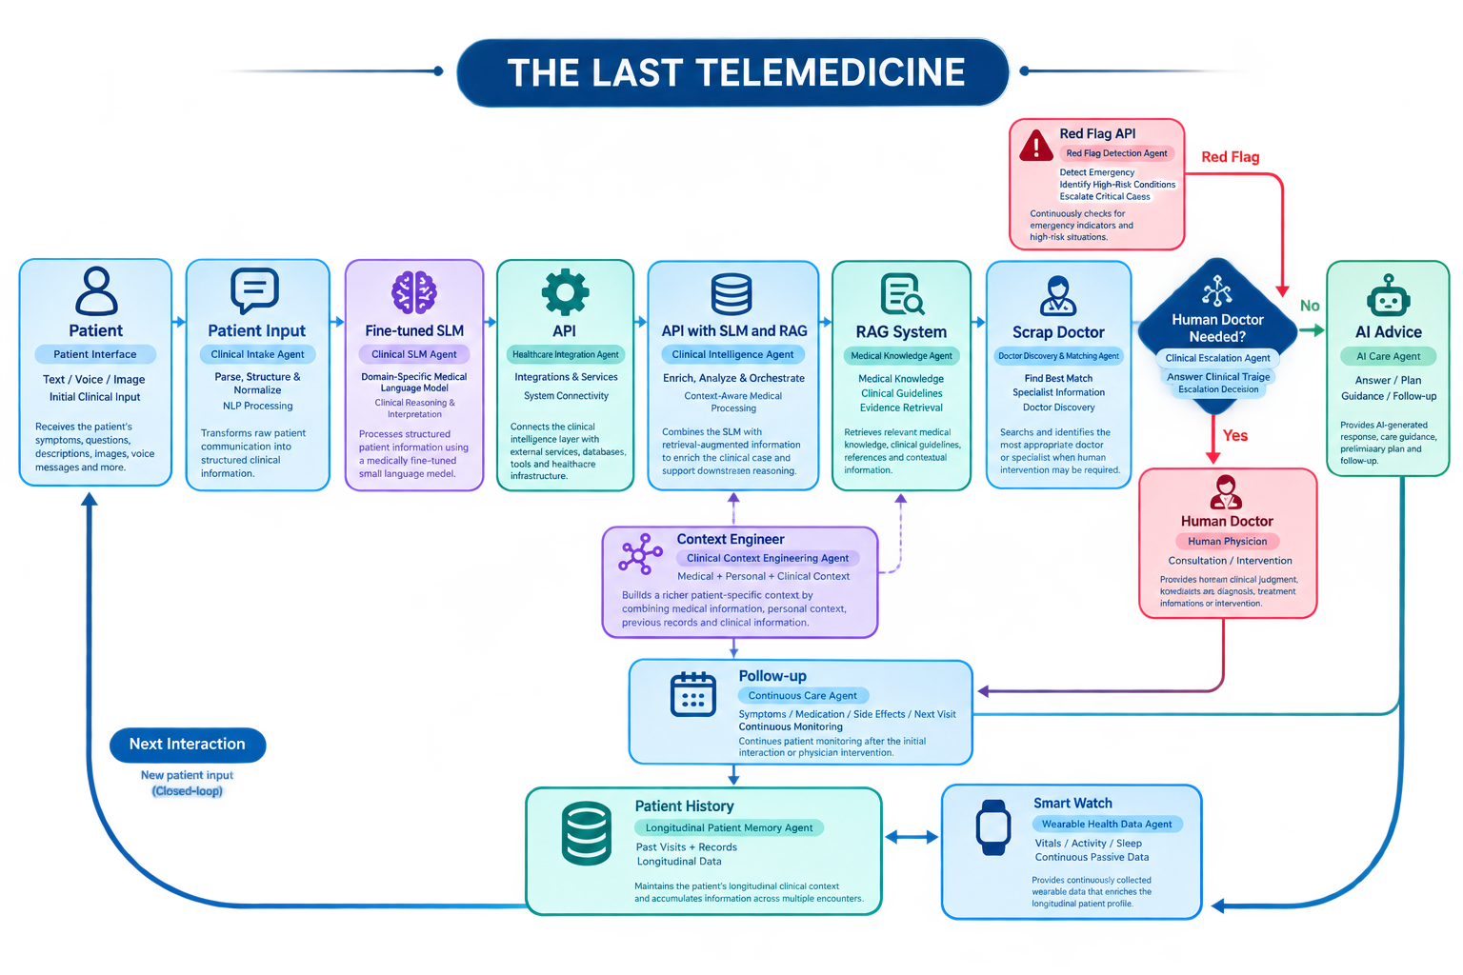
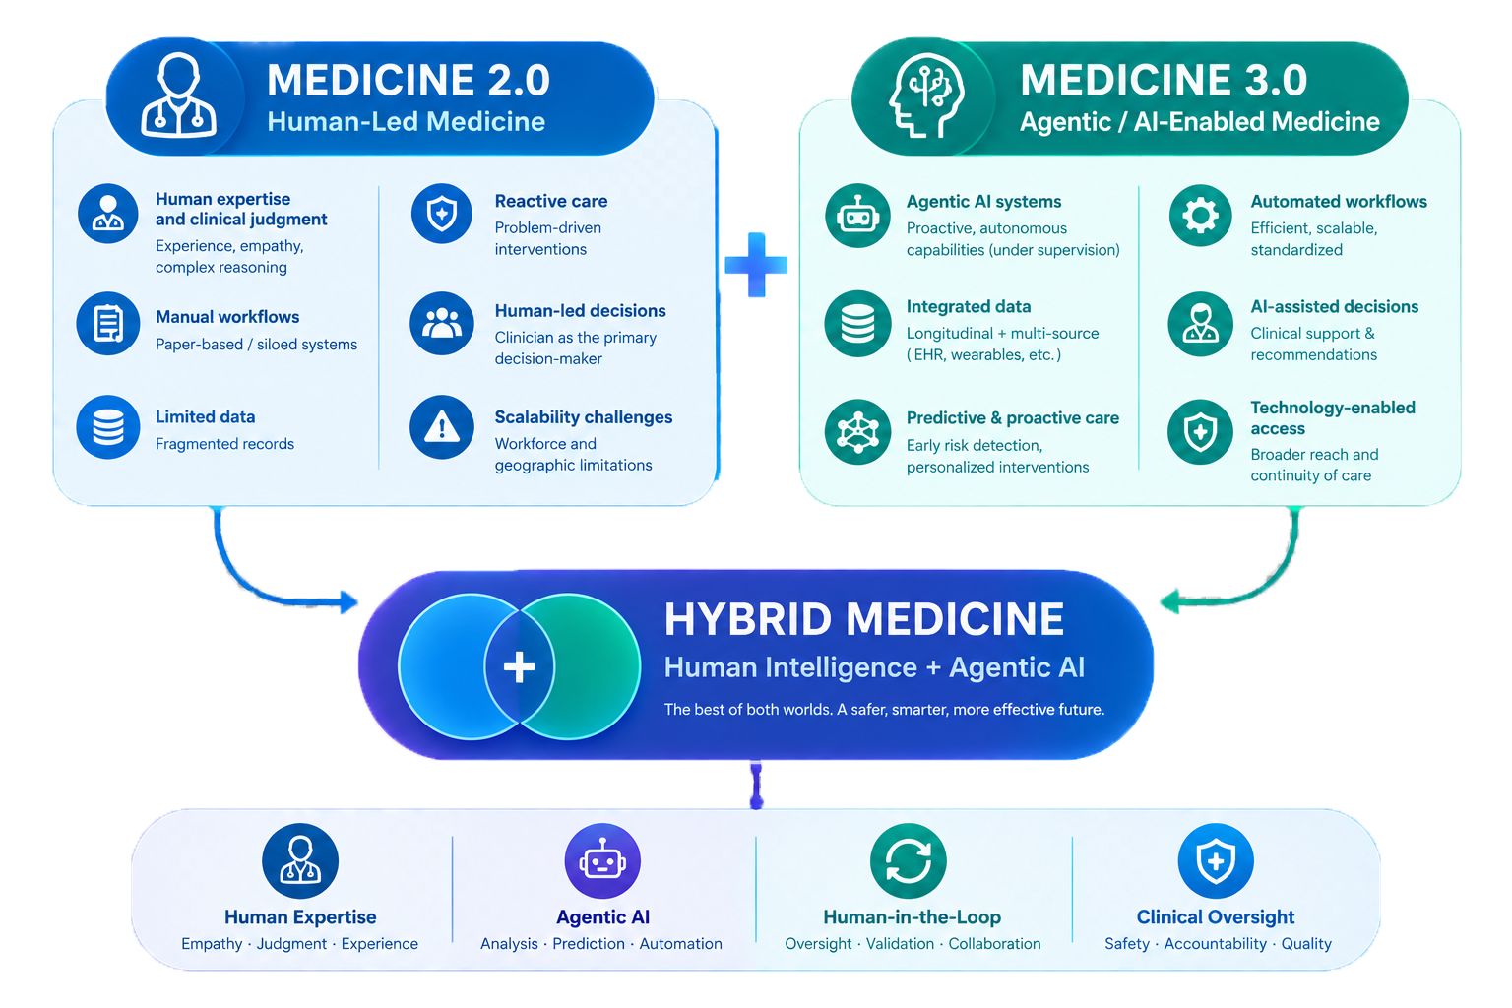
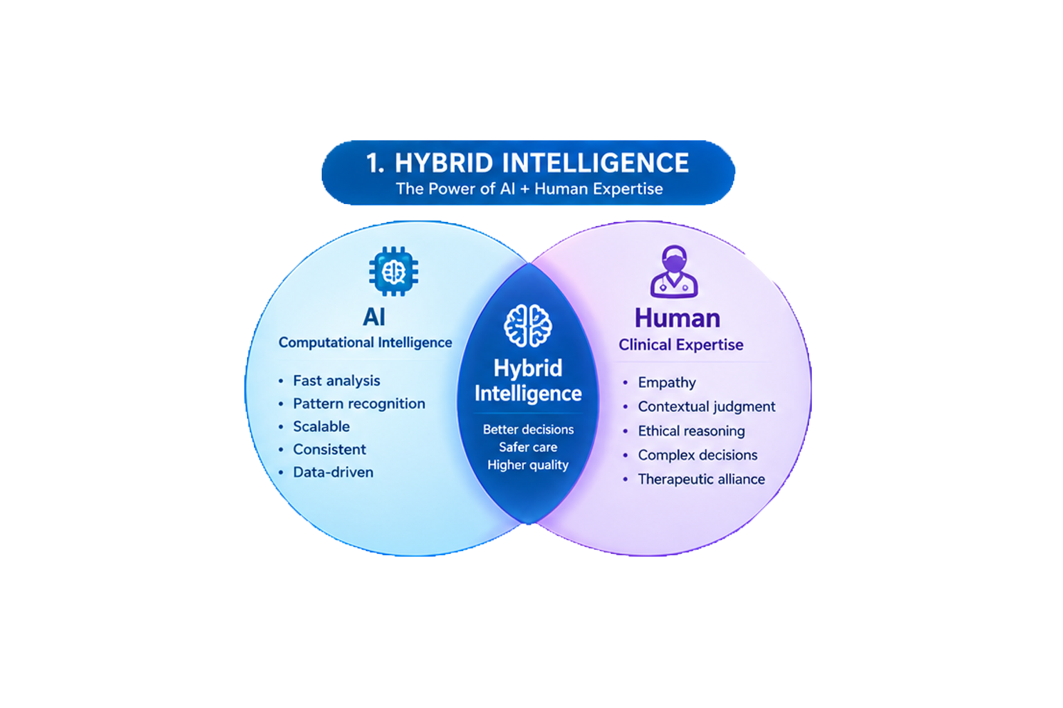
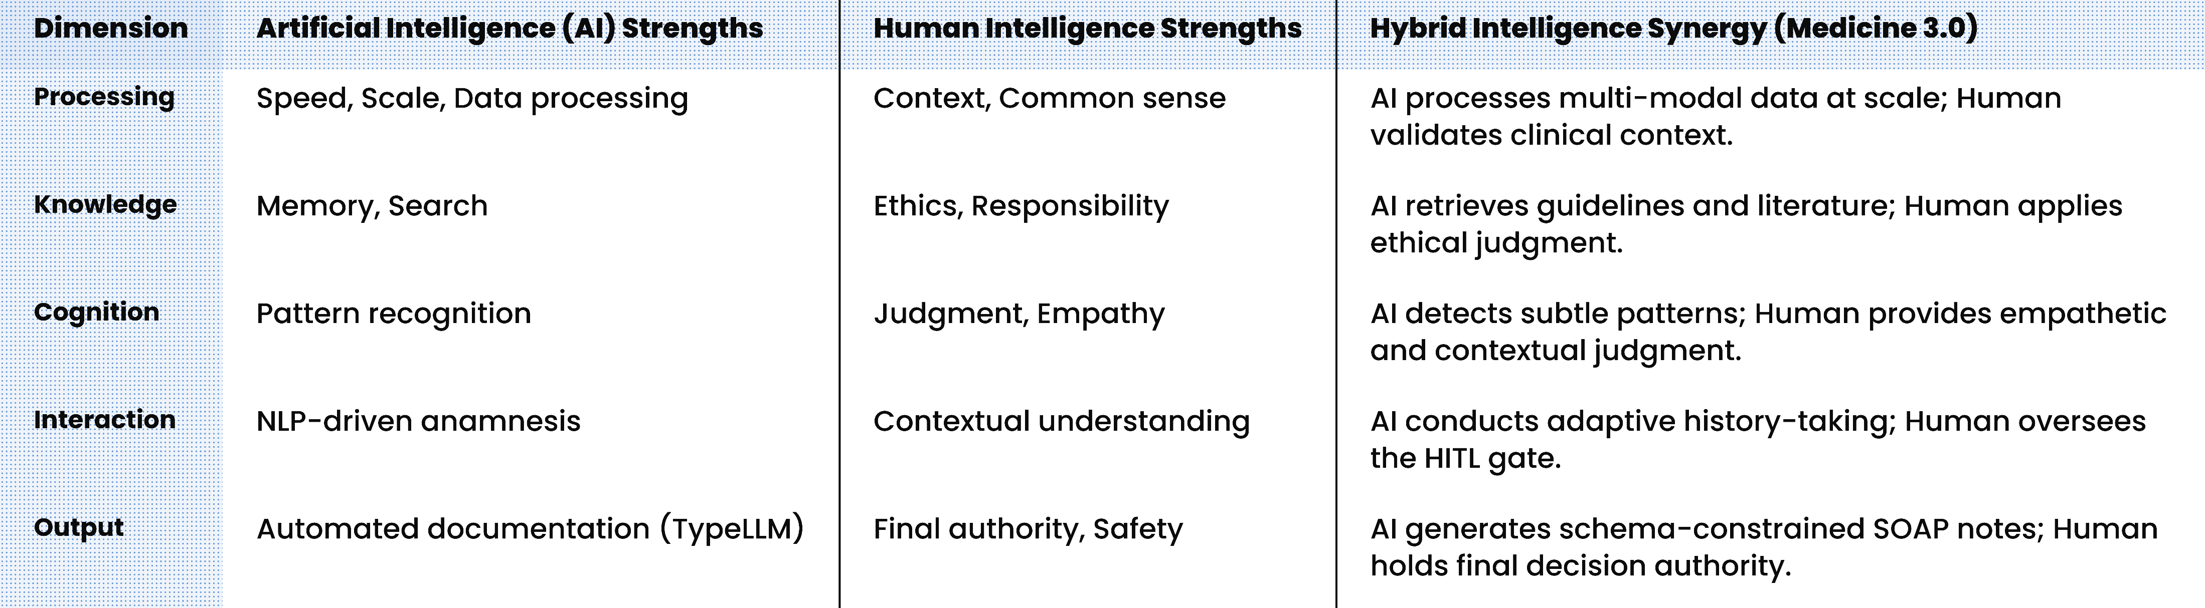
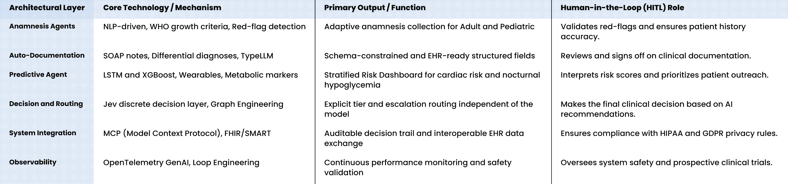
Hybrid Intelligence in Medicine 3.0: Enhancing Preventive and Curative Decision-Making through AI–Human Collaboration in Personalized Telehealth Systems
Hossein Tork Ladani (1)*, Zahra Shokri Mashhadi (2), Mahdi Tork Ladani (3)
Electrical Engineering, Islamic Azad University (Isfahan Branch), Iran
Isfahan University of Medical Sciences, Iran
Jurisprudence and Law, Shahed University, Tehran, Iran · *ho3seintork@gmail.com
Graphical Abstract
Backgrounds
Findings
Conclusion
Medicine 3.0 prioritizes proactive prevention, yet clinical AI systems often remain fragmented across isolated modules. We propose an updated Human in the Loop architecture that integrates Graph, Loop, and Context Engineering with MCP to support longitudinal, interoperable care.
The architecture comprises Adult and Pediatric Anamnesis Agents for adaptive, red flag aware history taking; an Auto Documentation Agent generating structured SOAP notes and differential diagnoses; and a Generation 3 Predictive Agent that continuously analyzes wearable biometrics, metabolic markers, and lifestyle data, forecasting events such as cardiac risk or nocturnal hypoglycemia via a stratified risk dashboard. These four agents are organized as a directed graph rather than a linear chain, with each anamnesis exchange governed by a bounded Act Observe Verify loop. Risk estimation through LSTM and XGBoost is separated from risk routing through a discrete Jev decision layer, and the Auto Documentation output is schema constrained by TypeLLM to support structured EHR interoperability. Governance remains anchored in applicable privacy and regulatory requirements, with physician oversight applied at the final stage: the clinician reviews, modifies if needed, and then approves the system output before it enters the clinical record, ensuring the system remains auditable, EHR ready, and aligned with the proactive and personalized paradigm of Medicine 3.0.
This design deliberately merges Medicine 2.0 and Medicine 3.0 rather than replacing one with the other. While a patient is being treated for an acute or active condition under the evidence based logic of Medicine 2.0, the same encounter simultaneously feeds the predictive layer, which assesses future risk of recurrence and of related conditions. In this way, each treatment moment becomes a prevention moment, turning episodic care into a continuous loop that addresses both the present illness and the patient's long term health trajectory.
The architecture shifts care from reactive treatment toward proactive, personalized prevention aligned with Medicine 3.0, elevating the system from a hybrid chatbot to a Human AI Hybrid Agentic Healthcare System. It aligns with current technical interoperability and observability practices, including MCP, FHIR, SMART, CDS Hooks, and OpenTelemetry GenAI conventions. Clinical translation still requires prospective trials, expert panel feasibility assessment, and infrastructure planning. The framework explicitly separates generative reasoning, predictive estimation, decision routing, tool execution, and clinical authorization. This separation is intended to improve auditability, interoperability, and human control in agentic healthcare.
Methods
A conceptual analytical framework was developed through a targeted literature review and architectural synthesis. Four agents combine LLMs, SLMs, predictive models, and classical algorithms under Human in the Loop governance. The architecture contains seven layers: Intelligence, Context, Execution, Control, System, Healthcare, and Governance.
References
1. Attia P. Outlive: The Science and Art of Longevity. New York: Harmony Books; 2023.
2. Topol EJ. High-performance medicine: the convergence of human and artificial intelligence. Nat Med. 2019;25(1):44-56.
3. Olawade DB, et al. Human in the loop artificial intelligence in healthcare: applications, outcomes, and implementation challenges. Int J Med Inform. 2026;213:106362.
4. Tricco AC, Lillie E, Zarin W, et al. PRISMA extension for scoping reviews (PRISMA-ScR): checklist and explanation. Ann Intern Med. 2018;169(7):467-73.
5. Yuan D, et al. Agentic large language models for healthcare: current progress and future opportunities. Med Adv. 2025.

