Slide 1


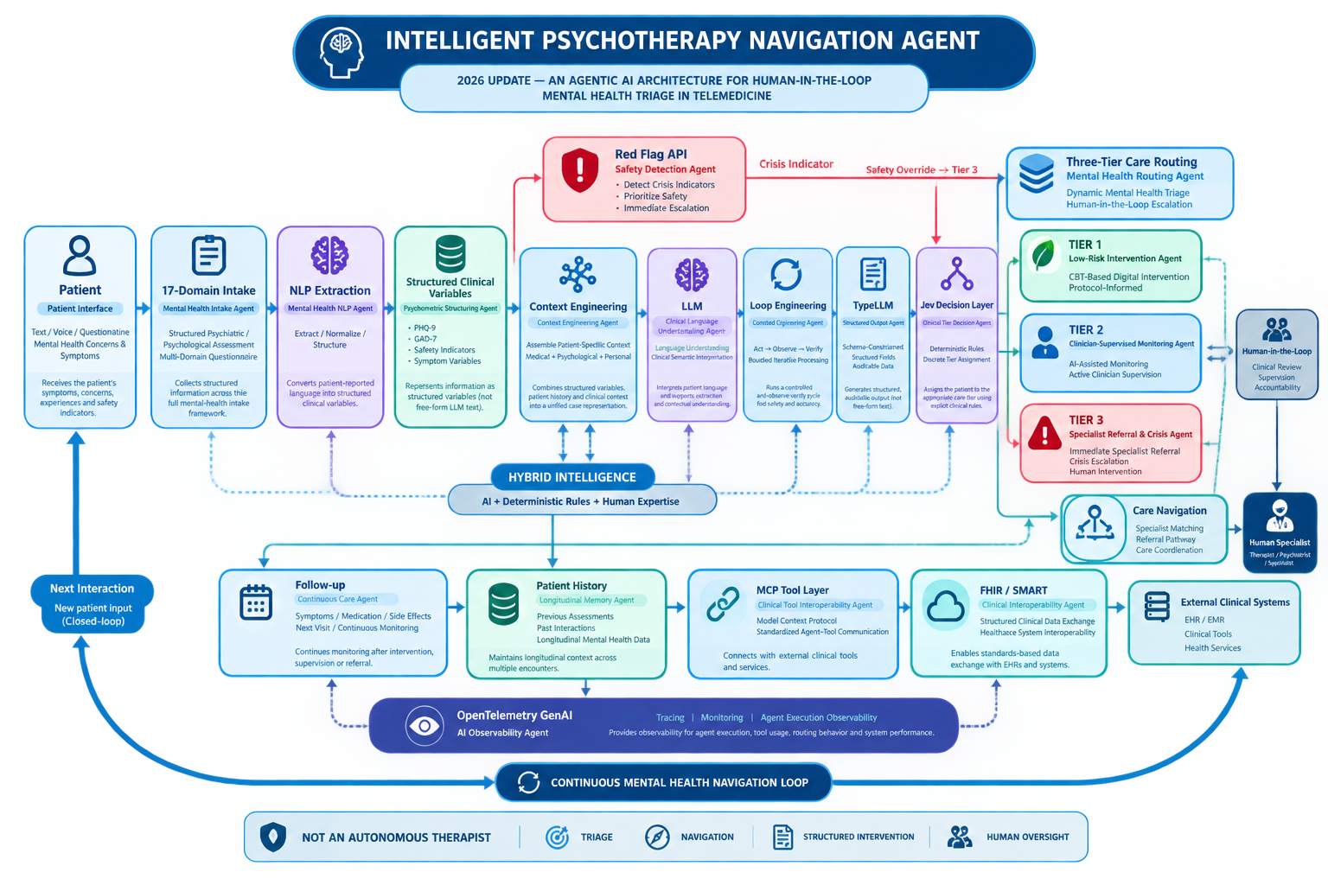
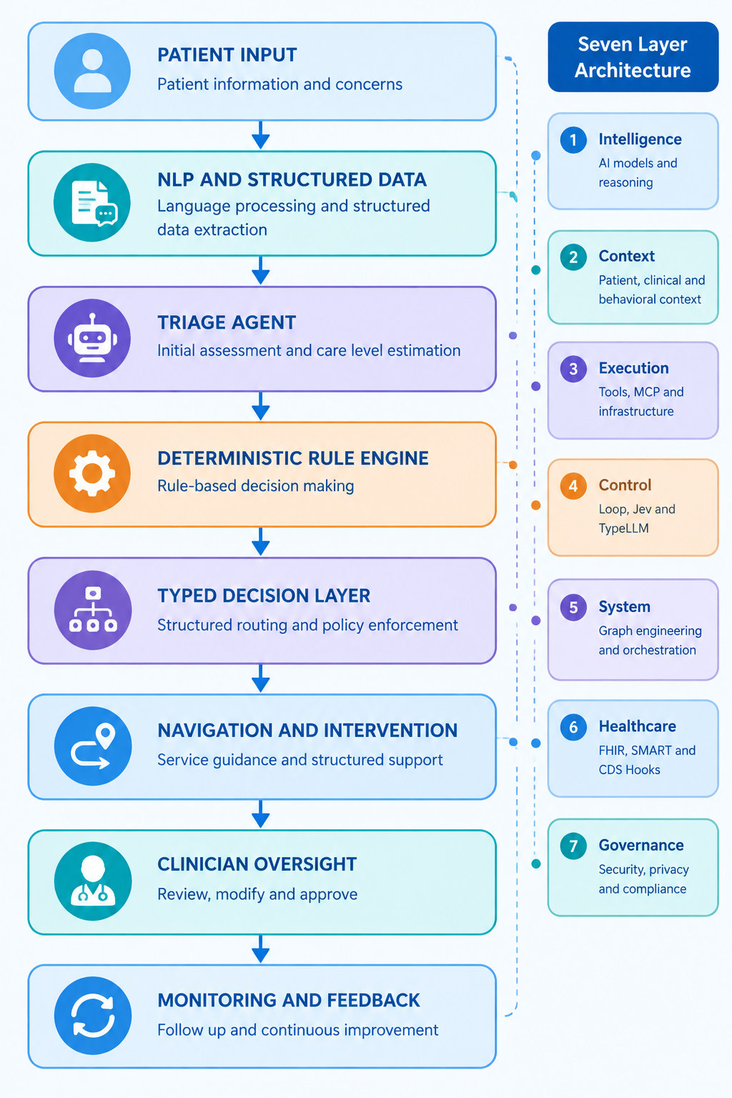
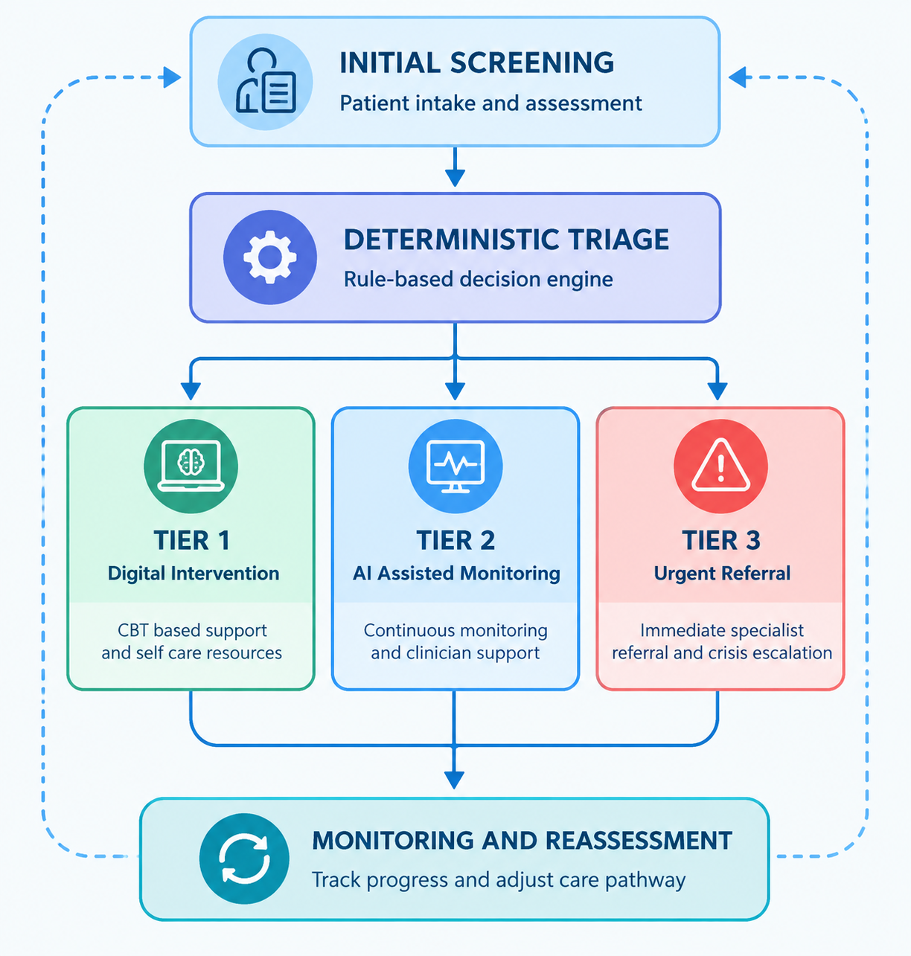
Intelligent Psychotherapy Navigation Agent: A Hybrid Intelligence and Human-in-the-Loop Framework for Mental Health Triage in Telemedicine
Hossein Tork Ladani (1)*, Shirin Salmanizadeh (2), Mahdi Tork Ladani (3)
Electrical Engineering, Islamic Azad University (Isfahan Branch), Iran
PhD Candidate, Health Psychology, Islamic Azad University (Najafabad Branch), Iran
Jurisprudence and Law, Shahed University, Tehran, Iran · *ho3seintork@gmail.com
Graphical Abstract
Backgrounds
Findings
Conclusion
The rising global burden of mental health disorders, coupled with limited access to psychological care, calls for scalable triage solutions on telemedicine platforms. Existing AI assisted systems often blur the line between autonomous treatment and clinician supervised support, raising concerns about reliability and accountability. Recent agentic AI advances offer opportunities to improve structured triage and navigation while preserving clinical oversight.
The agent performs three distinct functions: Triage, which determines the care level; Navigation, which identifies an appropriate service pathway; and Intervention, which provides structured, protocol informed support. Patients are dynamically routed into Tier 1, CBT based digital intervention; Tier 2, AI assisted monitoring under active clinician supervision; or Tier 3, immediate specialist referral and crisis escalation. A deterministic rule engine assigns care tiers using structured intake variables, while a typed decision layer supports predefined routing. Safety indicators override severity based routing, directing crisis cases to Tier 3 regardless of upstream scoring. The architecture separates language generation from consequential routing decisions, supporting auditability and clinician oversight.
This framework integrates triage, navigation, and intervention rather than treating them as isolated functions. Initial screening determines the appropriate level of care, while navigation connects patients to suitable services and interventions provide structured, protocol informed support. Information gathered throughout this process can inform ongoing monitoring and reassessment, allowing care pathways to adapt to changing patient needs. In this way, a single triage encounter can become the starting point for continuous, clinician supervised mental healthcare.
The agent is positioned as a triage, navigation, and structured intervention tool rather than an autonomous therapist. Its updated architecture separates language generation from rule based care assignment and predefined decision routing. Continuous human oversight at Tiers 2 and 3 preserves clinician authority, while prospective clinical trials and safety evaluations remain necessary before deployment.
Methods
A Hybrid Intelligence paradigm combines a Human in the Loop architecture across three care tiers. A 17 domain intake form is processed via NLP extraction into structured variables, including PHQ 9, GAD 7, and safety indicators, which feed a deterministic rule engine rather than the LLM itself for tier assignment. Seven architectural layers organize intelligence, context, execution, control, system orchestration, healthcare interoperability, and governance.
References
1. WHO. Depression and Other Common Mental Disorders. Geneva: WHO; 2023.
2. Torous J, et al. The growing field of digital psychiatry. World Psychiatry. 2021;20(3):318-35.
3. Fitzpatrick KK, et al. Woebot: automated CBT conversational agent. JMIR Ment Health. 2017;4(2):e19.

