Slide 1


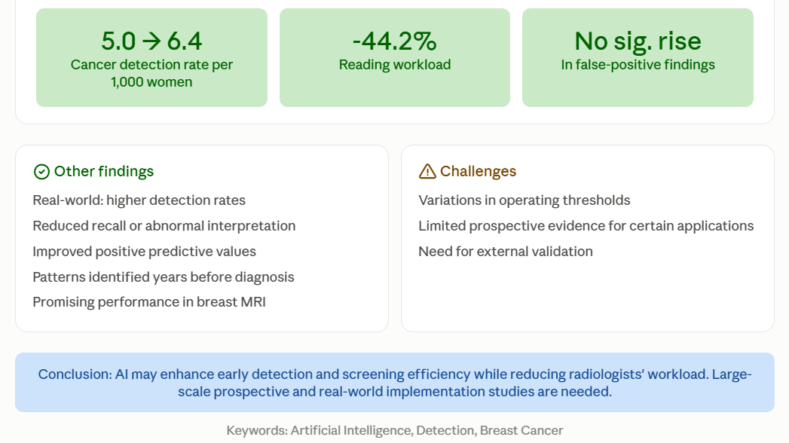
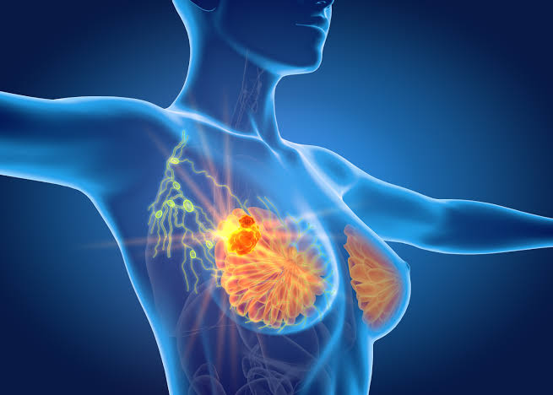
if available
Code: 1572
Artificial Intelligence in Early Detection of Breast Cancer: A Narrative Review
Alireza Raghimi Nashrudkoli¹, Majid Sammak², Setayesh Dehghannavaz Chokami³, Seyed Mohammad Hossein Hosseini⁴
Student Research Committee, School of Nursing and Midwifery, Guilan University of Medical Sciences, Rasht, Iran
Backgrounds
Findings
Conclusion
Breast cancer remains a leading cause of cancer-related mortality worldwide. Artificial intelligence has emerged as a transformative diagnostic tool in imaging-based screening. This narrative review examines its applications..
AI-assisted screening demonstrated potential improvements in cancer detection and workflow efficiency. In a randomized controlled trial involving 105,934 women, AI-supported screening increased the cancer detection rate from 5.0 to 6.4 per 1,000 women and reduced reading workload by 44.2%, without a significant increase in false-positive findings. Real-world studies reported increased cancer detection rates, reduced recall or abnormal interpretation rates, and improved positive predictive values following AI implementation. AI systems also demonstrated the potential to identify imaging patterns associated with breast cancer years before clinical diagnosis and showed promising performance in breast magnetic resonance imaging. However, variations in operating thresholds, limited prospective evidence for certain applications, and the need for external validation remain important challenges.
AI may enhance early breast cancer detection and screening efficiency while reducing radiologists’ workload. Large-scale prospective studies and real-world implementation research are needed to establish clinical effectiveness, generalizability, and safe integration into screening programs.
References
Bothou A, Bolou A, Dinas K, Kyrkou G, Hardy D, Pappou P, Varela P, Margioula-Siarkou G, Balafouta M, Diamanti A. Artificial Intelligence in Early Breast Cancer Detection: A Systematic Review of Innovations in Preventive Women's Healthcare. Healthcare (Basel). 2026 Jun 12;14(12):1674. doi: 10.3390/healthcare14121674. PMID: 42354532; PMCID: PMC13299207.
Chang YW, Ryu JK, An JK, Choi N, Park YM, Ko KH, Han K. Artificial intelligence for breast cancer screening in mammography (AI-STREAM): preliminary analysis of a prospective multicenter cohort study. Nat Commun. 2025 Mar 6;16(1):2248. doi: 10.1038/s41467-025-57469-3. PMID: 40050619; PMCID: PMC11885569.
Hernström V, Josefsson V, Sartor H, Schmidt D, Larsson AM, Hofvind S, Andersson I, Rosso A, Hagberg O, Lång K. Screening performance and characteristics of breast cancer detected in the Mammography Screening with Artificial Intelligence trial (MASAI): a randomised, controlled, parallel-group, non-inferiority, single-blinded, screening accuracy study. Lancet Digit Health. 2025 Mar;7(3):e175-e183. doi: 10.1016/S2589-7500(24)00267-X. Epub 2025 Feb 3. PMID: 39904652.
Methods
In this review, a systematic literature search was conducted across PubMed, Scopus and Web of Science. Studies published between 2023 and 2026 were identified using the keywords: Artificial Intelligence, Detection and Breast Cancer. Only studies published in English and available in full text were included. A total of 302 articles were retrieved, of which 170 were found relevant, and 9 were finally selected for synthesis and analysis.

