Slide 1

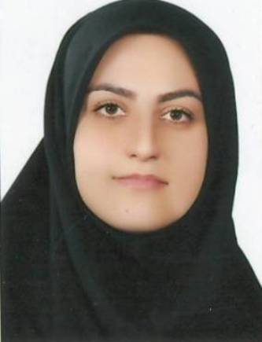
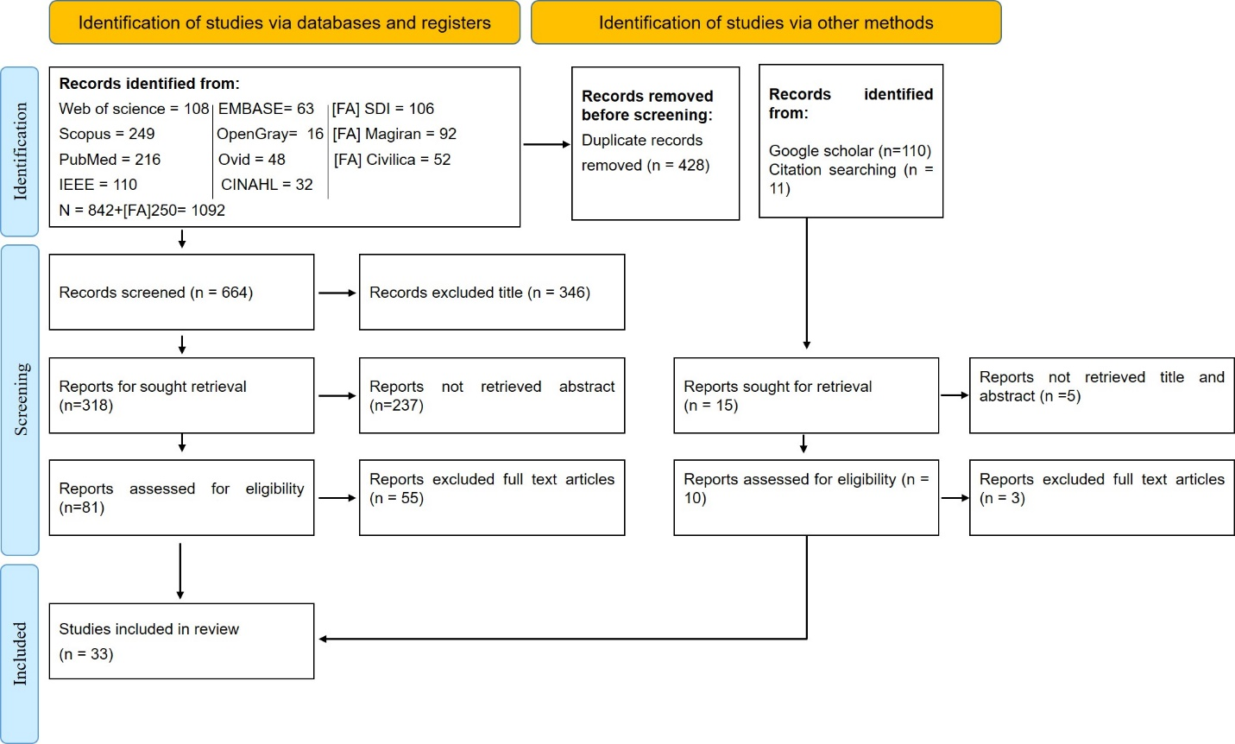
if available
Identifying the components of providing hospital medical services to children and adolescents: a systematic review
Code:1541
Author’s photo
Leila Mohammadinia¹, Ali Behforouz², Mohsen Nouri ³*,Elham Safi Najaf Abadi⁴
1. Associate Professor, Ph.D. Health in Disasters and Emergencies, Department of Health Policy and Management, School of Management and Medical Informatics, Tabriz University of Medical Sciences, Tabriz, Iran.
2 .M.Sc. Student of Health Services Management, Department of Health Policy and Management, School of Management and Medical Informatics, Tabriz University of Medical Sciences, Tabriz, Iran.
3. Department of Health in Disasters and Emergencies, School of Health Management and Information Sciences, Iran University of Medical Sciences, Tehran, Iran
*Corresponding 1: M61noori@gmail.com
4. Ph.D. Student in Health Policy, Department of Health Policy and Management, School of Management and Medical Informatics, Tabriz University of Medical Sciences, Tabriz, Iran.
Backgrounds
Findings
Conclusion
Hospitals play a vital role in improving community health and must provide high-quality, safe, and efficient healthcare services through standardized performance indicators. However, children have unique physical, psychological, and developmental needs that make them more vulnerable to medical errors and injuries, requiring specialized care and trained healthcare professionals. Despite the importance of pediatric healthcare, existing quality assessment initiatives have largely focused on maternal and infant health, particularly breastfeeding and children under two years of age, while insufficient attention has been paid to sick children, especially those older than six years. Therefore, there is a need for comprehensive standards and assessment tools that address the specific healthcare needs of all children and adolescents under 18 years of age. This study aims to identify the relevant domains and components and develop a checklist for evaluating the quality of healthcare services provided to this population.
Key components identified include environmental design, staff attire, therapeutic support, and assistance for parents. The study concludes that policymakers should emphasize informational and therapeutic support, as well as environmental design, in pediatric healthcare planning and development.
Child-friendly environment: Improve hospital design and recreational facilities.
Psychological support: Reduce anxiety and stress.
Child preferences: Consider children’s choices in hospital design and nurse uniform colors.
Therapeutic interventions: Use music therapy and other supportive therapies.
Nutritional support: Reduce consumption of sugar-sweetened beverages.
Parental support: Reduce family stress and provide emotional support.
Information provision: Clearly explain treatment procedures to children.
Future research: Address underexplored areas of pediatric care.
Methods
This study is a systematic review conducted using relevant keywords and an unrestricted time search up to February 2023 in databases including PubMed, EMBASE, CINAHL, Web of Science, Scopus, OpenGrey, and Ovid. Initially, 1,092 documents were found. After removing duplicates and reviewing the content, 21 relevant documents were selected, and 8 were chosen for detailed analysis. The quality of these articles was evaluated using the CASP checklist, and the search process followed the PRISMA flow diagram.
References
1.Afshari A, Eslami A-a, Mostafavi F, Moazam E, Golzari M, Etminani R. Self-assessment for implementation of health promotion standards in hospitals, in medical education centers of Isfahan city. Iranian Journal of Health Education and Health Promotion.2020;8(3):249-60.
2.Aufegger L, Bùi KH, Bicknell C, Darzi A. Designing a paediatric hospital information tool with children, parents, and healthcare staff: a UX study. BMC Pediatrics. 2020;20(1):1-10.
3.Hinic K, Kowalski MO, Holtzman K, Mobus K. The effect of a pet therapy and comparison intervention on anxiety in hospitalized children. Journal of Pediatric Nursing. 2019;46:55-61.

