Slide 1


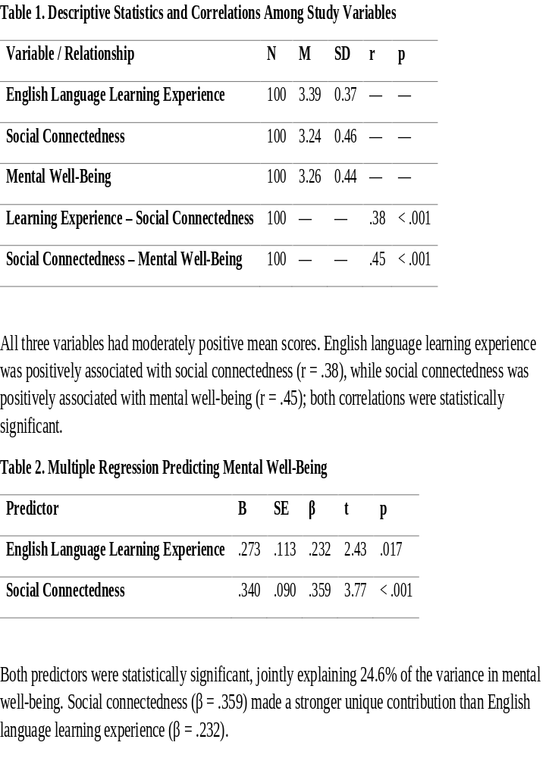
if available
Author’s photo
Abstract
This study investigated the relationships among these three variables among adult EFL learners. A quantitative correlational design was adopted, and 100 adult EFL learners (22-30) were selected through convenience sampling to participate. Accordingly, data were collected through measures of English-language learning experience, social relationships, and mental well-being. To analyze the collected data, descriptive statistics, Pearson product-moment correlations, and multiple linear regression were used. The results revealed a significant positive relationship between English language learning experience and social connectedness. It was also found that social connectedness and mental well-being were significantly and positively related. Moreover, the regression analysis indicated that both English language learning experience and social connectedness significantly predicted learners’ mental well-being, jointly explaining approximately 24.6% of its variance, and social connectedness made a more significant contribution. The findings suggest that adult EFL classrooms may provide socially meaningful environments associated with learners’ psychological well-being, and are not merely physical sites for linguistic development. The study highlights the importance of creating supportive, interactive, and socially connected EFL learning environments for adult learners.
English Language Learning, Social Connectedness, and Mental Well-Being in Adult EFL Learners
Sousan Sattar Boroujeni (1)
English Department, Na.C., Islamic Azad University, Najafabad, Iran. Email: sousansattar@iau.ac.ir
Backgrounds
Findings
Conclusion
Traditional View: Language learning is often viewed merely as acquiring vocabulary, grammar, and communicative competence.
The Social Reality: Adult EFL learners are social beings. Classrooms provide opportunities for interaction, friendship, and a sense of belonging.
The Gap: While social connectedness is linked to well-being in psychology, limited research examines this relationship specifically within adult EFL contexts.
Research Aim: To examine the relationships among English language learning experience, social connectedness, and mental well-being among adult EFL learners (ages 22–30).
.
EFL Classrooms are Social Environments: Positive English-learning experiences are significantly associated with greater social connectedness, which in turn is strongly linked to mental well-being.
Social Connectedness Matters Most: When predicting mental well-being, social connectedness made a stronger unique contribution than the language learning experience itself.
Pedagogical Takeaway: Teachers should foster supportive, interactive, and socially connected EFL environments (e.g., pair work, group discussions, collaborative tasks) to potentially enhance adult learners' psychological well-being.
RQ1: ELLE & Social Connectedness: A significant positive correlation was found (r = .38, p < .001). Learners with more positive English learning experiences reported higher social connectedness.
RQ2: Social Connectedness & Mental Well-Being: A significant positive correlation was found (r = .45, p < .001). Stronger social connectedness was linked to higher mental well-being.
RQ3: Predicting Mental Well-Being: The regression model was significant (F(2,97) = 15.86, p < .001). English learning experience and social connectedness jointly explained 24.6% of the variance in mental well-being.
r.
.
Methods
Design: Quantitative, cross-sectional correlational design.
Participants: 100 adult EFL learners (ages 22–30) enrolled in private English institutes. Selected via convenience sampling.
Instruments: English Language Learning Experience Scale (ELLES): 10 items, 5-point Likert scale.
Social Connectedness Scale: Measures interpersonal closeness and belonging.
Warwick-Edinburgh Mental Well-being Scale (WEMWBS): 14-item scale measuring positive mental well-being. mental well-being.
Data Analysis: Descriptive statistics, Pearson product-moment correlations, and multiple linear regression (p < .05).
References
Dewaele JM, Guedat-Bittighoffer D, Botes E, Dat MA. How intense and authentic communication in foreign language classes has a positive effect on learner emotions. Can Mod Lang Rev. 2024;80(4):262-284. doi:10.3138/cmlr-2023-0012
.Liu Z, Sun D, Zhang L, Wang X, Yang Y. The impact of classroom interaction on willingness to communicate: the mediating roles of speaking self-efficacy and foreign language enjoyment. PLoS One. 2025;20(7):e0328226. doi:10.1371/journal.pone.0328226.
Social Connectedness was a stronger unique predictor (β = .359, p < .001) compared to English Learning Experience (β = .232, p = .017).

