Slide 1


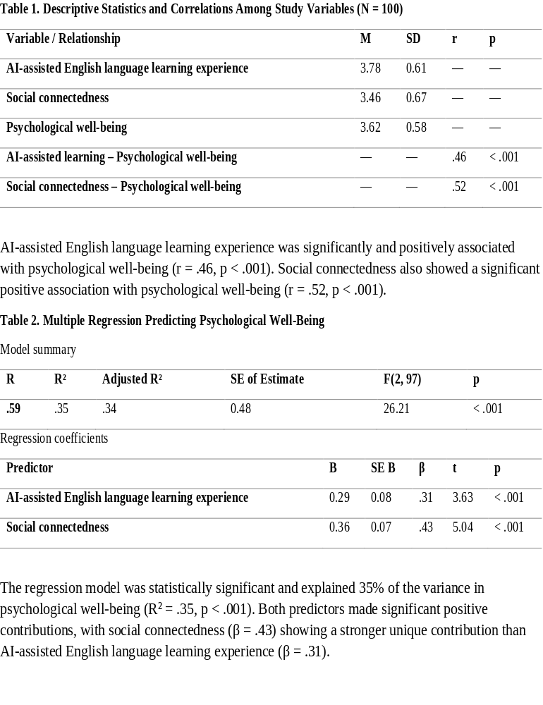
if available
Abstract
AI integration in language education has created flexible, individualized learning opportunities, yet less attention has been paid to its psychological benefits, particularly among adult EFL learners. This study investigated the relationship between AI-assisted English language learning, social connectedness, and psychological well-being among 100 adult EFL learners aged 30 and above. Using a quantitative correlational design, participants completed measures of AI-assisted learning experience, social connectedness, and psychological well-being. Multiple regression analysis revealed that AI-assisted learning (r = .46) and social connectedness (r = .52) were significantly and positively correlated with psychological well-being. Together, they explained 35% of the variance, with social connectedness emerging as the stronger predictor (β = .43). Findings suggest that AI-assisted English learning may offer psychological benefits beyond linguistic development and highlight the continued importance of human connection in adult language education.
Author’s photo
AI-Assisted English Language Learning and Psychological Well-Being among Adult EFL Learners
Sousan Sattar Boroujeni (1)
English Department, Na.C., Islamic Azad University, Najafabad, Iran. Email: sousansattar@iau.ac.ir
Backgrounds
Findings
AI has transformed language education through conversational systems, intelligent tutoring, automated feedback, and generative AI tools.
Adult EFL learners (30+) often need flexible, individualized learning due to work and family responsibilities. Existing research focuses on linguistic outcomes, with less attention to psychological benefits
Research Gap: Limited research on AI-assisted learning and psychological well-being in adult learners. Social connectedness rarely examined alongside AI-assisted learning. Also, most studies focus on university students, not adults aged 30+.
Research Questions:
Is there a significant relationship between AI-assisted English language learning experience and psychological well-being?
Is there a significant relationship between social connectedness and psychological well-being?
To what extent do AI-assisted learning and social connectedness predict psychological well-being?
Conclusion
Discussion:
RQ1: AI-Assisted Learning & Well-Being
Significant positive relationship supports emerging research (Rezai et al., 2024; Huang et al., 2024). AI may support autonomy, competence, and personal growth. Low-pressure environment may reduce language anxiety
RQ2: Social Connectedness & Well-Being
Consistent with Nahmatova et al. (2023) among adults in Azerbaijan. Positive relations are a core dimension of psychological well-being (Ryff, 1989)
RQ3: Combined Prediction
Both variables jointly explain 35% of variance in well-being. Social connectedness emerged as the stronger predictor (β = .43). Technology complements but does not replace human connection
AI-assisted English learning is positively associated with psychological well-being among adult EFL learners. Social connectedness remains a crucial factor—stronger than AI experience in this sample. AI should complement, not replace, human interaction in language learning. Findings support a multidimensional view of language learning: linguistic + psychological + social
Pedagogical Implications:
Integrate AI activities that promote autonomy and personal growth
Guide learners in strategic (not passive) AI use
Maintain collaborative and interpersonal learning opportunities
r.
.
Methods
Design: Quantitative correlational study.
Participants: 100 adult EFL learners aged 30+, recruited from English language institutes and selected via convenience sampling having experience with at least one AI tool for English learning.
Instruments: AI-Assisted Learning Experience: frequency, usefulness, personalization, autonomy, satisfaction.
Social Connectedness Scale: belonging, closeness, social environment connection
Psychological Well-Being: personal growth, autonomy, positive relations, purpose, self-acceptance
Data Analysis: Pearson correlation (RQ1, RQ2), Multiple regression (RQ3), Significance level: p < .05
References
Crompton, H., et al. (2024). AI and English language teaching. Br J Educ Technol, 55(6), 2503-2529.
Huang, F., et al. (2024). Modelling generative AI acceptance... Eur J Educ, 59(4).
Nahmatova, U., et al. (2023). Social connectedness and mental wellbeing. Discov Psychol, 3:15.
Rezai, A., et al. (2024). ChatGPT and well-being in EFL learners. Eur J Educ, 59(4).
Ryff, C.D. (1989). Happiness is everything, or is it? J Pers Soc Psychol, 57(6), 1069-1081.
.

