Slide 1


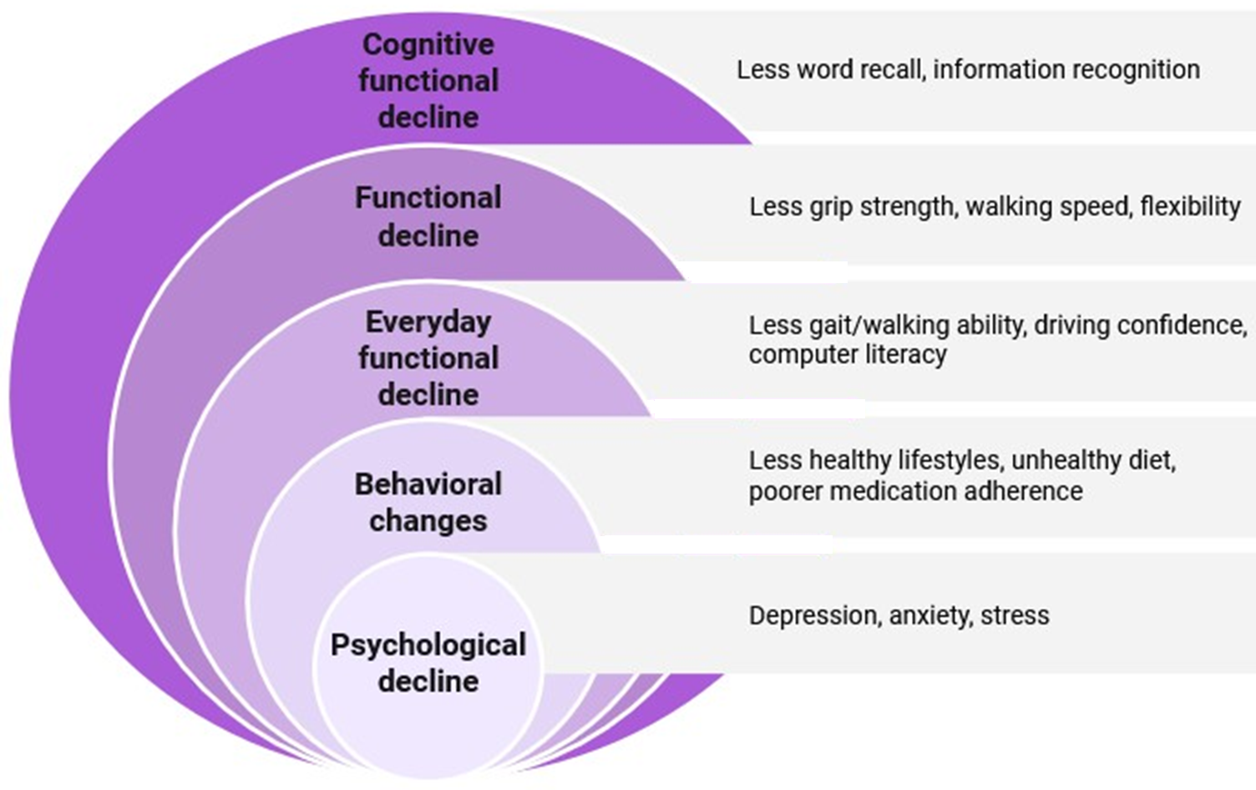







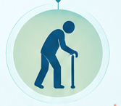

if available
Code:1477
From Interpersonal Ageism to Functional Decline: A Review of How Age-Based Social Judgments and Expectations Shape Self-Efficacy, Behavior, and Functional Ability in Older Adults
Mohammad Hossein Ghasri Khouzani (1), Samira Shariati Najafabadi (1,2)
Department of Medicine, Na.C., Islamic Azad University, Najafabad, Iran
Clinical Research Development Center, Na.C., Islamic Azad University, Najafabad, Iran
Backgrounds
Findings
Conclusion
Ageism refers to discrimination against older adults, with age-related stereotypes representing main cognitive component. Negative age stereotypes portray aging as a period of declining memory, cognition, and physical competence (1). This study reviews the influence of interpersonal ageism on older adults.
Older adults may internalize negative age stereotypes, which can undermine self-efficacy, health behaviors, cognitive and physical functioning, and everyday activities (2). Interpersonal ageism may further reinforce these effects. Negative social stereotypes can cause significantly greater harm to older adults functional performance than presenting fact-based, realistic information about aging, potentially affecting functional recovery and longevity (3).
Interpersonal ageism and socially prescribed age expectations can contribute to the internalization of negative age-related beliefs, consequently reducing self-efficacy and cognitive and physical functioning in older adults, with potential consequences for health and longevity. Therefore, it is essential to change societal perceptions of aging and promote a more realistic view of aging.
‣ Age stereotypes
Descriptive Stereotypes:
Less competence
Vulnerable (benevolent ageism)
Burden to society (hostile ageism)
• Unnecessary help
• Patronizing behavior
• Social exclusion
• Dependent
• Forgetful
• Outdated
References
1. Rasset P, Mange J, Augustinova M. What do we really know about age-related stereotypes and well-being of older adults? A commentary on the state of the art. Frontiers in Psychology. 2024;15:1358403.
Lamont RA, Swift HJ, Abrams D. A review and meta-analysis of age-based stereotype threat: negative stereotypes, not facts, do the damage. Psychology and aging. 2015;30(1):180.
Marques S, Mariano J, Mendonça J, De Tavernier W, Hess M, Naegele L, et al. Determinants of ageism against older adults: A systematic review. International journal of environmental research and public health. 2020;17(7):2560.
Prescriptive Stereotypes:
Social expectations
Behaving appropriate for their age
Methods
A review was conducted by searching major scientific databases, such as PubMed, for literature published up to June 2026. The search strategy combined keywords related to ageism, stereotyping, self-efficacy, social behavior, aging.
Less recovery following a severe disability
Reduced overall survival/longevity

