Slide 1



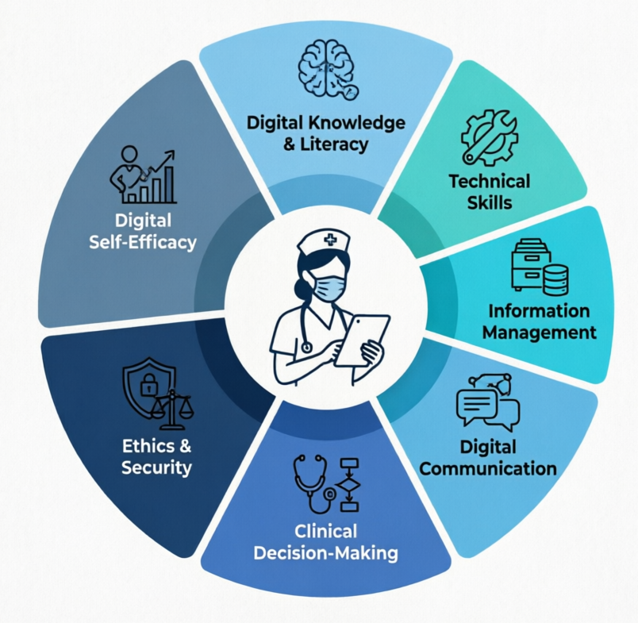
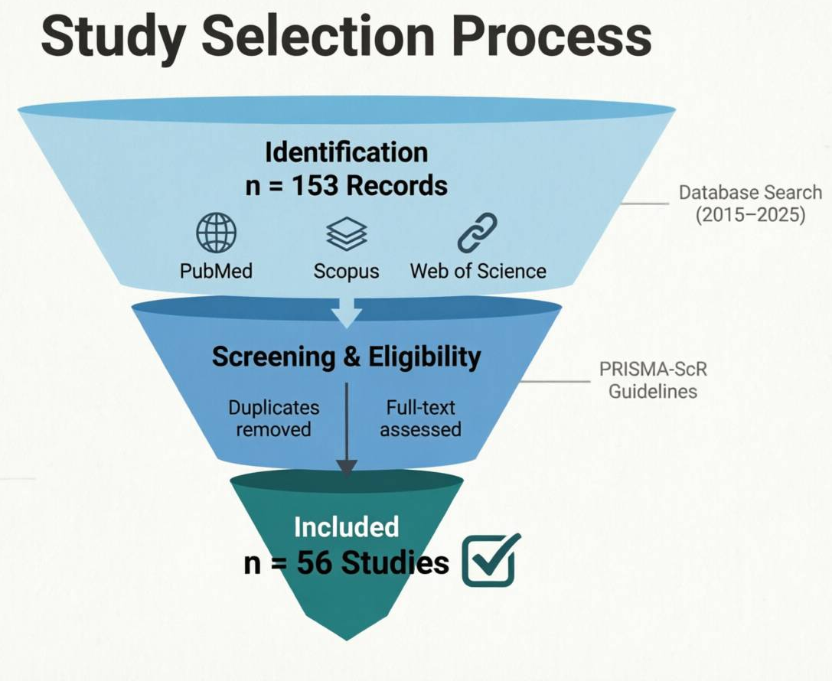
if available
Code:
Digital Health Competencies Among Clinical nurses: A Scoping Review of Education Technology adoption, and Implementation Barriers
20.1001.2.0525158426.1404.1.1.519.9
Hojjat Dehghan Mongabadi³
Sara Niksirat¹*, Soolmaz Moosavi²,
¹ Student Research Committee, Department of Medical Surgical Nursing, School of Nursing & Midwifery, Shahid Beheshti University of Medical Sciences, Tehran, Iran. Emai: saraniksirat1380@gmail.com. ² Department of Medical Surgical Nursing, School of Nursing & Midwifery, Shahid Beheshti University of Medical Sciences,Tehran, Iran. P.O.Box: 1996835119, Intersection of Valiasr St. and Niayesh Highway, in Front of Rajaei Hospital, Tehran, Iran; Emai: moosavi.soolmaz@yahoo.com.³ Student Research Committee, Department of Medical Surgical Nursing, School of Nursing & Midwifery, Shahid Beheshti University of Medical Sciences, Tehran, Iran. Email: h.dehghan1627@gmail.com.
Backgrounds
Findings
Conclusion
The increasing use of digital health technologies, including electronic health records, telehealth and clinical decision support systems, has changed nurses’ professional roles and competency requirements. Effective use of this technologies extends beyond technical skills and requires knowledge, digital skills, clinical decision-making abilities, professional attitudes and readiness. Althugh research in this field is expanding, evidence concerning the dimensions of nurses’ digital competencies and the factors affecting their development and use remains fragmented. This coping review aimed to identify and categorize digital health competencies requires by clinical nurses and to examine evidence related to education technology adoption, and barriers and facilitators to implementation
Of 153 records identify through the database search, 56 studies met the eligibility criteria and were included in the final review. Identified competencies were categorized into domains including digital knowledge and literacy, technical skills, information management, digital communication, clinical decision-making, ethical and information-security considerations, and digital self-efficacy or readiness
Developing nurses’ digital health competencies requires a structured education, opportunities for practical technology use, and or organizational support. Addressing both individual and organizational factors may facilitate more effective and safe integration of digital technologies into nursing practice.
Targeted education, organizational support, opportunities for practical training, and adequate technological infrastructure were identified as facilitators, whereas insufficient training, infrastructure limitations, workload, and inadequate attitude or readiness were reported as barriers.
References
Methods
1)Longhini J, Rossettini G, Palese A. Digital health competencies among health care professionals: systematic review. Journal of medical Internet research. 2022 Aug 18;24(8):e36414.
2) Comparcini D, Simonetti V, Tomietto M, Pastore F, Totaro M, Ballerini P, Trerotoli P, Mikkonen K, Cicolini G. The relationship between nurses' digital health literacy and their educational levels, professional roles, and digital attitudes: a cluster analysis based on a cross‐sectional study. Journal of clinical nursing. 2025 Jul;34(7):2885-97.
3) Mubarak Al Baalharith I, Aboshaiqah AE. Virtual healthcare revolution: understanding nurse competencies and roles. SAGE Open Nursing. 2024 Aug;10:23779608241271703.
This scoping review will be conducted based on the updated JBI guidance and the PRISMAـScR framework. PubMed, Scopus, and web of science will be searched for studies published from 2015 to 2025 studies involving clinical nurses and addressing digital competency, digital literacy, readiness, education, technology adoption, or implementation of digital health technologies will be included. following duplicate removal, title /abstract and full-text screening will be performed according to the predifined eligibility criteria.

