Slide 1

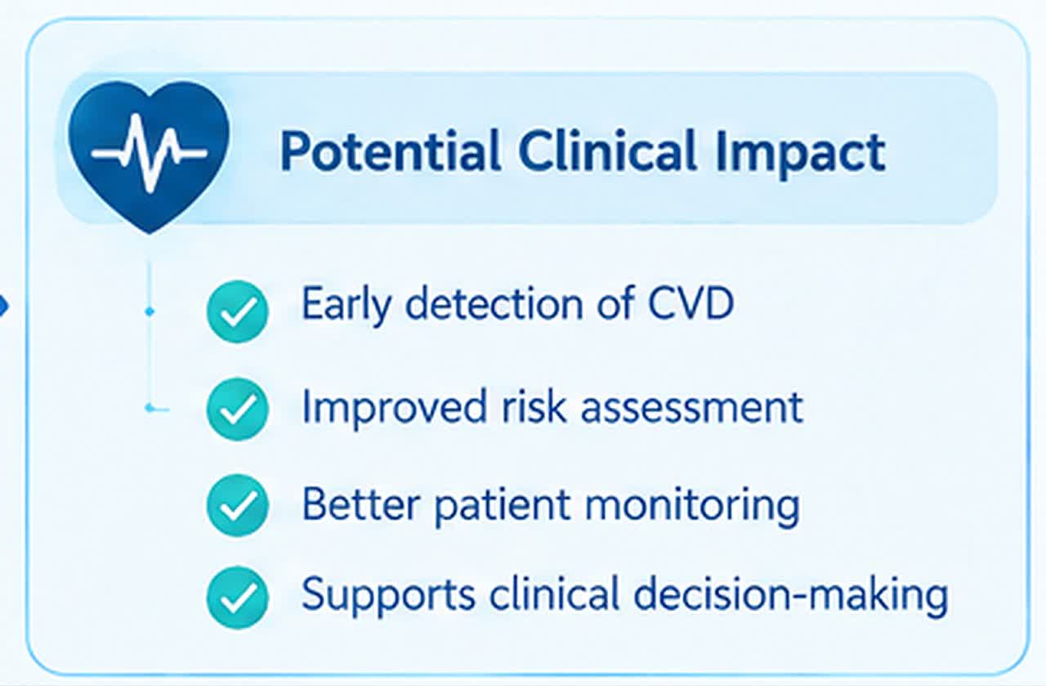

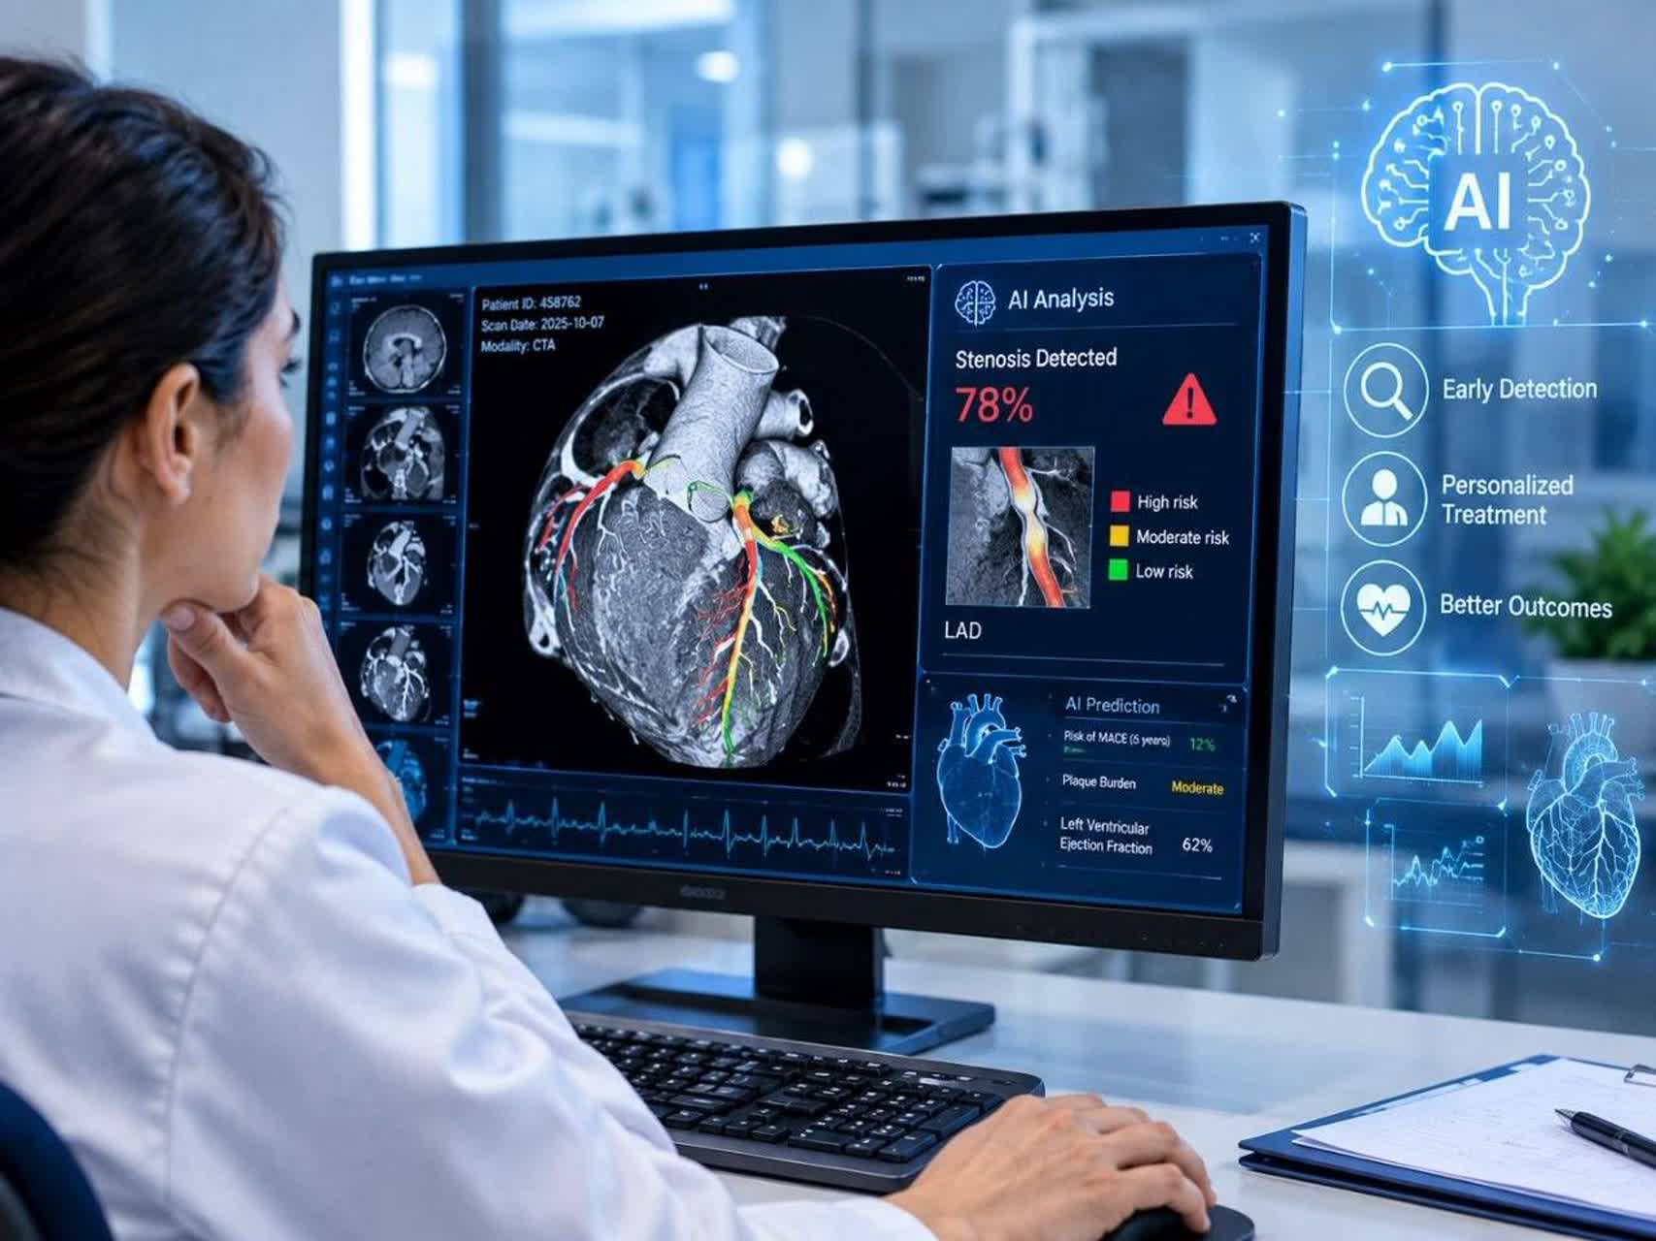
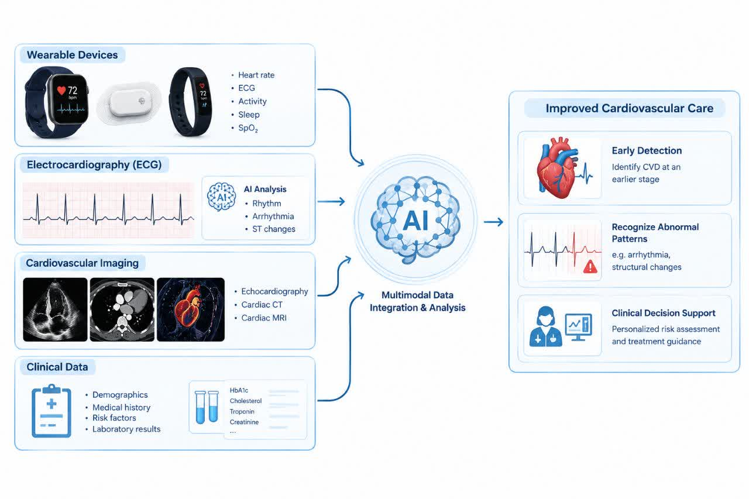
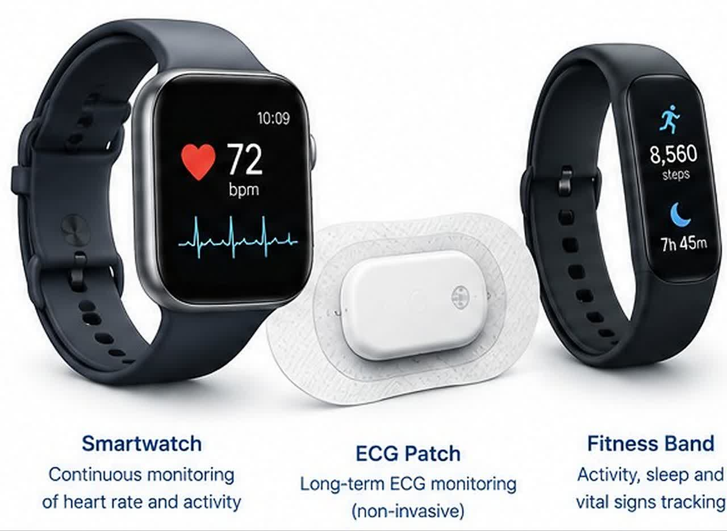
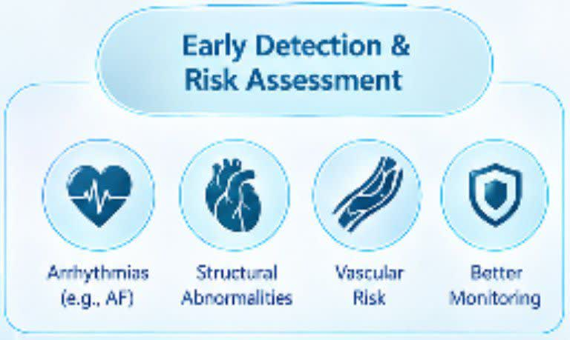
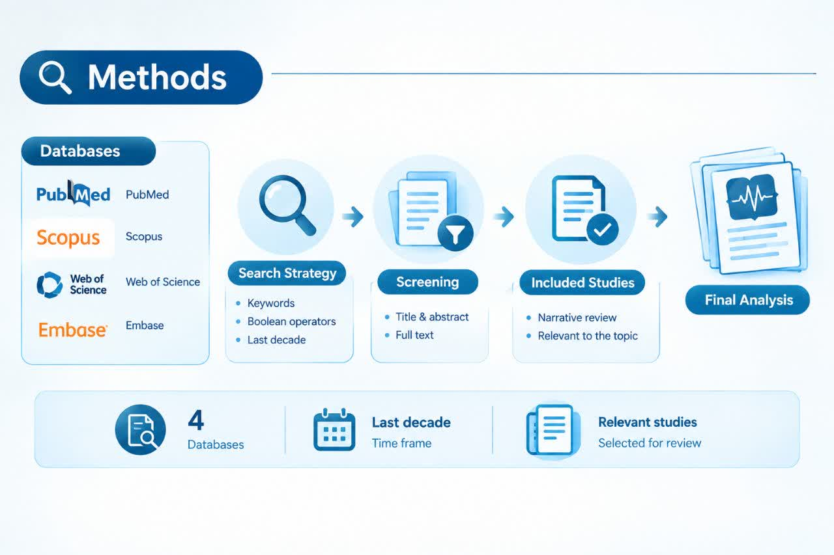
if available
Code: 1626
Author’s photo
Artificial Intelligence for Detection of cardiovascular disease using ECG, wearable devices, imaging, and clinical data
setayesh Saffari1, Mahdis Esmaeili1, Narges Hajian1, Samira shariati Najafabadi1,2*
Department of Medicine, Na.C., Islamic Azad University, Najafabad, Iran
Department of Medicine, Na.C., Islamic Azad University, Najafabad, Iran , Clinical Research Development Center, Na.C., Islamic Azad University, Najafabad, Iran.
Backgrounds
Findings
Conclusion
Cardiovascular diseases are among the main causes of mortality worldwide . However, early diagnosis of these diseases is still challenging for various reasons, including the fragmentation of clinical data. Multimodal artificial intelligence can be effective for integrating and simultaneously analyzing these data.
When ECG was analyzed using artificial intelligence, patterns reflecting structural abnormalities were shown, and these changes may not be apparent in conventional interpretation. Wearable devices, clinical data, and imaging can provide a more comprehensive assessment for diagnosis and treatment. However, regarding the use of artificial intelligence in the diagnosis and treatment of diseases, we face challenges such as interpretability, data privacy, the need for validation, and population diversity
Before using artificial intelligence in the clinical environment, it should be evaluated in different populations, with consideration of individuals' privacy. Multimodal artificial intelligence has high potential for assessment and assistance in diagnosis using clinical information and wearable devices. The use of artificial intelligence is considered a tool for assistance and support and is not intended to replace physicians; rather, it is intended to assist physicians
Wearable devices, including smartwatches and ECG patches, have made it possible to identify abnormalities over a long period and in a non-invasive manner . One example is the identification of atrial fibrillation . Also, AI, by analyzing different ECG data, cardiac imaging, and data obtained from wearable devices, can be helpful in examining the structure of the heart.
.
Methods
References
This study was conducted as a narrative review using searches of PubMed/MEDLINE, Scopus, and Web of Science for studies related to cardiovascular diseases and the application of artificial intelligence published over the last decade.
Mensah GA, Fuster V, Murray CJ, Roth GA, Abate YH, Abbasian M, et al. Global burden of cardiovascular diseases and risks, 1990-2022. Journal of the American College of Cardiology. 2023;82(25):2350-473.
Yang X-y, Li Y-m, Wang J-y, Jia Y-h, Yi Z, Chen M. Utilizing multimodal artificial intelligence to advance cardiovascular diseases. Precision clinical medicine. 2025;8(3):pbaf016.
Perez MV, Mahaffey KW, Hedlin H, Rumsfeld JS, Garcia A, Ferris T, et al. Large-scale assessment of a smartwatch to identify atrial fibrillation. New England Journal of Medicine. 2019;381(20):1909-17.
Illustrations are also great aids to help your research poster.

