Slide 1

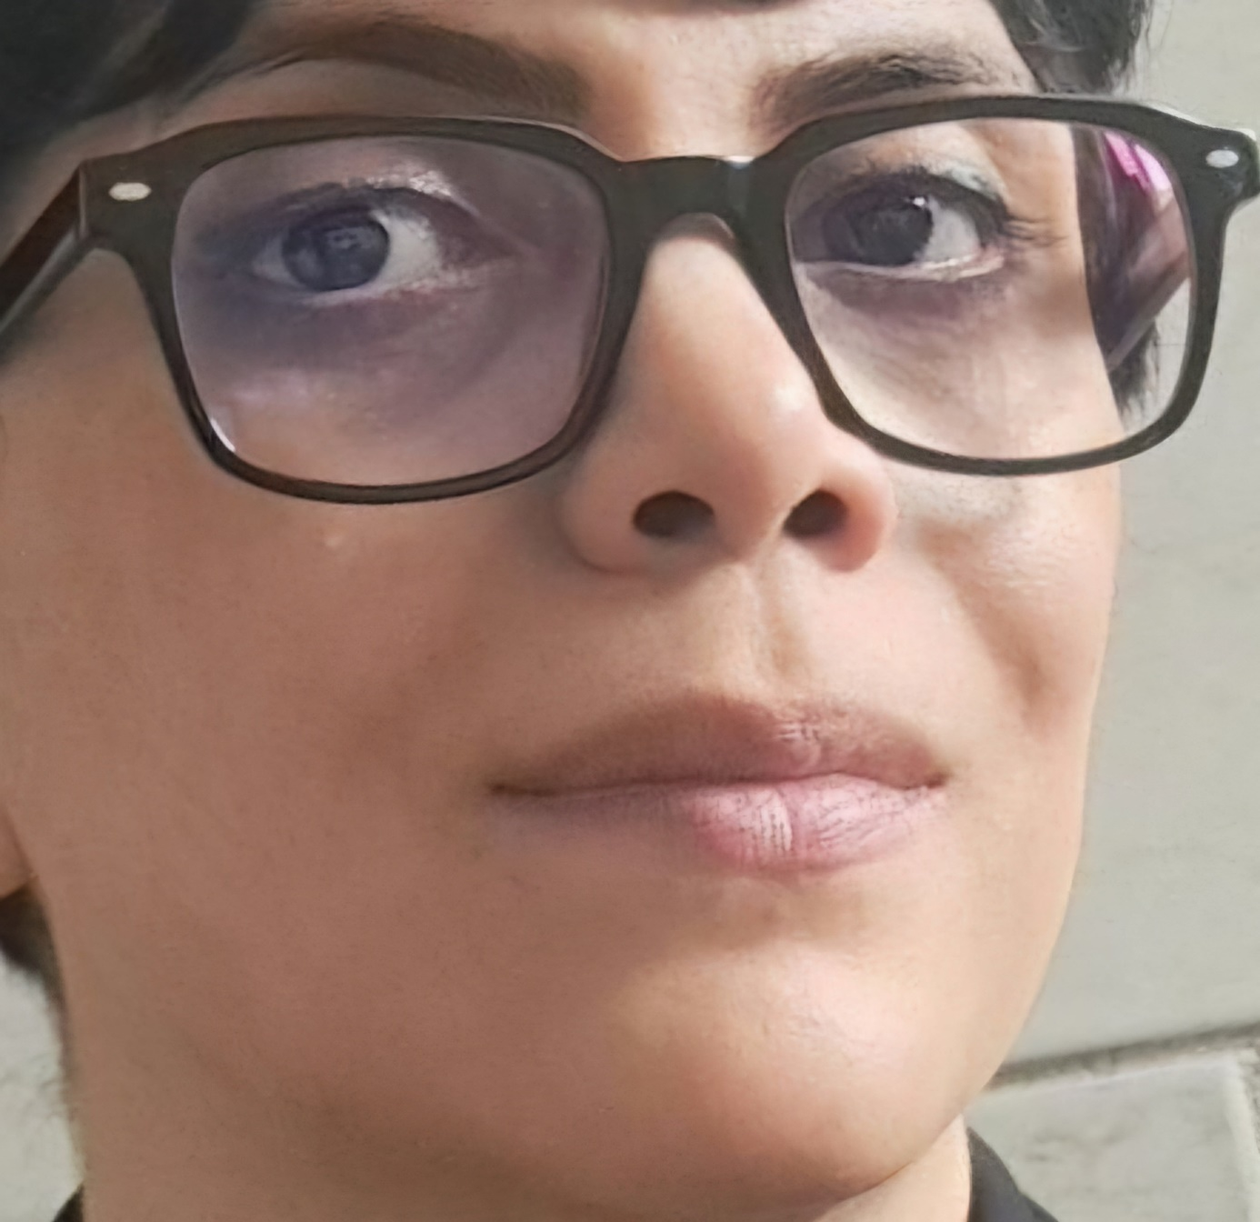

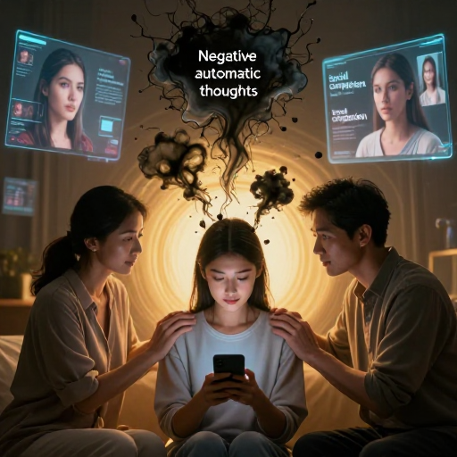
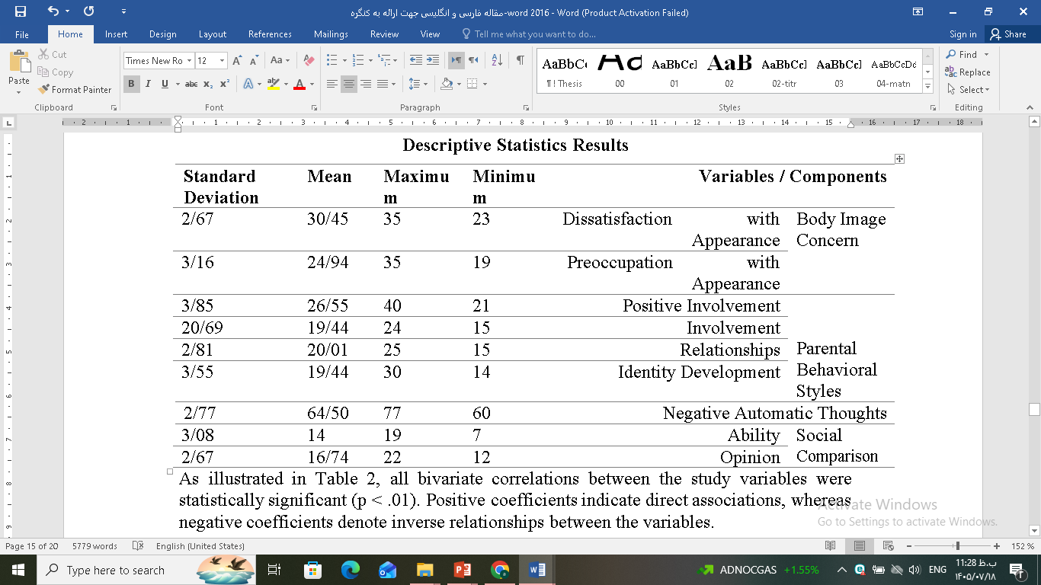
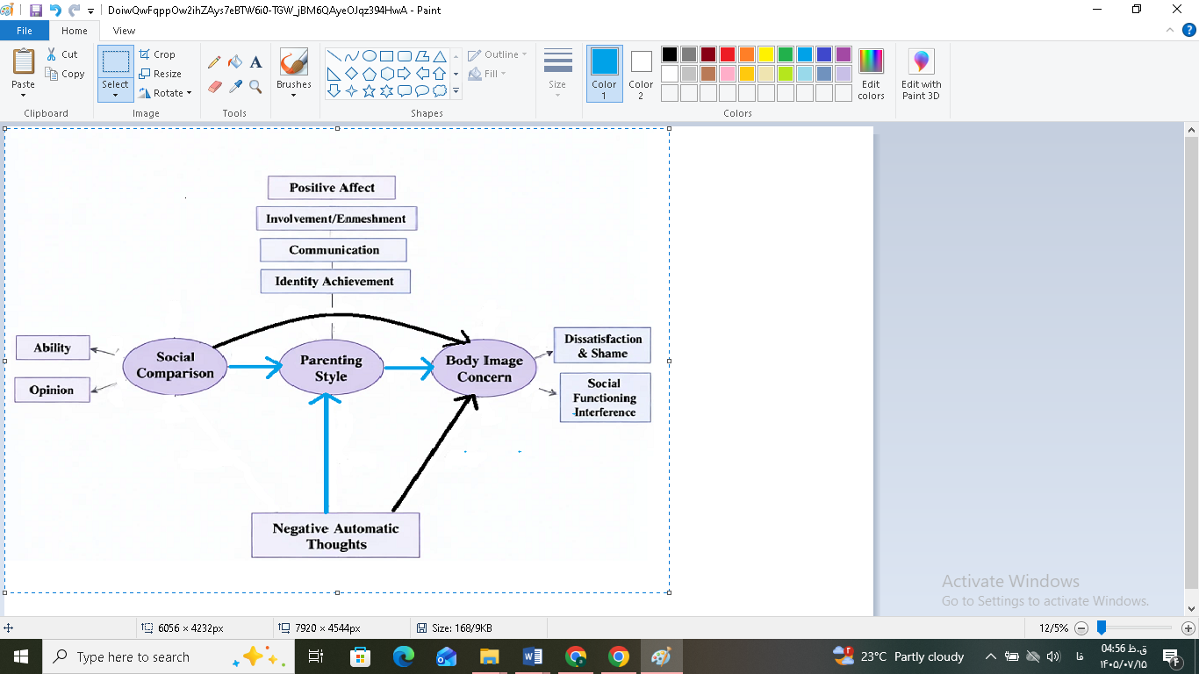
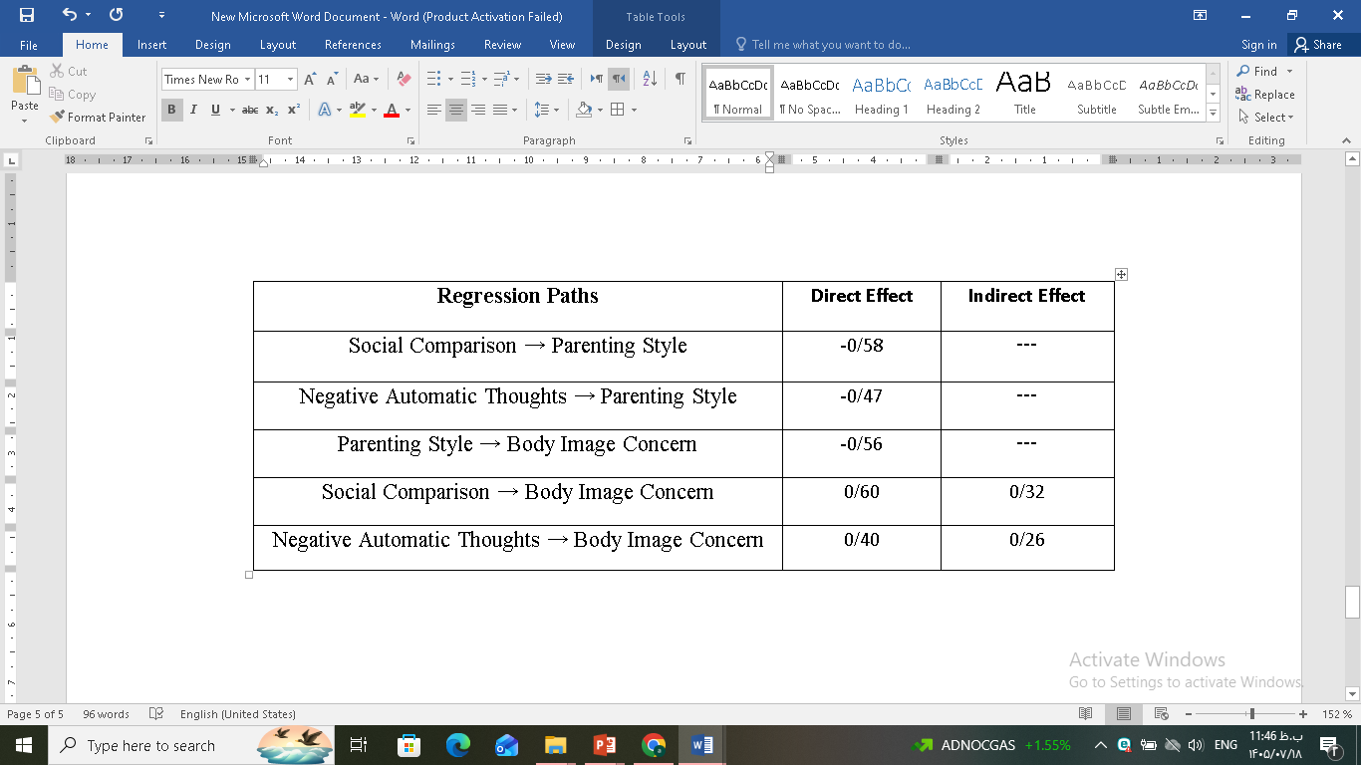
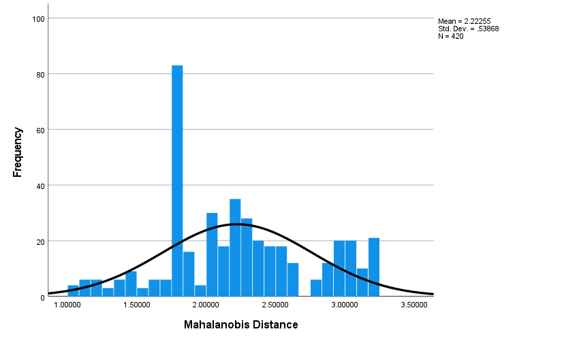
if available
The prediction of body image concerns based on negative automatic thoughts and social comparison mediated by parental behavioral style in young girls using Virtual networks
Code:1675
Azita Taghisoltani¹, Maryam Bahrami Hidaji² , Sharareh Zeighami Mohammadi³
^{1.} M.A. student, Department of health & clinical psychology,ka.C, Islamic Azad University,Karaj, Iran
2.Assistant Professor, Department of health & clinical psychology,ka.C, Islamic Azad University,Karaj, Iran
3.Assistant Professor, Clinical Cares & Health Promotion Research Center, ka.C, Islamic Azad University,Karaj, Iran
Backgrounds
Findings
Conclusion
I. Introduction & Problem Statement
Body Image: From Subjective Perception to Socio-Psychological Crisis
The Psychological Battlefield: Deconstructing Body Image Dissatisfaction
II. Theoretical Framework & Variables
Negative Automatic Thoughts: Cognitive Filters of Dissatisfaction
Social Comparison: A Catalyst for Body Image Disturbance
The Vicious Cycle: Interplay Between Cognition, Media, and Self-Perception
III. The Mediator Role (Parenting Styles)
Parenting Styles: A Psychological Buffer Against Social Media Pressure
Familial Architecture: Shaping the Ontogenesis of Body Perception
The Dual Role of Parenting: Protective Factors vs. Risk Profiles in Body Image
Parental Mediation: Architects of Internalized Body Image Schemas
The “Parenting Filter”: Transmuting Transient Cognitions into Chronic Beliefs
Parenting Behavioral Styles: The Missing Link in Body Dissatisfaction Etiology
Determinants of Cognitive Vulnerability: The Role of Parenting Pathways
IV. Conclusion & Clinical Implications
A Multifaceted Etiology of Body Image Concerns: Empirical Findings
Bridging Cognition and Environment: The Mediating Role of Parenting Styles
Beyond Individualism: A Roadmap for Family-Centric Therapeutic Interventions
Integrative Frameworks: Synthesizing Cognition, Social Comparison, and Family Dynamics
Revisiting Clinical Paradigms: Prioritizing Family Dynamics in Body Image Treatment
As shown in the table, there are significant positive direct effects from both Negative Automatic Thoughts (β=0.40,) and Social Comparison (β=0.60 ) on Body Image Concern. Conversely, a significant negative direct effect was found from Parenting Style on Body Image Concern (β=−0.56).
Regarding the mediation analysis, Parenting Style significantly mediated the relationship between Negative Automatic Thoughts and Body Image Concern (Indirect Effect = 0.26), as well as the relationship between Social Comparison and Body Image Concern (Indirect Effect = 0.32). The significance of these indirect effects was confirmed using the Sobel test (Z = 4.06 and Z = 5.03, respectively). Since the absolute values of the Sobel test statistics exceed the critical value of 1.96, the mediating role of Parenting Style in these relationships is statistically significant.
Methods
Standardized Coefficients for the Relationships Among Study Variables
Research Methodology
Research Objective: Applied Research
Research Design: Descriptive-Correlational
Primary Analytical Framework: Structural Equation
Modeling (SEM)
Statistical Technique: Path Analysis
Research Rationale: Predictive Modeling and Structural
Explanation of Psychological Phenomena
Participants & Procedure
Target Population: Female University Students (Aged 18–25)
Study Setting: Islamic Azad University, Karaj Branch
Sampling Strategy: Multistage Cluster Random Sampling
References
Histogram of the Mahalanobis distance distribution
1-Abdollahinia A, Bagheri M, Askarizadeh Q. Predicting body image concern based on narcissism and rumination with the mediating role of self-esteem in women seeking cosmetic surgery. J Alzahra Univ. 2025;21(3):127-143.
2- Khoshsooar S, Mikaeili N. The role of social comparison, interpersonal sensitivity, and cognitive flexibility in predicting disordered eating attitudes among female students. Soc Psychol Res. 2021;43:141-166.
3- Rezaeinezhad-Bakhtiari M, Shahriari-Ahmadi M. Predicting body image concern and anxiety in children based on family functioning and parental communication patterns in students with onychophagia. J IHS. 2024;10(3):12-17.
4- Gardam O, Kokenberg L, Kaur S, St John E, Carbonneau N, Guimond A. Parent and child influence in body image dissatisfaction: the moderating effect of parent acceptance of the COVID-19 pandemic. Body Image. 2023;45:183-191.
Conceptual Framework of the Study

