Slide 1


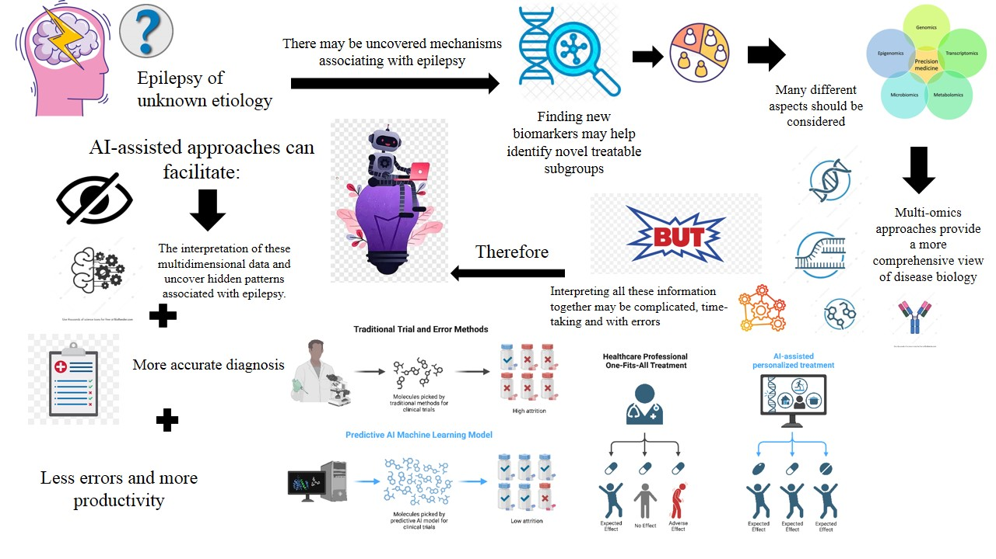
if available
Code:
Artiifcial Intelligence for Etiological and Biomarker Discovery in Epilepsy of Unknown Etiology
1521
Sarina Rezaei(1), Samira Shariati Najafabadi(1,2)
(1) Department of Medicine, Na.C., Islamic Azad University, Najafabad, Iran
(2)Clinical Research Development Center, Na.C., Islamic Azad University, Najafabad, Iran
Backgrounds
Findings
Conclusion
Epilepsy is one of the most frequent neurological disorders; however, the cause of epilepsy still remains undetermined in a large number of patients. Genetic variations, autoimmunity, neuroinflammation, metabolic dysfunction, structural anomalies, and molecular changes can be responsible for epilepsy with unknown causes but may go unnoticed using traditional methods of diagnosis. The application of artificial intelligence opens new possibilities for recognizing complicated patterns and analyzing various aspects for identifying the possible causes of the disorder.
Artificial intelligence-driven multimodal and multi-omics approaches have significant promise for exploring idiopathic forms of epilepsy through the analysis of different clinical, genetic, imaging, electrophysiological, and molecular variables. This may help uncover novel etiologies and biomarkers for epilepsy, and promote stratification of patients to tailor their diagnosis and treatment. Nevertheless, further validation in larger cohorts is necessary prior to their clinical application.
References
Han K, Liu C, Friedman D. Artificial intelligence/machine learning for epilepsy and seizure diagnosis. Epilepsy & Behavior. 2024;155:109736.
Chong D, Jones NC, Schittenhelm RB, Anderson A, Casillas-Espinosa PM. Multi-omics integration and epilepsy: Towards a better understanding of biological mechanisms. Prog Neurobiol. 2023;227:102480.
Ijaz T, Maqsood H, Rehman A, Tahir ul Qamar M, Ashfaq UA. Explainable machine learning identifies immune-inflammatory biomarkers and therapeutic candidates in drug-resistant epilepsy. Scientific Reports. 2025;16(1):965.
Methods
The present study is a review done by searching the PubMed/MEDLINE and Google Scholar. Keywords include idiopathic epilepsy, artificial intelligence and related terms.
Artificial intelligence can aid in detection and interpretation of genetic variants, polygenic risk, clinical phenotypes, EEG phenotypes, and imaging biomarkers related to epilepsy. Genomics and metabolomics data integration can be useful for detecting molecular biomarkers and pathways. This section is one of the longest parts as it builds on the information that supports the objective and thesis. You can trim down the analysis to the most important parts. Include key graphs, tables, images, ... that show a visual analysis of the data. Add your information, graphs and images to this section. Further, blood and cerebrospinal fluid biomarkers, extracellular vesicles, neural autoantibodies, MRI, EEG, and clinical phenotypes can be combined using multimodal analysis for biologically distinct subgroups and treatment etiology. However, some limitations such as small dataset sizes, non-diverse datasets, overfitting, lack of external validation, and sampling biases still persist.

