Slide 1



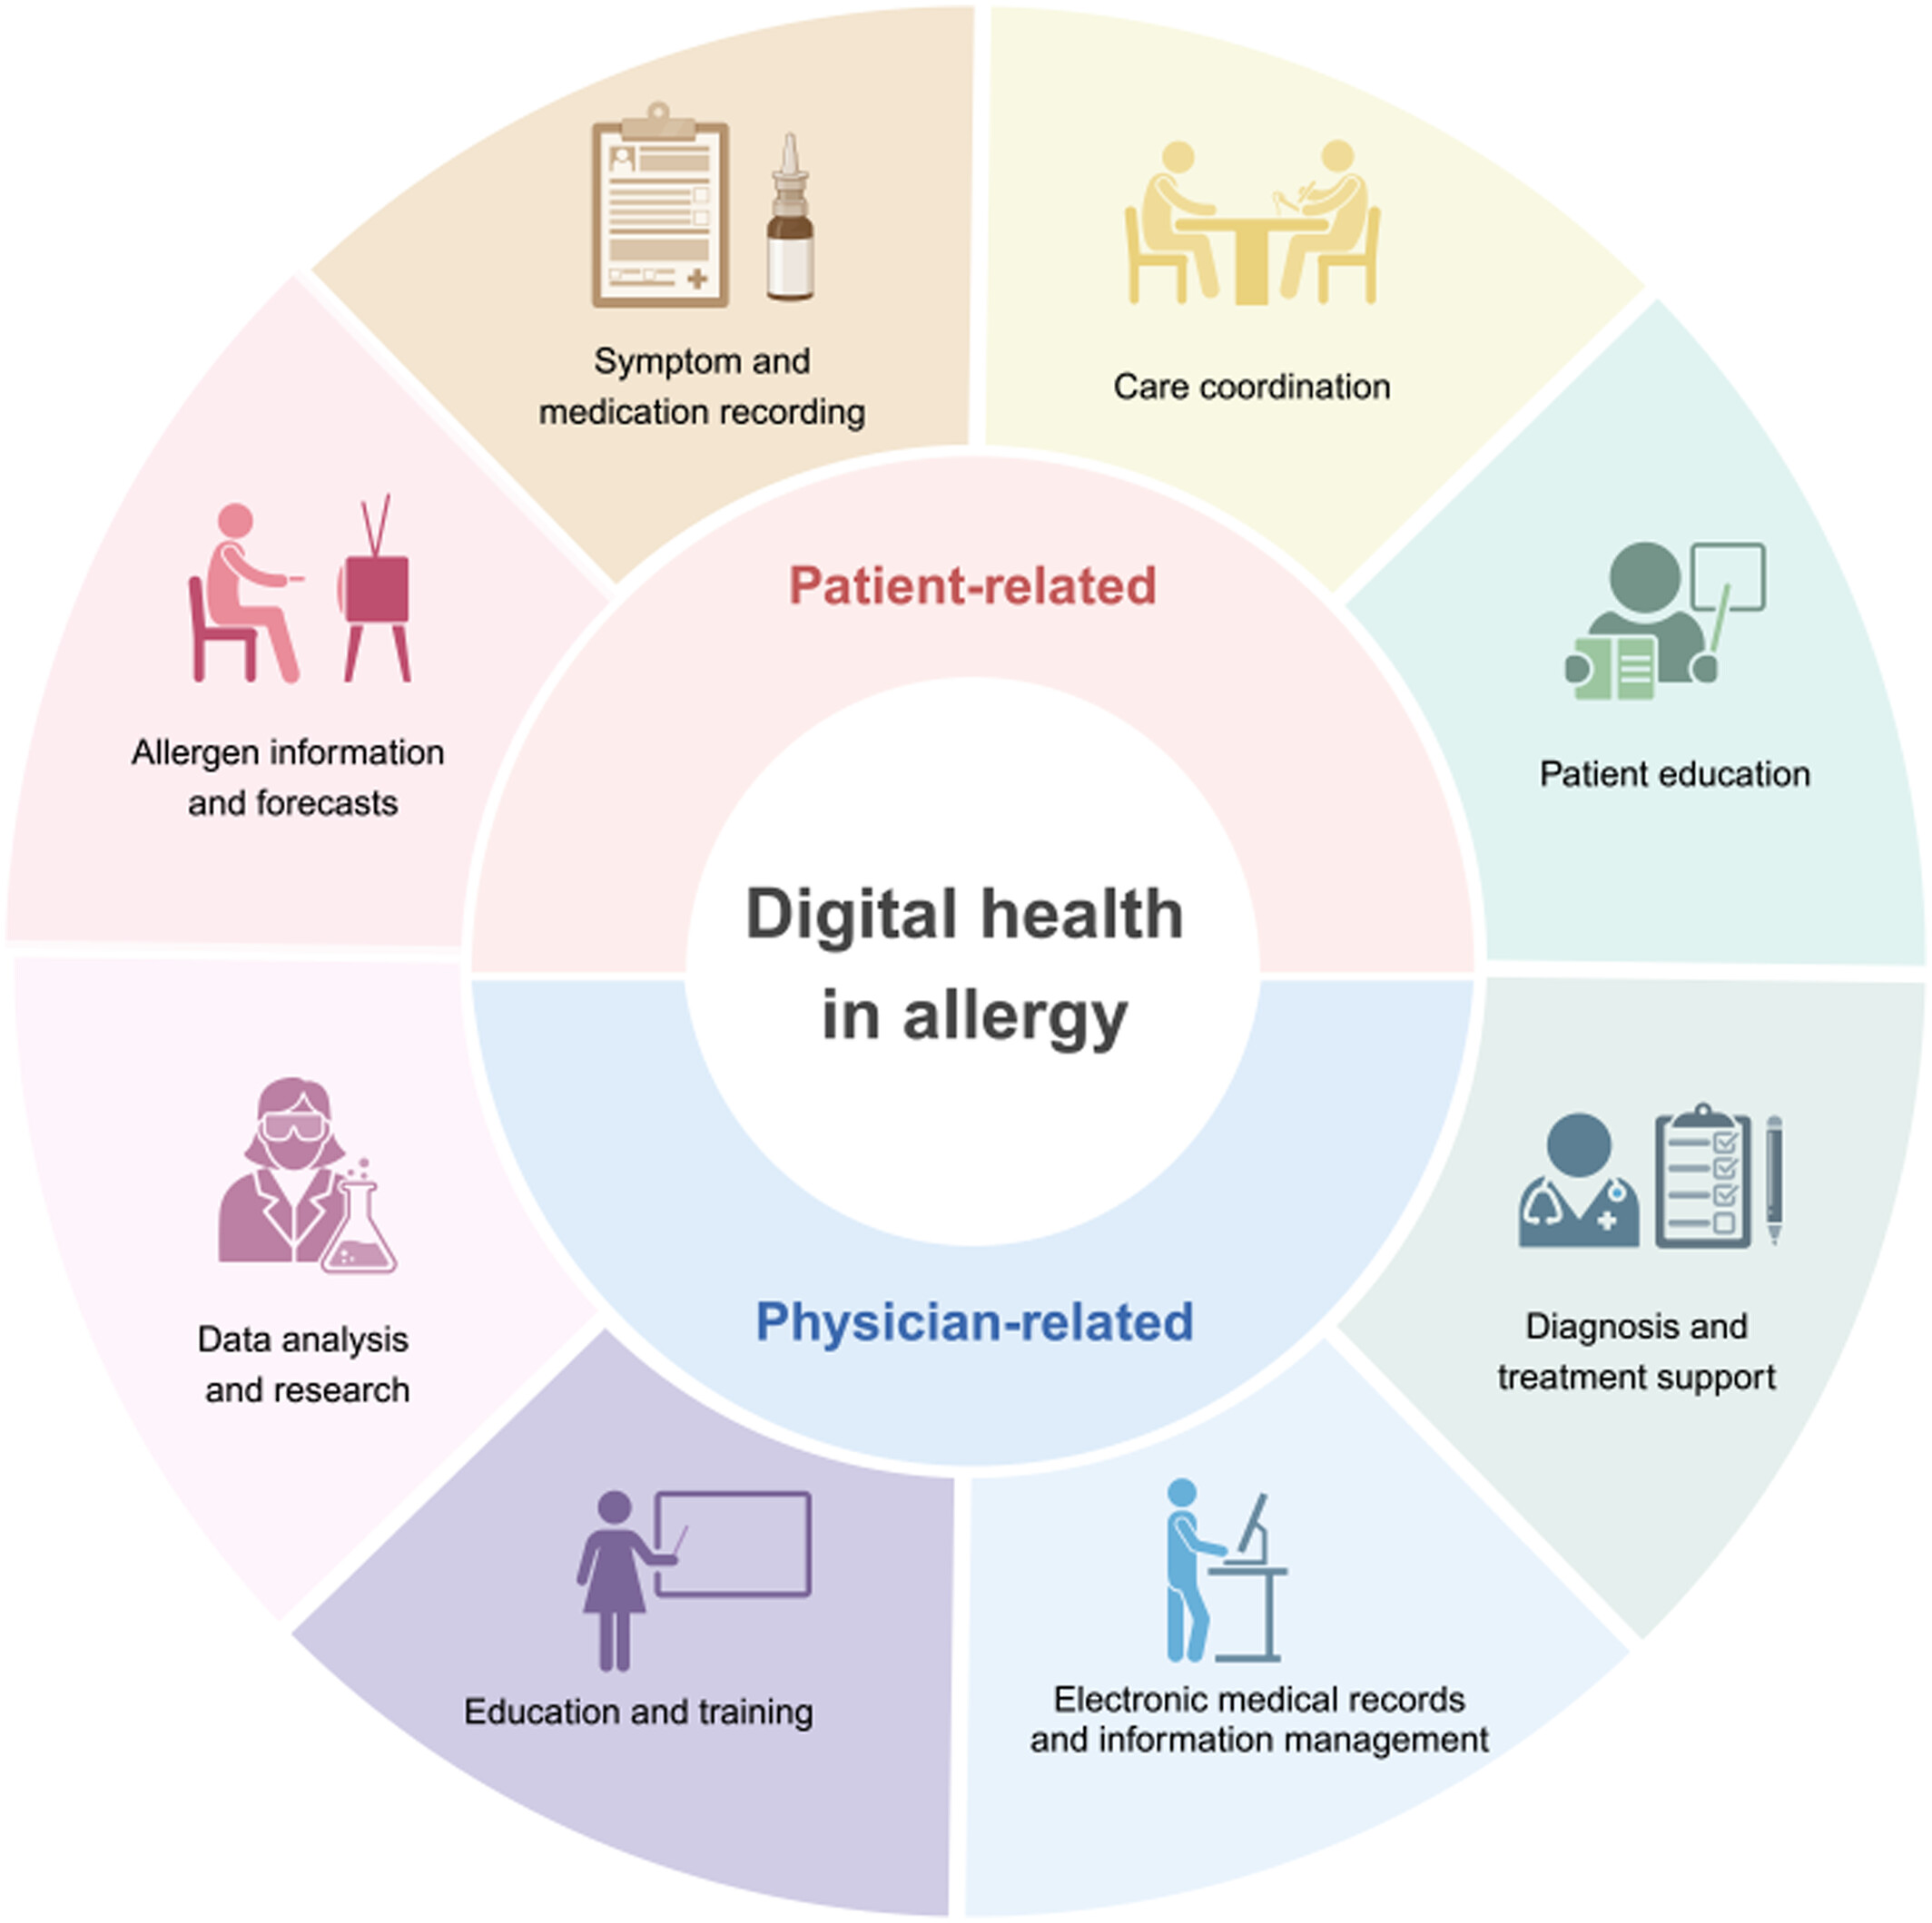
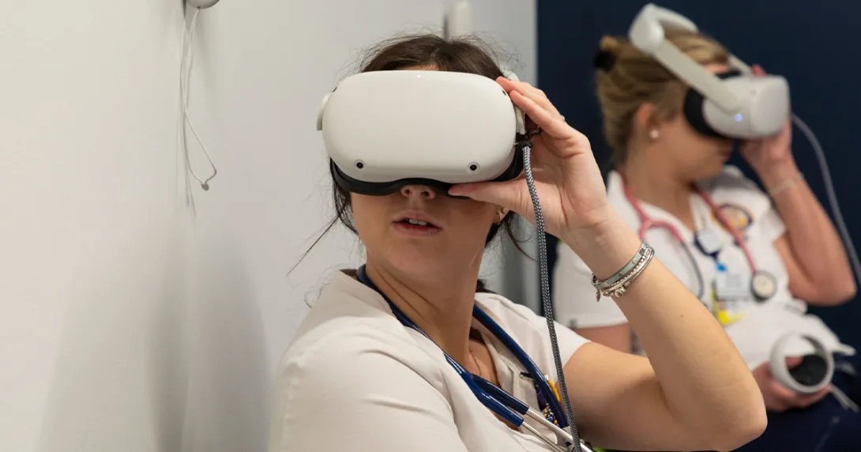


if available
Digital Health Literacy and Technological Readiness as Predictors of Clinical Judgment and Simulation Self-Efficacy in Pediatric Nursing: A Cross-Sectional Correlational Study
Code:1310
Fahimeh Torki1, Mina Jouzi2*
1 .Fahimeh Torki,Master Student, Department of Nursing, Nursing and Midwifery Sciences Development Research Center, Na.C., Islamic Azad University, Najafabad, Iran.
2 . Corresponding author :Mina Jouzi, PhD, Associate Professor, Department of Nursing, Nursing and Midwifery Sciences Development Research Center, Na.C., Islamic Azad University, Najafabad, Iran.
Backgrounds
Findings
Conclusion
The study used a descriptive-correlational cross-sectional design at Islamic Azad University, Najafabad Branch, Iran, during 2024–2025, recruiting 320 senior pediatric nursing students via convenience sampling. Data were collected using four validated Persian instruments: eHEALS, TRI, LCJR, and SSES, with 305 complete questionnaires analyzed (95.3% response rate). Pearson correlation and multiple linear regression in SPSS 26 tested relationships between digital health literacy, technological readiness, clinical judgment, and simulation self-efficacy. No experimental manipulation or special technology was applied beyond the HFM/VR simulation exposure already embedded in the curriculum; all measures were self-reported.
Simulation technology alone does not guarantee improved clinical judgment or self-efficacy; students' digital competencies are fundamental. Digital health literacy was the strongest predictor of clinical judgment (β = 0.36), while technological readiness independently predicted simulation self-efficacy (β = 0.12). Together they explained 38% and 44% of the variance, revealing a digital divide that requires integrating digital literacy training and pre-simulation technological orientation into nursing curricula.
Digital health literacy and technological readiness significantly predict clinical judgment and simulation self-efficacy in pediatric nursing students. Digital health literacy showed the strongest effect (β = 0.36 for clinical judgment; β = 0.49 for self-efficacy), while technological readiness also contributed significantly. Together, they explained 38% and 44% of the variance, respectively. These findings highlight a digital divide, suggesting that simulation technology alone is insufficient without cultivating students' digital competencies.
Methods
References
Digital health literacy is the ability to seek, find, understand, appraise, and apply electronic health information to solve health problems. In pediatric simulation, it involves critically appraising digital health data and processing digital clinical cues such as virtual monitors and e-MARs to support clinical reasoning and judgment.
1-Sezer E, Çelik H, Karabacak Ü, Lasater K. Lasater clinical judgment rubric in nursing education: a Turkish validity and reliability study. BMC Nurs. 2025 Jan 20;24(1):70.
2-Zare F, Rahimi R, Zehtab Hashemi H, Faghani L, Ghaedi G, Nabavi S. Examining the Telehealth Readiness Among Individuals With Multiple Sclerosis. J Patient Exp. 2025 Oct 15;12:23743735251383247.
3-Dermody G, El Haddad M, Wadsworth D, Prichard R, Craswell A. Need for a Shared Responsibility for Developing Digital Expertise in the Nursing Profession. Stud Health Technol Inform. 2025 Nov 12;333:24–7.

