Slide 1


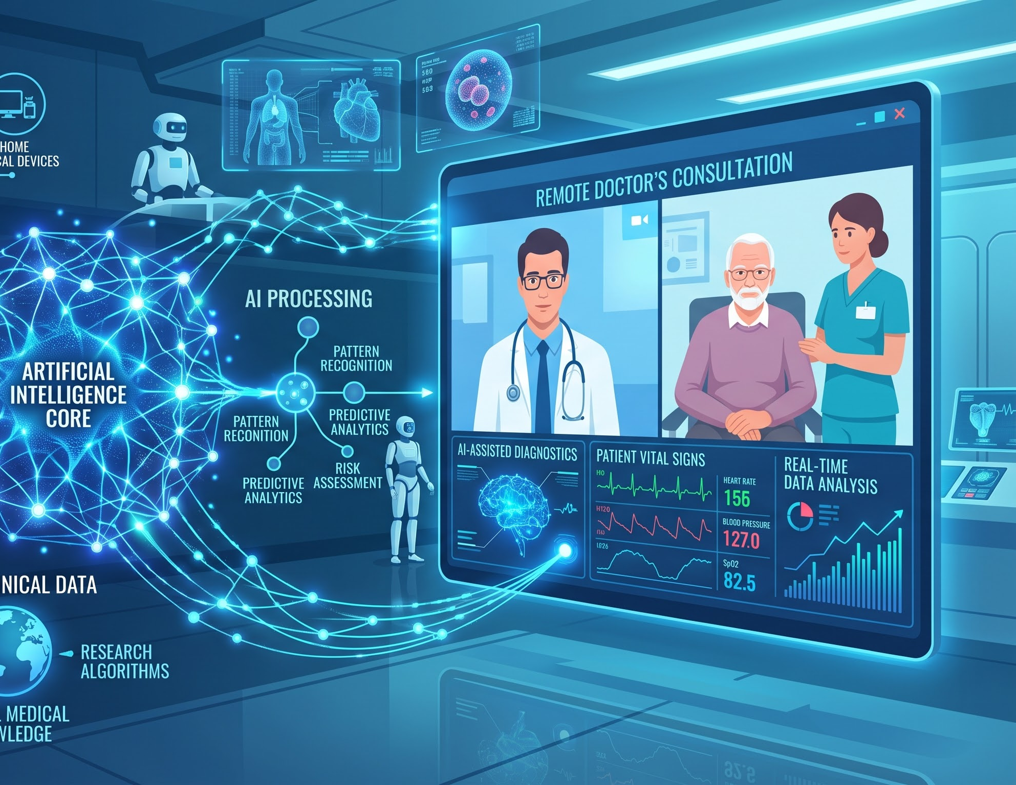
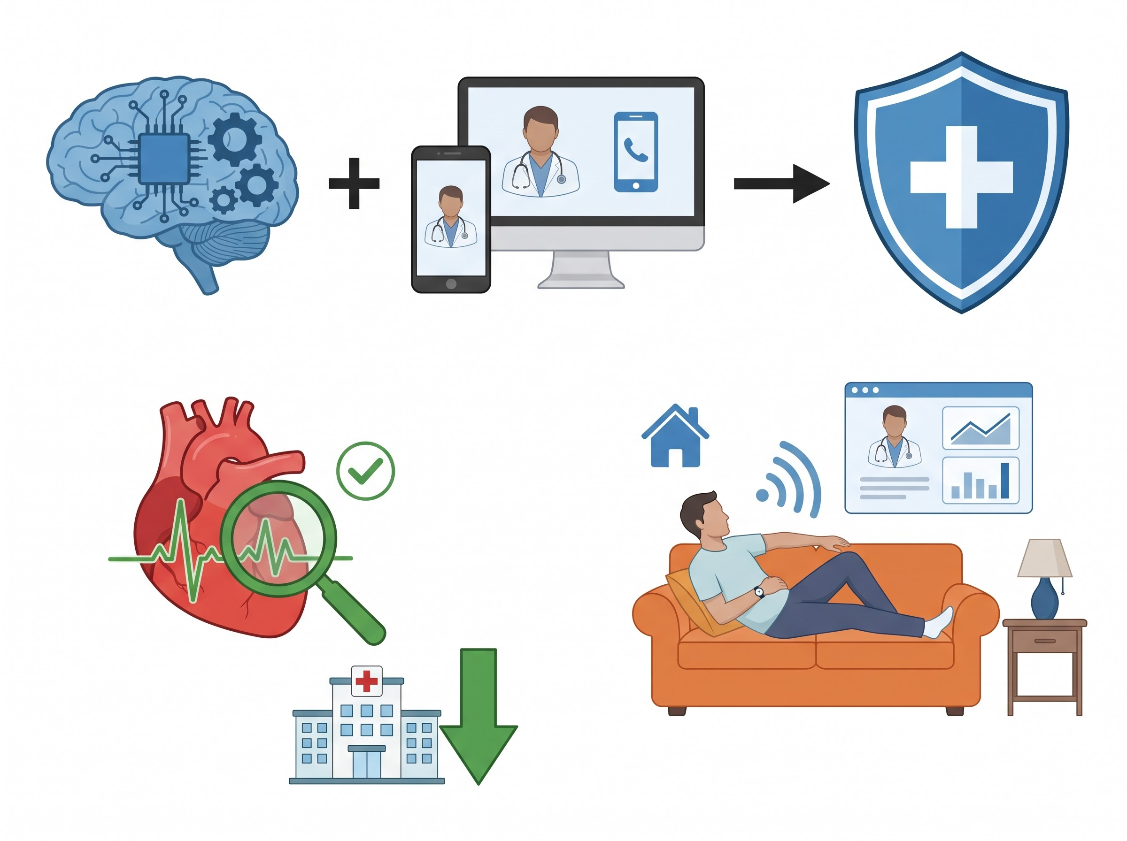
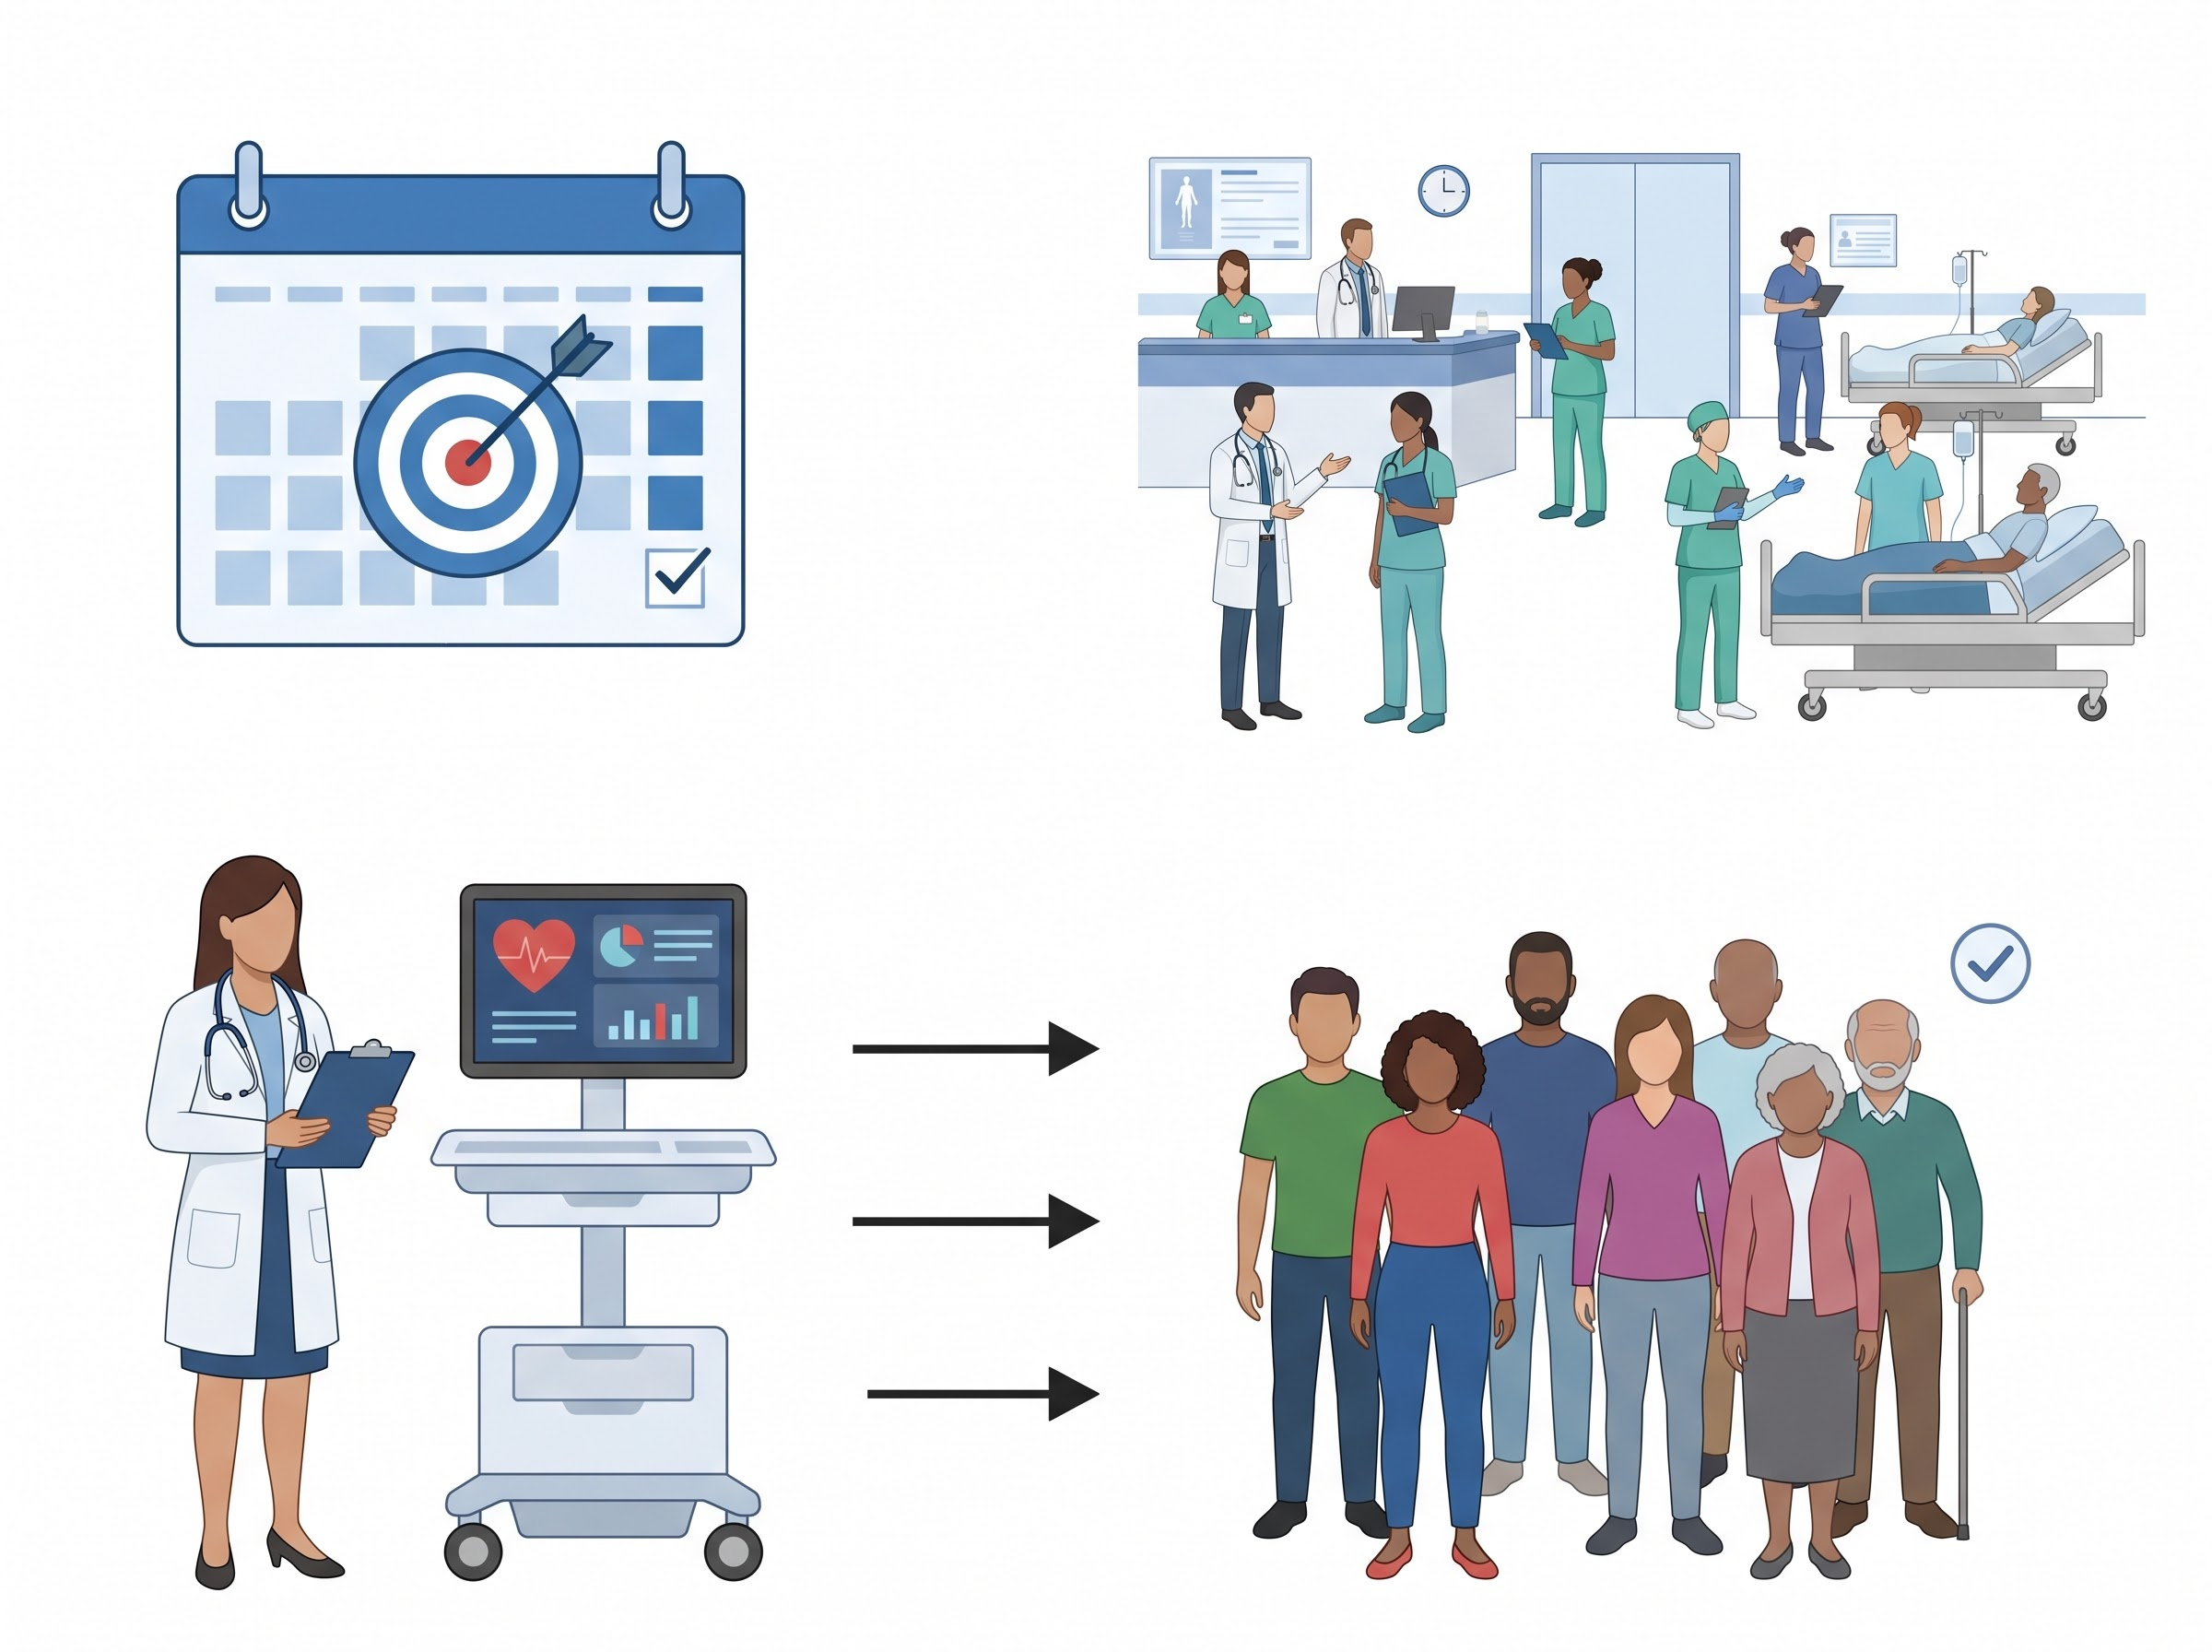
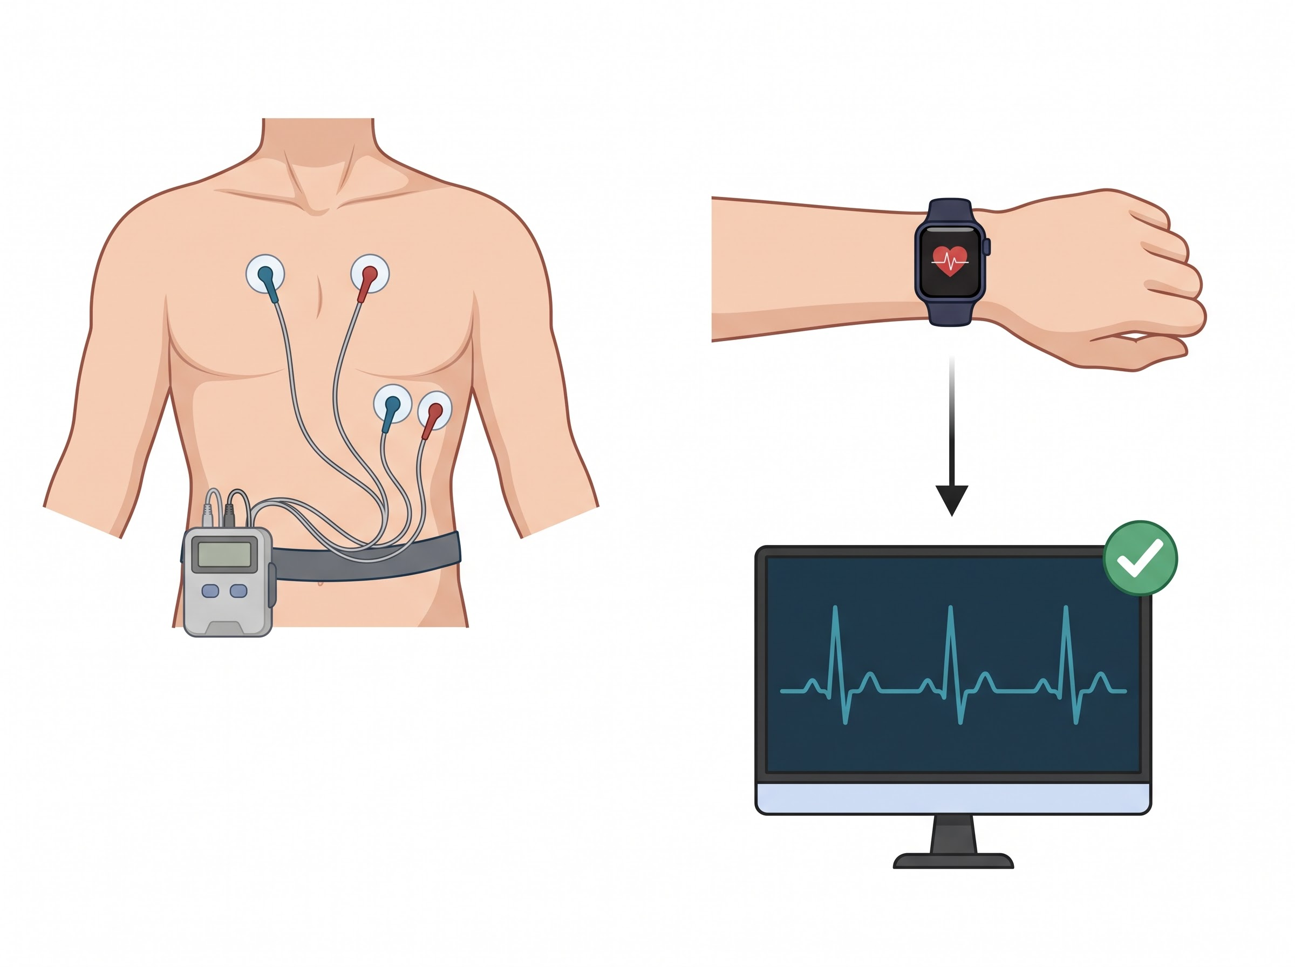
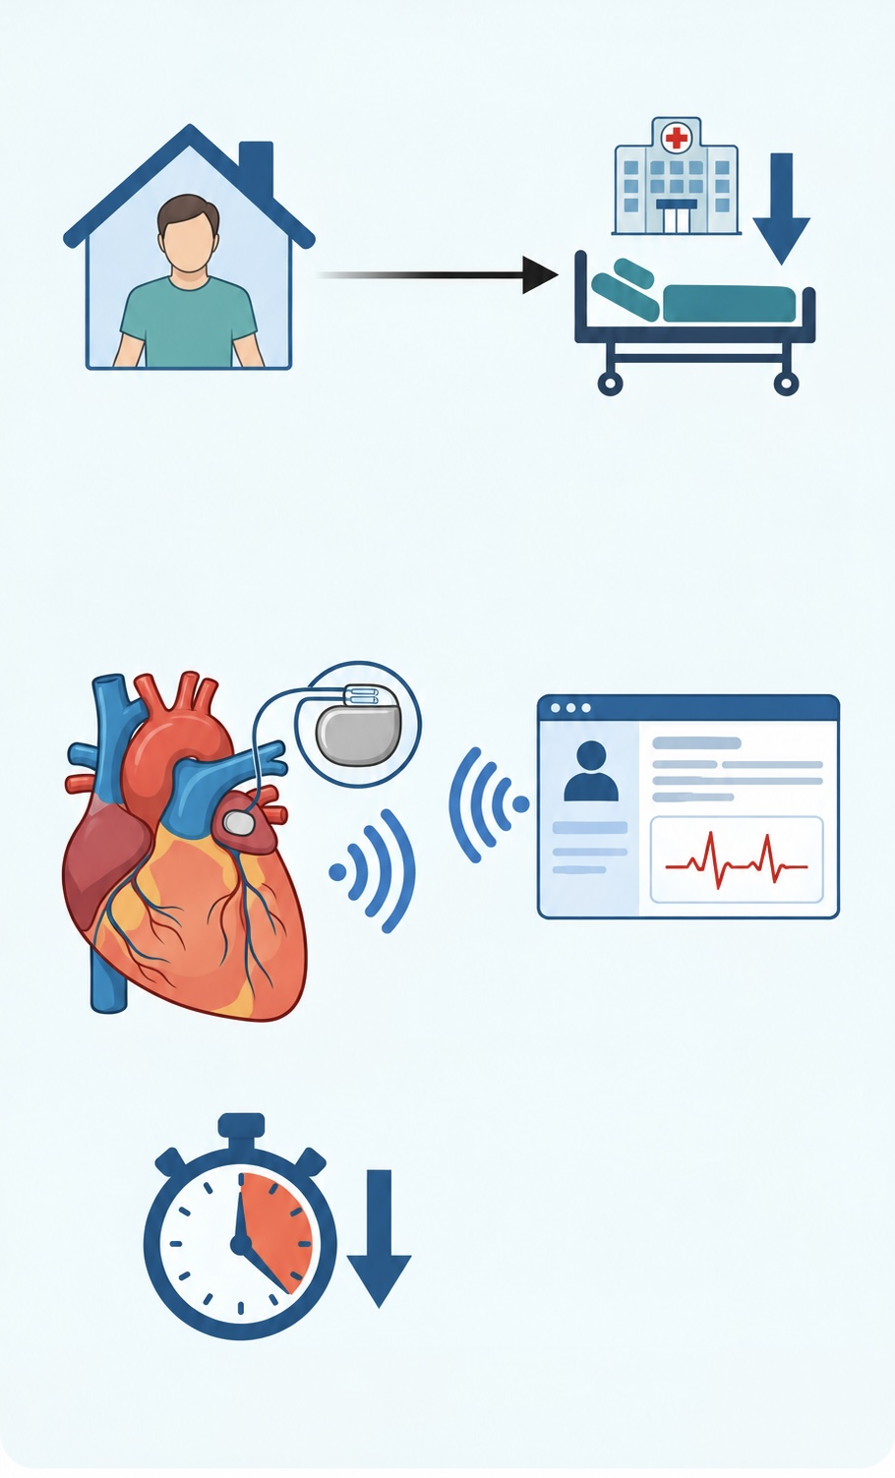
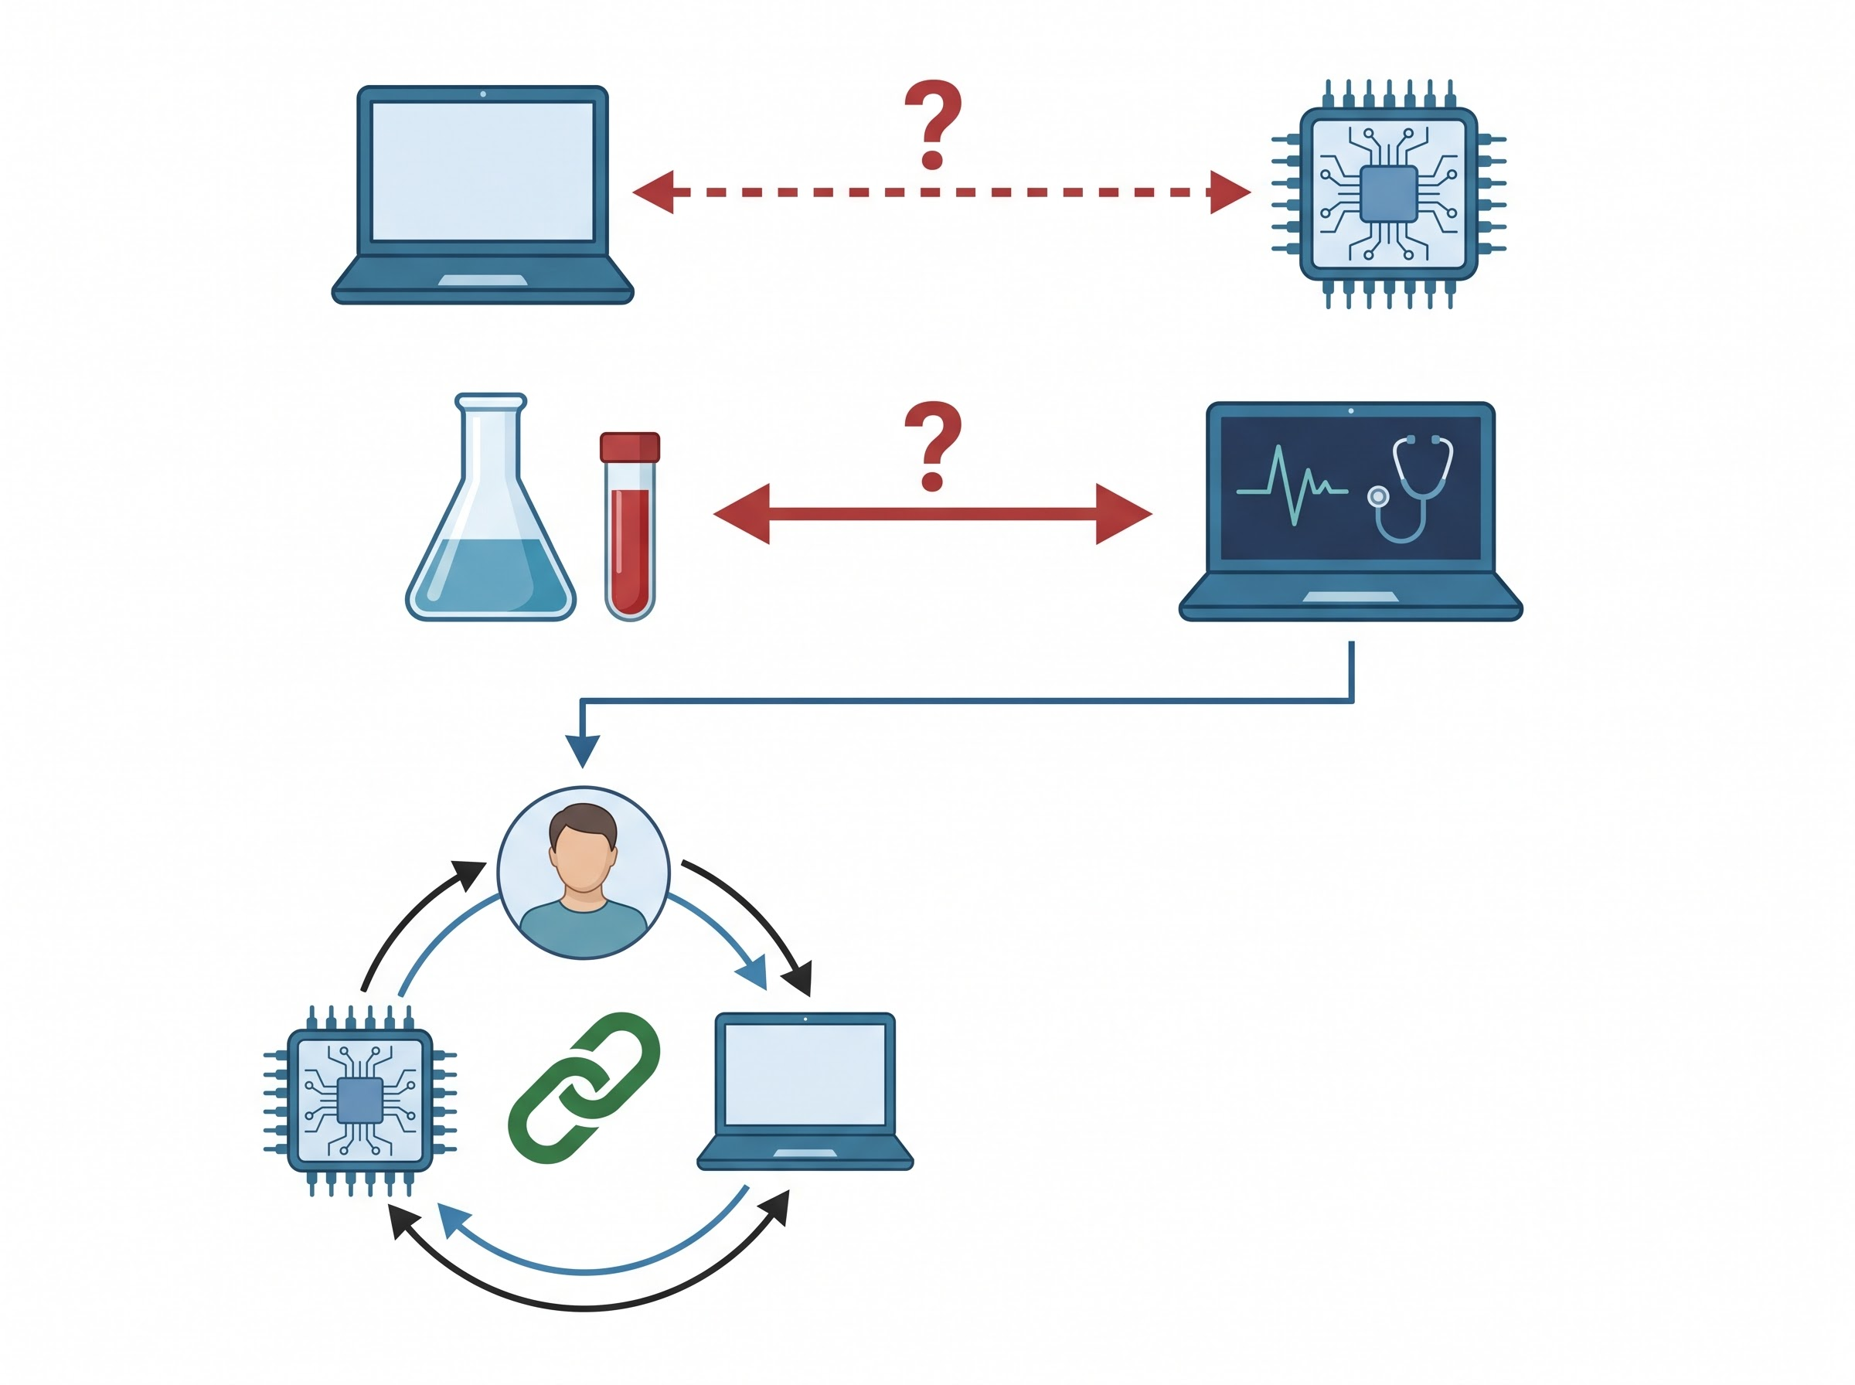
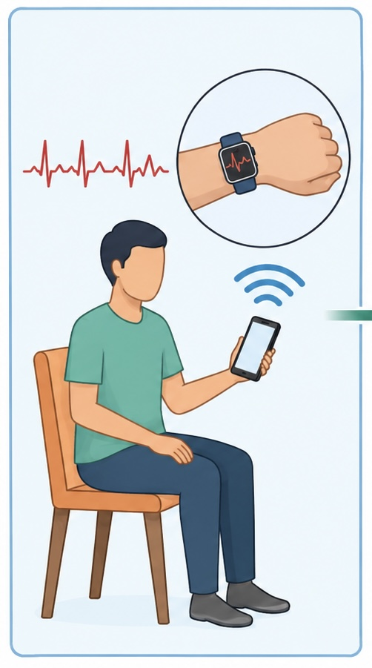


if available
Code: 1438
Integration of Artificial Intelligence and Telemedicine for Atrial Fibrillation Detection and Remote Monitoring: A Review of Current Evidence
MohammadHossein Asghari1, Samira Shariati Najafabadi (1,2
1.Department of Medicine, Na.C., Islamic Azad University, Najafabad, Iran
Clinical Research Development Center, Na.C., Islamic Azad University, Najafabad, Iran
Backgrounds
Findings
Conclusion
Atrial fibrillation (AF) is the most prevalent cardiac arrhythmia and is associated with substantial risks of heart failure. Artificial intelligence (AI) has showed potential to improve the AF detection (1, 2). Meanwhile, telemedicine has facilitated continuous patient remote monitoring and may reduce unnecessary hospitalizations (3, 4). Existing studies haven’t reviewed these technologies comprehensively. This review aimed to evaluate existing evidence on integration of AI and telemedicine in diagnosing and remote monitoring AF, to identify gaps in the combination of these two approaches.
AI algorithms, specifically deep learning models applied to data from wearable Electrocardiograph devices, have shown high sensitivity for AF diagnosis and have been superior to traditional methods in some studies (1, 2, 5). Telemedicine virtual wards have shown potential for reducing hospitalizations (3). Also, AI-assisted remote monitoring of implantable cardiac devices has reduced the time to diagnosis (4). Despite these advances, most telemedicine models do not fully use AI-based predictive tools. Moreover, AI-based studies have not focused enough on the real-world implementation of telemedicine, highlighting the need for integrated care models (5).
Integrating the diagnostic capabilities of AI with telemedicine-based monitoring may improve early detection and outpatient management of AF. Future studies should focus on prospective evaluation of AI-telemedicine platforms in actual clinical settings.
Gaps & needed Integration
Prospective Clinical Evaluation
Deep Learning on Wearable vs. Traditional
Telemedicine and Implantable Devices
Evaluation in Actual Clinical Settings
Virtual Wards
Underutilized
Future Research
Actual clinical Setting
Traditional Holter Monitoring
Introduction : Intelligent AFIB Management
Wearable Smartwatch
AI diagnostic core
Telemedicine
Data collection
Autonomous Analysis
Informed care
Telemedicine platform
AI Predictive Tools
Early AF Detection
Outpatient management
Future Prospective studies
Wearable Devices
Cloud Server
Home
Reducing Hospitalization
No Predictors
Next Step
Irregular ECG
Patient Dashboard
Real-World Gaps
Atrial Fibrillation
Early Recognition ✅
Patient App
Data
Analysis
Implantable Devices (CIEDs)
Clinical Telemedicine
Self home-based care / no hospital visit needed
Lab/Studies
Minimized Admissions
On-site Platform Evaluation
Patient-Centered Outcomes
AI Cloud Analysis
(Deep Learning)
The goal : integrated care impact
The future : Real-Word Evidence
Patient at Home with AFib
Telemedicine & AI Analysis
Clinical/ Virtual Ward
AI-Assisted remote monitoring
Remote Clinical Team
AI High Sensitivity for AF
Patient
Methods
References
A narrative review was conducted by searching major scientific databases, such as PubMed. The search was performed using keywords related to atrial fibrillation, artificial intelligence, and telemedicine.
Superior to Traditional Methods
Reduced Time to Diagnosis
AI
Telemedicine
1. Khaja S, Baijoo K, Aziz R. Artificial intelligence-powered advancements in atrial fibrillation diagnostics: a systematic review. The Egyptian Heart Journal.
Deep Learning AI Model
Integrated Care Models Needed

