Slide 1

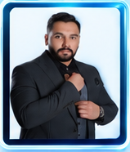
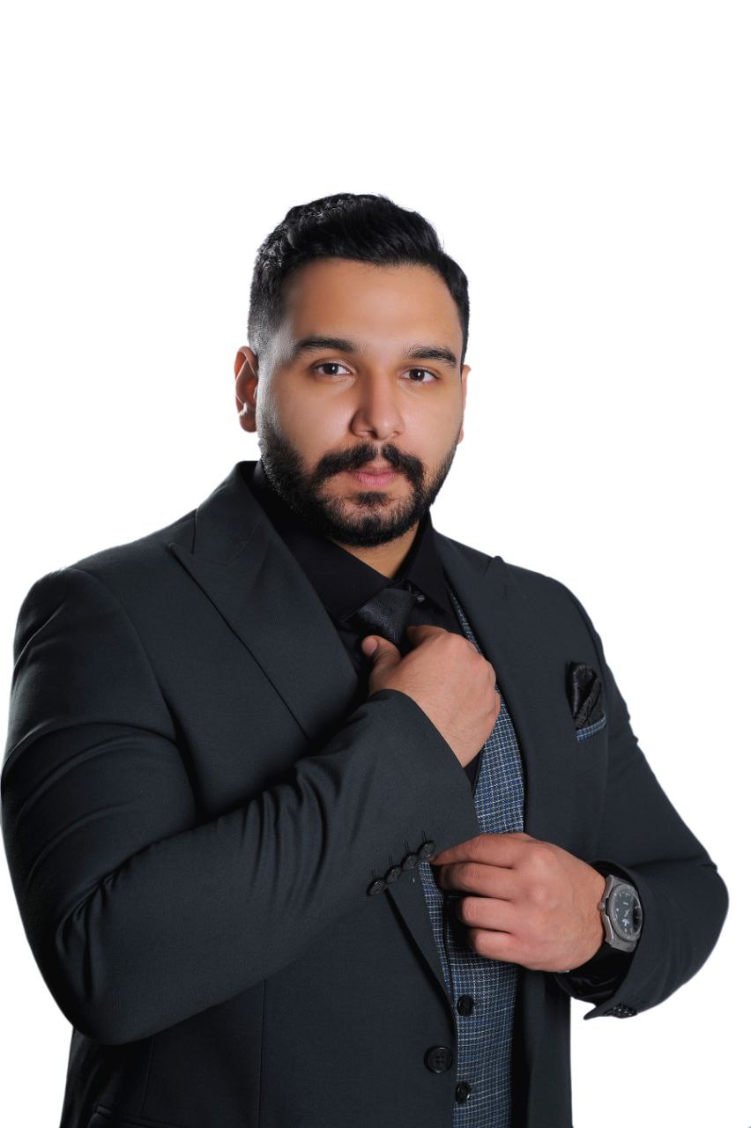



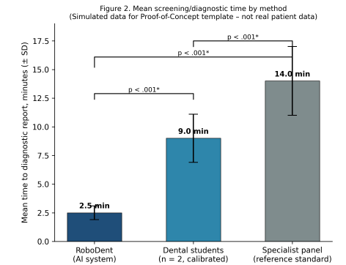

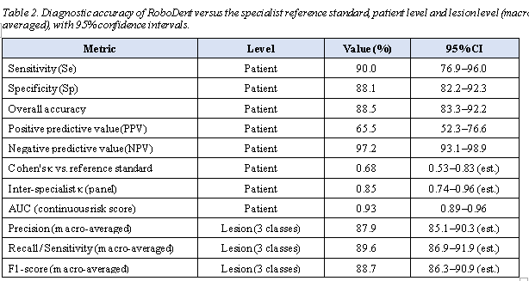
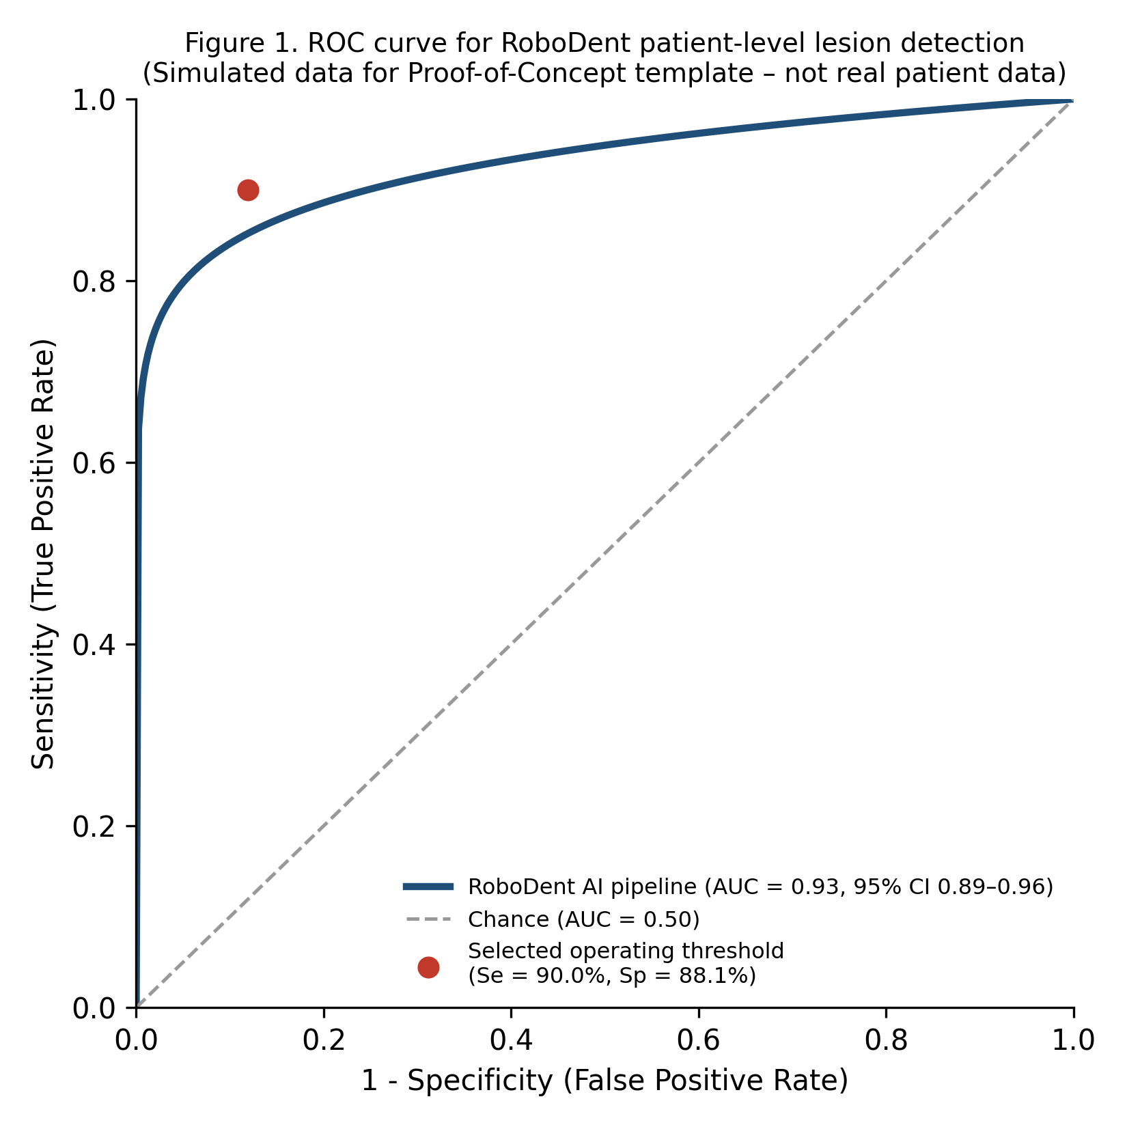

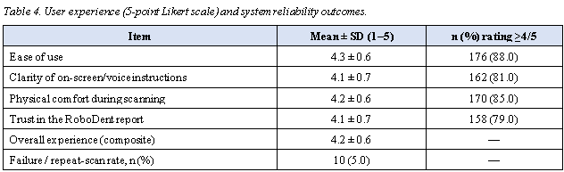
Parham Farzam1, Amirmansour Shirani2, Danoush Dehghanian3*
1 Department of Diagnostic Sciences, School of Dentistry, Islamic Azad University, Isfahan (Khorasgan) Branch, Isfahan, Iran
2 Department of Oral and Maxillofacial Pathology, School of Dentistry, Islamic Azad University, Isfahan (Khorasgan) Branch, Isfahan, Iran
3 Department of Oral Health and Community Dentistry, School of Dentistry, Islamic Azad University, Isfahan (Khorasgan) Branch, Isfahan, Iran
Oral diseases remain among the most prevalent noncommunicable conditions worldwide, yet access to timely screening is limited outside clinical settings. RoboDent is a domestically developed, artificial-intelligence-powered kiosk that combines an intraoral camera with a convolutional neural network pipeline (ResNet50 and EfficientNet backbones) to screen for intraoral lesions without requiring a dentist to be present. Its diagnostic accuracy against a specialist reference standard has not previously been evaluated in a real clinical population. To determine the accuracy and efficiency of RoboDent in detecting dental caries, periodontal/mucosal soft-tissue lesions, and other intraoral pathology, relative to a panel of oral medicine specialists, in a prospective Proof-of-Concept (PoC) study.
Simulated, internally consistent placeholder results (not real patient data) were generated to populate this PoC template. At the patient level (reference-standard lesion prevalence 20.0%, 40/200), RoboDent achieved a sensitivity of 90.0% (95% CI 76.9–96.0), specificity of 88.1% (95% CI 82.2–92.3), overall accuracy of 88.5% (95% CI 83.3–92.2), positive predictive value of 65.5%, negative predictive value of 97.2%, Cohen's kappa of 0.68 against the reference standard, and an AUC of 0.93 (95% CI 0.89–0.96). At the lesion level, macro-averaged precision was 87.9%, recall 89.6%, and F1-score 88.7%.
RoboDent completed screening in a mean of 2.5 (SD 0.6) minutes, versus 9.0 (SD 2.1) minutes for dental students and 14.0 (SD 3.0) minutes for the specialist reference examination (all pairwise comparisons p < .001). Mean user-experience score was 4.2/5 (SD 0.6), and the image-quality failure rate was 5.0%.
In this simulated PoC template, the RoboDent system shows the pattern of diagnostic performance and time-efficiency that would be needed to support its use as an autonomous first-line intraoral screening and triage tool. These placeholder findings illustrate the analysis plan only; a prospective clinical study with real, specialist-verified data, independent of the device-development team, is required before any accuracy claim can be made.
In this prospective, single-centre, blinded diagnostic accuracy PoC study, adults attending the Dental Faculty of Islamic Azad University, Isfahan (Khorasgan) were screened sequentially by RoboDent, by two calibrated dental students, and by a reference panel of faculty oral-medicine specialists (index test and reference standard interpreted independently and blinded to each other). Sample size (n = 200) was calculated using the Buderer method for an expected sensitivity of 90%, specificity of 87%, an assumed lesion prevalence of 20%, 95% confidence, and an absolute margin of error of 10 percentage points, inflated for 10% anticipated non-completion. Patient-level diagnostic accuracy (sensitivity, specificity, accuracy, predictive values, Cohen's kappa, area under the receiver-operating-characteristic curve [AUC]) and lesion-level multiclass performance (precision, recall, F1-score, macro-averaged across caries, periodontal/hard-tissue, and mucosal/soft-tissue categories) were computed. Screening time and a 5-point Likert user-experience score were compared across the three methods.
1. World Health Organization. Global oral health status report: towards universal health coverage for oral health by 2030. Geneva: World Health Organization; 2022.
2. Peres MA, Macpherson LMD, Weyant RJ, Daly B, Venturelli R, Mathur MR, et al. Oral diseases: a global public health challenge. Lancet. 2019;394(10194):249–260.
3. Pitts NB, Zero DT, Marsh PD, Ekstrand K, Weintraub JA, Ramos-Gomez F, et al. Dental caries. Nat Rev Dis Primers. 2017;3:17030.
4. Listl S, Galloway J, Mossey PA, Marcenes W. Global economic impact of dental diseases. J Dent Res. 2015;94(10):1355–1361.
5. Schwendicke F, Samek W, Krois J. Artificial intelligence in dentistry: chances and challenges. J Dent Res. 2020;99(7):769–774.

