Slide 1


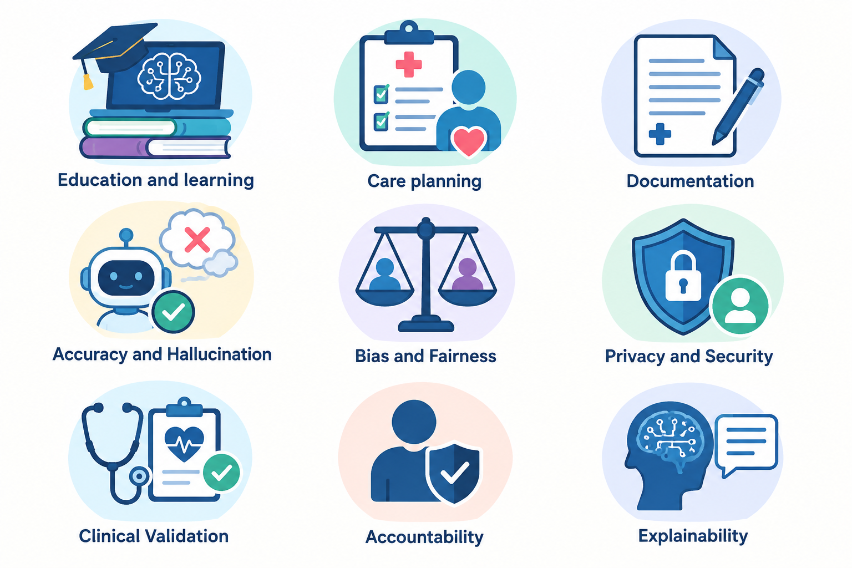

Large Language Models in Nursing Practice:
Opportunities, Risks, and Future Directions
Author’s photo
Code: 1539
Melika Hosseini*,¹ Mansoureh Ashghali Farahani² Anita Pouzesh³
¹ Student Research Committee, School of Nursing and Midwifery, Iran University of Medical Sciences, Tehran, Iran
² Nursing and Midwifery Care Research Center, Health Management Research Institute, School of Nursing and Midwifery, Iran University of Medical Sciences, Tehran, Iran
³ Student Research Committee, School of Nursing and Midwifery, Iran University of Medical Sciences, Tehran, Iran
Backgrounds
Findings
Clinical validation
LLMs are entering nursing education, care planning, documentation, communication, and decision-support workflows. By generating and transforming clinical language, they may standardize information, reduce repetitive tasks, tailor education, and assist parts of the nursing process. Their clinical use also raises concerns about accuracy, bias, privacy, explainability, and accountability.
The literature points to useful augmentation across the nursing workflow — but with human oversight at every high-stakes step.
Where the evidence is promising — and where caution is required
Evidence for patient outcomes and real-world utility remains limited, creating a need for prospective, multisite evaluation.
Accuracy & hallucination
Conclusion
1 Education & learning
Generated text can contain omissions, misleading statements, or unsafe recommendations; nurse verification is required.
Interactive tutoring, curriculum support, critical-thinking prompts, and simulation of complex clinical scenarios are promising uses. Educators remain central to validation and responsible use.
What responsible adoption looks like
Explainability
• Use LLMs as supervised augmentation tools within nurse-led, evidence-based workflows.
• Require human verification before clinical recommendations, documentation, or patient-facing content is acted upon.
• Disclose AI involvement and use privacy-preserving data practices.
• Provide competency-based education, local validation, monitoring, and clear accountability.
Why this matters
A critical caveat
The pathway from input to output may be difficult to interpret; transparent disclosure of AI involvement supports safer use.
LLMs may help organize assessment information, identify care-plan gaps, support handover and documentation, and create interactive learning experiences for nurses and students.
Outputs remain probabilistic and may be incomplete or misleading. Key concerns include bias, privacy, explainability, and accountability—especially when outputs affect care.
2 Care planning & support
LLMs may assist with assessment interpretation, nursing diagnoses, care-plan drafting, identifying gaps, communication, and professional development. Structured prompts and standardized terminology may improve consistency.
Bias & fairness
Model outputs may reproduce or amplify bias; fairness should be considered during selection, testing, and monitoring.
References
Accountability
Methods
1. Rodrigues D, Cruz-Correia R. Stud Health Technol Inform. 2024;316:1024–1028. doi:10.3233/SHTI240584.
2. Nashwan AJ, Abujaber A. Cureus. 2023;15:e40542. doi:10.7759/cureus.40542.
3. Song J, Liu W, Wang Y, et al. Comput Inform Nurs. 2025;43(9):e01328. doi:10.1097/CIN.0000000000001328.
4. Michalowski M, Topaz M, Peltonen LM. J Adv Nurs. 2025;82(1):907–912. doi:10.1111/jan.16911.
5. Cao Y, Hu L, Cao X, Peng J. BMC Nurs. 2025;24:394. doi:10.1186/s12912-025-03010-2.
3 Documentation & workflow
Responsibility for patient care cannot be delegated to a probabilistic model; roles and escalation pathways should be explicit.
Narrative review of recent scientific literature published between 2023 and 2026.
2 Care planning & support
Multimodal LLMs could combine audio, video, and structured data to support real-time records, interoperability, and smoother workflows, potentially reducing repetitive manual entry.
Privacy & security
2023
2024
2025
2025
Clinical information must be handled using privacy-preserving practices and appropriate governance.
Care planning & ethics
[2]
Nursing education
[1]
Clinical nursing
[3,5]
Documentation vision
[4]

