Slide 1
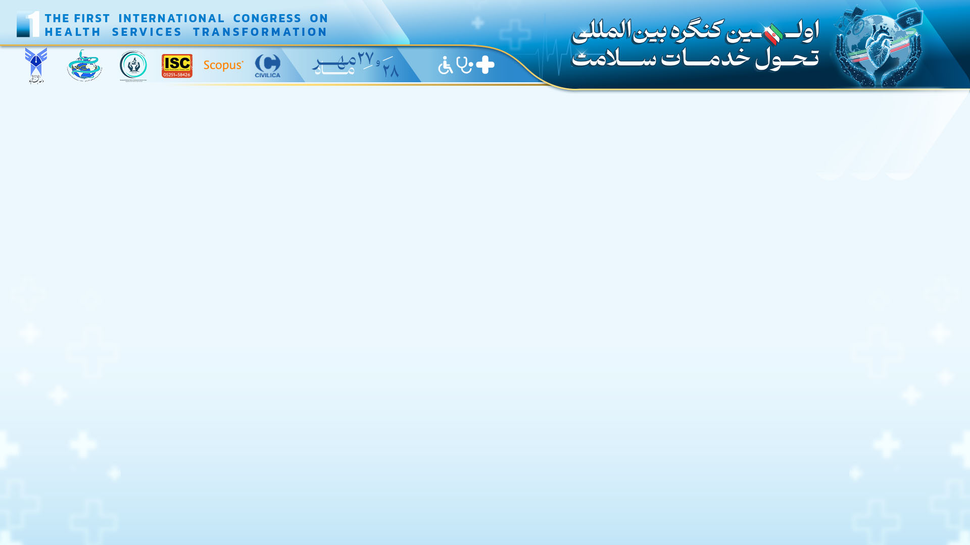

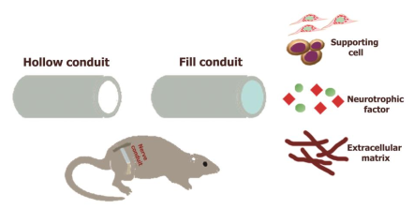
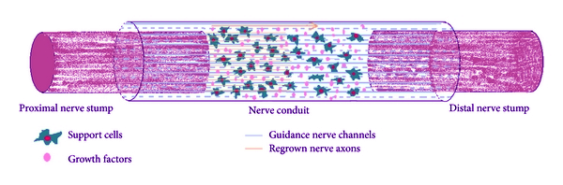
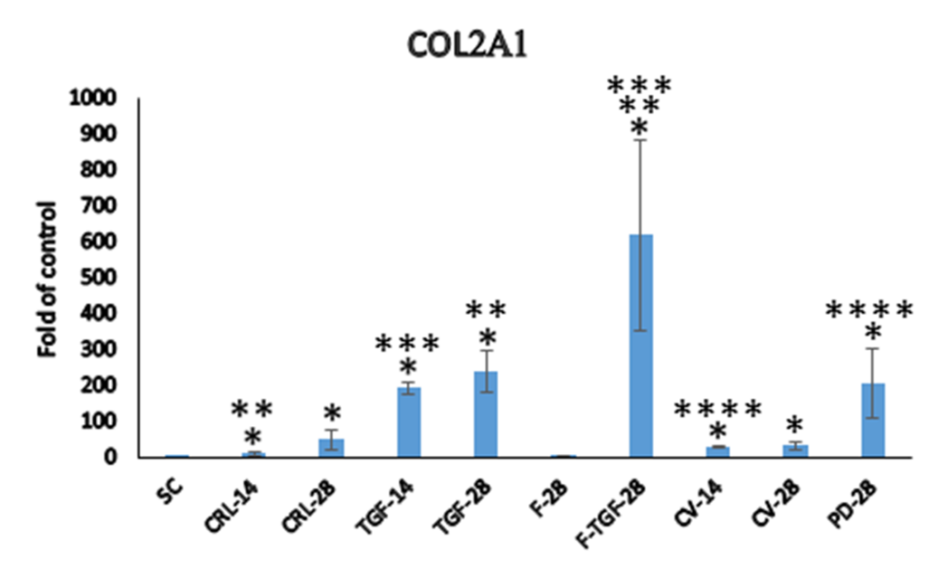
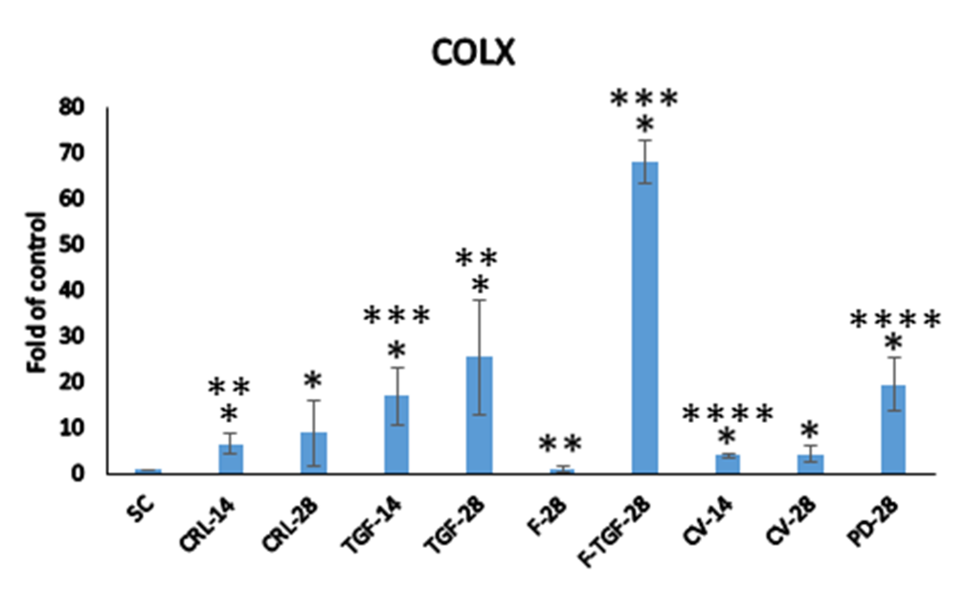

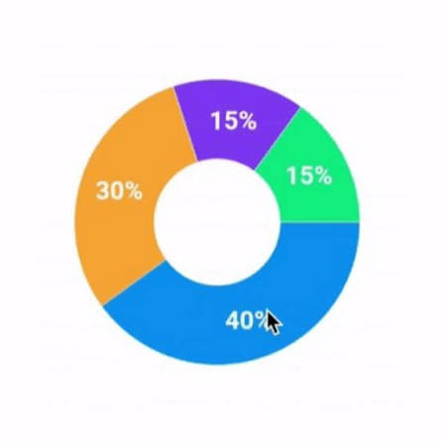
IRCT20240513061776N1
RCT
82 women
2-month follow-up
The Effect of Self-Management Training Based on the 5As Model on Sexual Satisfaction in Iranian Women
Zahra Haghighi¹, Ashraf Kazemi², Marjan Beigi²˒³*
¹ Student Research Committee, Faculty of Nursing and Midwifery, Isfahan University of Medical Sciences, Isfahan, Iran
² Department of Midwifery and Reproductive Health, Faculty of Nursing and Midwifery, Isfahan University of Medical Sciences
³ Reproductive Sciences and Sexual Health Research Center | *Corresponding author: beigi@nm.mui.ac.ir
5As self-management: education, collaboration, and follow-up
BACKGROUND & OBJECTIVE
KEY FINDINGS
CONCLUSION
Sexual satisfaction contributes to sexual health, relationship quality, and overall wellbeing. Educational approaches that change attitudes and behavior may provide sustainable benefits.
The 5As model supports behavior change through five linked actions: Assess, Advise, Agree, Assist, and Arrange.
Objective
To determine whether self-management training based on the 5As model improves sexual satisfaction among Iranian women of reproductive age.
Two months after the intervention, women receiving the 5As program reported substantially higher sexual satisfaction than controls.
The participatory model can support educational and counseling programs in health centers. Longer follow-up and cost-effectiveness studies are needed before broad implementation.
METHODS
Design: Randomized clinical trial
Participants: 84 married women aged 15–49; 82 completed follow-up
Allocation: Intervention (n=40) and control (n=42)
Intervention: Individualized education using Assess, Advise, Agree, Assist, and Arrange
Outcome: Larson Sexual Satisfaction Questionnaire (25–125)
Analysis: Independent and paired t tests; ANCOVA; α=0.05
Ethics: IR.MUI.REC.1403.033
KEY REFERENCES
Adjusted between-group difference after intervention: 24.09 points (95% CI 19.94–28.24), p<0.001, η²=0.805
All women in the intervention group reached the high-satisfaction category after training; none in the control group did. The intervention group improved by 24.06 points (p<0.001), while the control group showed no significant change (p=0.17).
1. Rausch D, Rettenberger M. Sex Med Rev. 2021;9:365–380.
2. Mirian Z, et al. Sci Rep. 2023;13:11316.
3. Bahrami N, et al. J Kerman Univ Med Sci. 2016;23:344–356.
Funding: Isfahan University of Medical Sciences
Clinical trial registration: IRCT20240513061776N1

