Slide 1


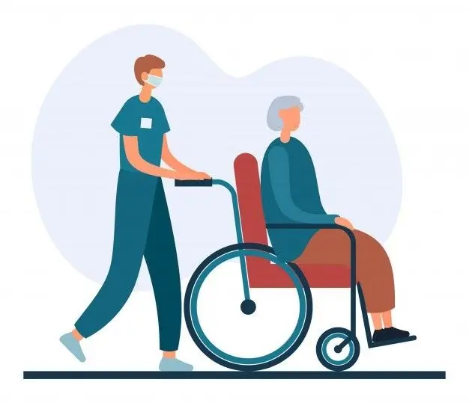

if available
Effectiveness of Telerehabilitation in Older Adults After Hip Fracture Surgery: A Scoping Review
Code: 1352
Behnaz Farahmand Fard¹, Negar Esmaeelzadeh*¹, Ali Gholami Fadardi²
1. Department of Nursing, School of Nursing and Midwifery, Torbat Heydariyeh University of Medical Sciences, Torbat Heydariyeh, Iran
2. Department of Nursing, School of Nursing and Midwifery, Shahid Beheshti University of Medical Sciences, Tehran, Iran
Backgrounds
Findings
Conclusion
Hip fracture is a leading cause of disability and functional decline in older adults. Telerehabilitation can improve access and continuity of care post-discharge. This scoping review mapped the evidence on the effectiveness of telerehabilitation in older adults following hip fracture surgery.
Interventions included synchronous video exercises, phone/web-based programs, mobile applications, and remote monitoring. Telerehabilitation was generally associated with improved ADL, treatment adherence, and patient satisfaction, showing functional outcomes comparable to conventional rehabilitation. However, effects on mobility, gait, balance, and pain were inconsistent. Substantial heterogeneity was noted across protocols and outcome measures.
Telerehabilitation is a feasible complement or alternative to conventional care following hip fracture surgery; however, standardized protocols and long-term trials are warranted.
Methods
This methodological scoping review was conducted according to the Arksey and O’Malley framework and reported using the PRISMA-ScR guidelines. PubMed, Scopus, Web of Science, CINAHL, and Google Scholar were searched for English-language studies published between 2016 and 2026. Of 845 records identified, 14 studies met the inclusion criteria. Data were extracted and synthesized descriptively.
References
Xiao, H., Zeng, W., Lu, L., Yuan, J., Yan, Z., & Wang, J. (2025). Effectiveness of telerehabilitation in postoperative outcomes in patients on hip fracture surgery: a meta-analysis of randomized controlled trials. BMC Sports Science, Medicine and Rehabilitation, 17(1), 130.‏

