Slide 1



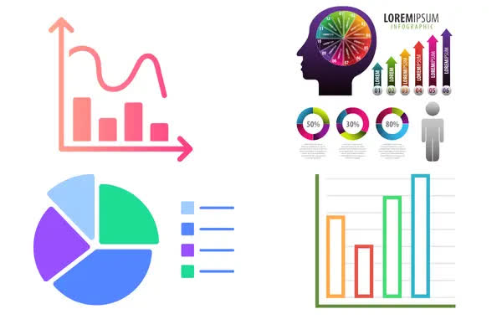
if available
Code: 1353
Effectiveness of Digital Health Interventions in Promoting Self-Management, Quality of Life, and Mental Health Among Older Adults with Chronic Diseases: A Scoping Review
Negar Esmaeelzadeh¹, Behnaz Farahmand Fard*¹
1. Department of Nursing, School of Nursing and Midwifery, Torbat Heydariyeh University of Medical Sciences, Torbat Heydariyeh, Iran
Backgrounds
Findings
Conclusion
The increasing burden of chronic diseases among older adults highlights the need for accessible and sustainable self-management support. Digital health interventions may improve communication with healthcare providers, promote self-care, and support psychosocial well-being. This scoping review mapped the evidence on the effects of digital health interventions on self-management, quality of life and mental health among older adults with chronic diseases.
Interventions included mobile health applications, telehealth, wearable devices, telemonitoring and technology-supported education. The evidence generally suggested improvements in self-efficacy, medication management, symptom monitoring, quality of life and selected psychological outcomes. However, effects varied according to intervention content, digital literacy, usability, patient engagement and integration with routine care. Common barriers included cognitive and sensory limitations, low digital health literacy, limited access to devices or the internet and age-unfriendly interface design.
Digital health interventions may support self-management and improve quality of life and mental health among older adults with chronic diseases. Age-friendly design, digital-literacy training, caregiver support and integration with professional care should be prioritized.
Methods
This methodological scoping review was conducted according to the Joanna Briggs Institute framework and reported using the PRISMA-ScR guideline. PubMed, Scopus, Web of Science, CINAHL, were searched for English- and Persian-language studies published between 2018 and 2026.keywords: Aged, Chronic Disease, Digital Health, Telemedicine, Self-Management, Quality of Life and Mental Health.
References
Hu, E., Wang, H., Yao, J., Liao, M., & Chen, W. (2025). Impact of digital health interventions on quality of life and mental health in older adults with chronic diseases: a systematic review and meta-analysis. Frontiers in Aging, 6, 1737277.‏

