Slide 1




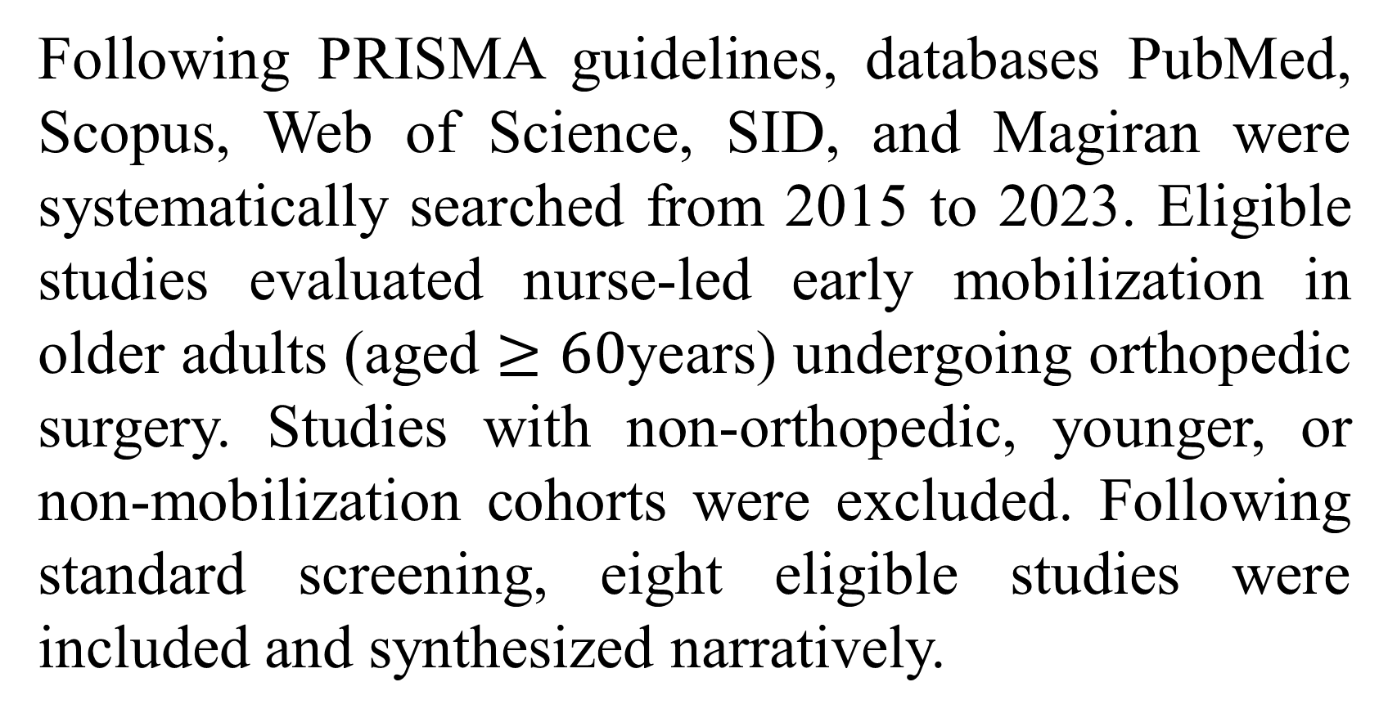
if available
Code: 1354
The Role of Nursing Interventions in Early Mobilization of Older Adults Following Orthopedic Surgery: A Systematic Review of Functional Outcomes and Postoperative Complications
Behnaz Farahmand Fard¹, Negar Esmaeelzadeh*¹, Ali Gholami Fadardi²
1. Department of Nursing, School of Nursing and Midwifery, Torbat Heydariyeh University of Medical Sciences, Torbat Heydariyeh, Iran
2. Department of Nursing, School of Nursing and Midwifery, Shahid Beheshti University of Medical Sciences, Tehran, Iran
Backgrounds
Findings
Conclusion
Nursing interventions are central and pivotal to the safe and effective delivery of early mobilization in geriatric orthopedic care, directly mitigating postoperative morbidity and functional dependency. To bridge the gap between evidence and clinical practice, healthcare systems should implement standardized, individualized, and nurse-led multidisciplinary mobilization protocols. Such structured pathways, reinforced by ongoing nursing assessments, are essential to optimize recovery trajectories and improve quality of life in this vulnerable population.
Orthopedic surgery in older adults often leads to functional decline and complications. This systematic review evaluated the role of nursing interventions in early mobilization and their impact on functional outcomes and postoperative complications in older orthopedic patients.
Nursing interventions primarily encompassed multimodal pain management, hemodynamic and fall-risk monitoring, progressive ambulation, patient education, and multidisciplinary coordination. Early mobilization significantly enhanced functional recovery, mobility, and activities of daily living (ADL), while reducing hospital length of stay.
Methods
Following PRISMA guidelines, databases PubMed, Scopus, Web of Science, SID, and Magiran were systematically searched from 2015 to 2023. Eligible studies evaluated nurse-led early mobilization in older adults (aged $≥60$years) undergoing orthopedic surgery. Studies with non-orthopedic, younger, or non-mobilization cohorts were excluded. Following standard screening, eight eligible studies were included and synthesized narratively.
References
Sarkies, M. N., Testa, L., Carrigan, A., Roberts, N., Gray, R., Sherrington, C., ... & Sheehan, K. (2023). Perioperative interventions to improve early mobilisation and physical function after hip fracture: a systematic review and meta-analysis. Age and ageing, 52(8), afad154.‏
Decreased incidences of thromboembolic, pulmonary, cognitive (delirium), and pressure injury complications were reported, though variations existed based on surgical type and timing.

