Slide 1



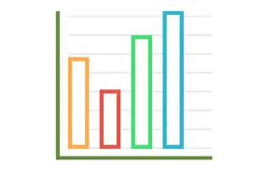
if available
Code: 1355
Barriers and Facilitators of Digital Health Technologies Adoption in Older Adults with Chronic Diseases: An Integrative Review of Evidence
Negar Esmaeelzadeh¹, Behnaz Farahmand Fard*¹
1. Department of Nursing, School of Nursing and Midwifery, Torbat Heydariyeh University of Medical Sciences, Torbat Heydariyeh, Iran
Backgrounds
Findings
Conclusion
Digital health technologies offer substantial potential to enhance independence and self-management in chronic patients; however, their adoption among the older population faces unique challenges. This study aimed to synthesize existing evidence regarding the barriers and facilitators of digital health technology adoption in older adults with chronic diseases.
Among the 11 included studies, key barriers were categorized into four dimensions: individual (low digital health literacy, cognitive decline), technological (poor user interface design, system complexity), economic (equipment costs), and psychological (privacy concerns, resistance to change). Conversely, major facilitators included perceived usefulness, continuous support from family and caregivers, older-adult-centered user design, and personalized training.
Digital interventions are highly effective tools in community health nursing for empowering older adults in chronic disease management. To maximize clinical and psychological benefits, future interventions must prioritize age-friendly designs and provide adequate digital literacy training for the elderly.
Methods
References
This integrative review was conducted based on the Whittemore and Knafl methodological framework. A comprehensive search was performed in PubMed, Scopus, and Web of Science databases from 2021 to 2026 using a MeSH-based search strategy. The methodological quality of included studies was appraised using the Mixed Methods Appraisal Tool (MMAT), and data were synthesized using thematic analysis.
Bertolazzi, A., Quaglia, V., & Bongelli, R. (2024). Barriers and facilitators to health technology adoption by older adults with chronic diseases: an integrative systematic review. BMC public health, 24(1), 506.‏

