Slide 1


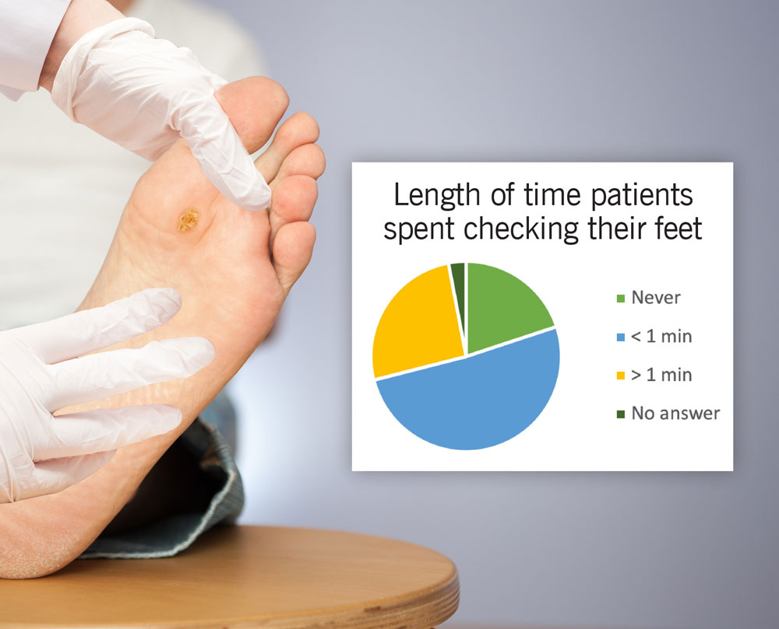

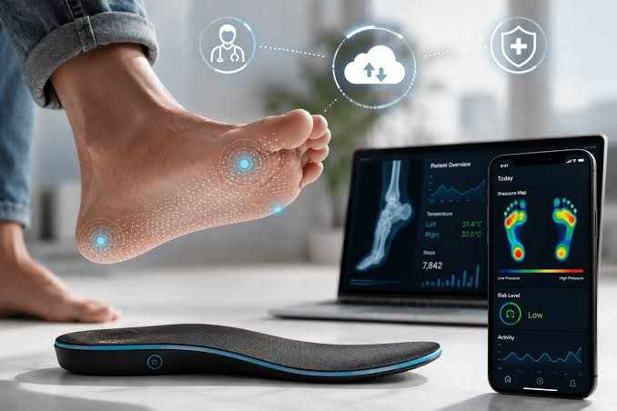
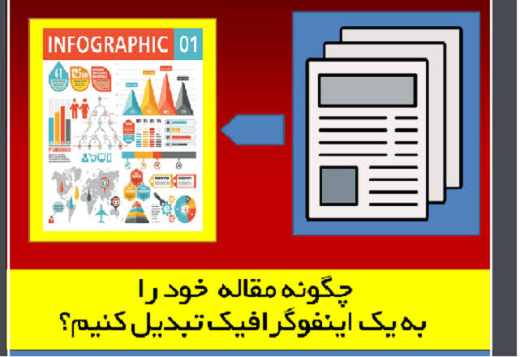
if available
Nurses’ Perspectives on Artificial Intelligence for Diabetic Foot Ulcer Management: A Structured Narrative Review
Code: 1493
Behnaz Farahmandfard¹, Kheizaran Miri², Negar Esmaeelzadeh³, Ali Gholamifadardi⁴, Alireza Sardashti*⁵
1. School of Nursing and Midwifery, Torbat Heydariyeh University of Medical Sciences, Torbat Heydariyeh, Iran
2. Assistant Professor of Nursing, School of Nursing and Midwifery, Torbat Heydariyeh University of Medical Sciences, Torbat Heydariyeh, Iran
3. School of Nursing and Midwifery, Torbat Heydariyeh University of Medical Sciences, Torbat Heydariyeh, Iran
4. Department of Nursing, School of Nursing and Midwifery, Shahid Beheshti University of Medical Sciences, Tehran, Iran
5. Master of Science Student in Nursing, BSc, Student Research Committee, Torbat Heydariyeh University of Medical Sciences, Torbat Heydariyeh, Iran
Backgrounds
Findings
Conclusion
Diabetic foot ulcer (DFU) is a common, chronic, and costly complication of diabetes. While Artificial Intelligence (AI) is increasingly applied in wound assessment, monitoring, and clinical decision support, evidence regarding nurses’ perceptions and their actual usage of these technologies in DFU care remains limited.
The selected studies examined multisensory screening systems, AI-based wound monitoring applications, and generative AI models. From a nursing perspective, AI is perceived as beneficial for wound assessment, facilitating early risk detection, tracking wound progression, and reducing documentation burdens. However, concerns were raised regarding image quality, usability, integration with electronic health records (EHR), infection control, maintenance costs, reliability, and the potential for inaccurate or outdated outputs from generative AI.
AI can support nursing assessment and clinical decision-making in DFU care; however, current evidence is limited and heterogeneous. Future implementation should prioritize human oversight, clinical validation, data quality, and continuous verification of AI-generated outputs.
Methods
A structured narrative review was conducted across PubMed, Scopus, Web of Science, CINAHL, and the Scientific Information Database (SID). The search strategy included keywords related to diabetic foot ulcers, AI, machine learning, and nursing workflow. From 118 studies published between 2020 and 2026, three studies met the predetermined inclusion criteria after methodological quality assessment using the Critical Appraisal Skills Programme (CASP) and Joanna Briggs Institute (JBI) tools.
References
Ding, D., Alhaskawi, A. H., Shen, J., Yang, M., Liu, Y., He, L., ... & Lu, H. (2026). Nursing Roles in Diabetic Foot Ulcer Prevention, Wound Management, and Digital Monitoring. Journal of Visualized Experiments (JoVE), (235), e71452.‏

