Slide 1
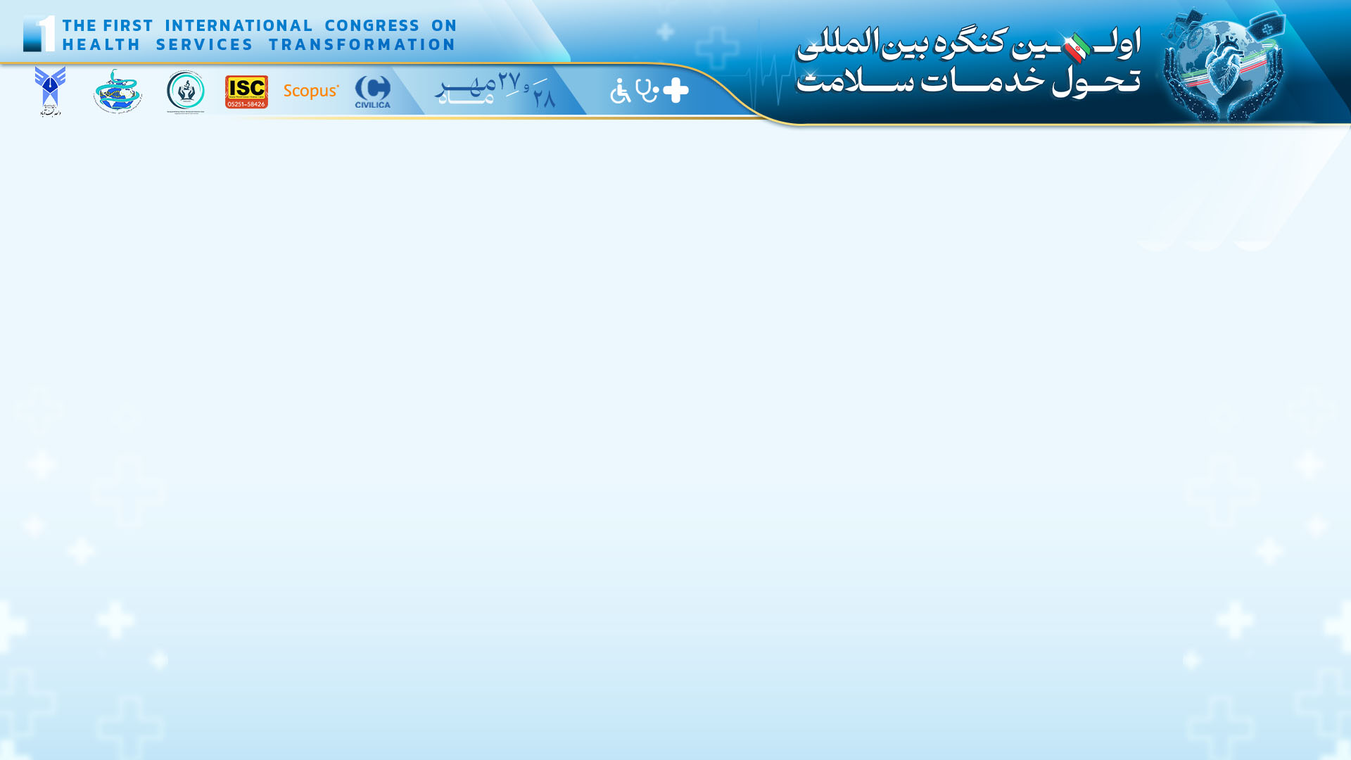
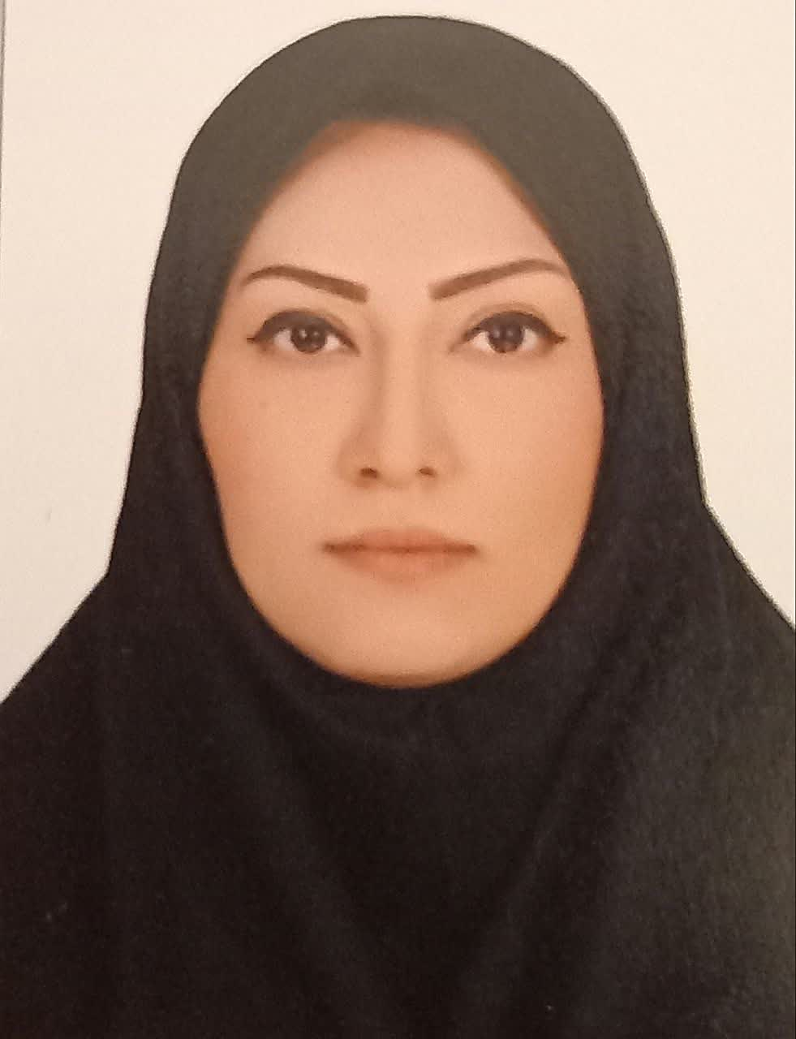
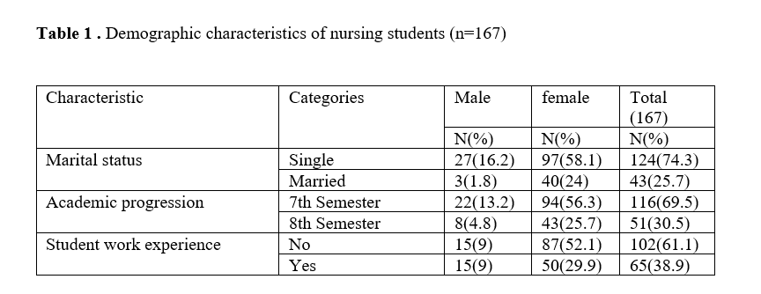
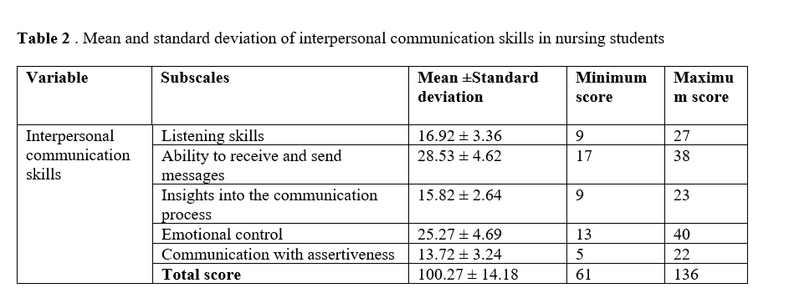
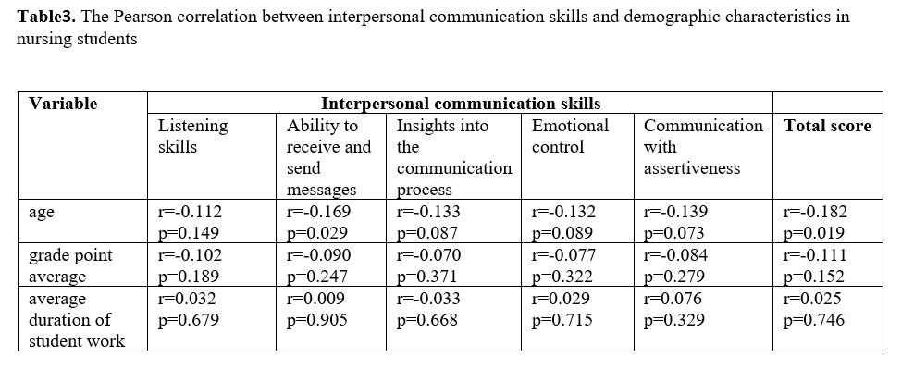
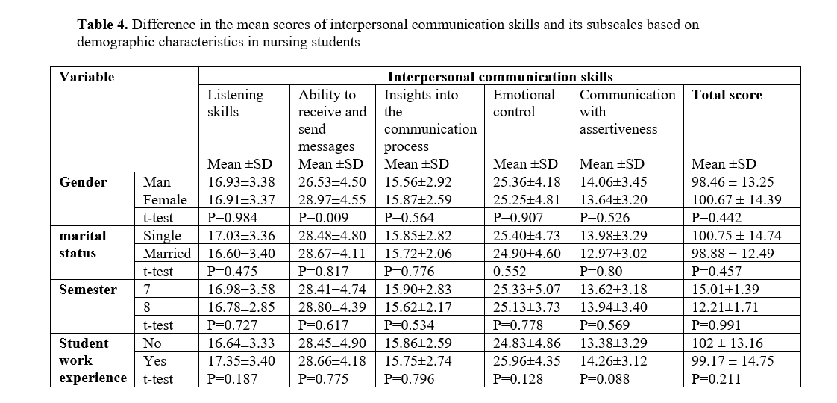
if available
Interpersonal Communication Skills of Nursing Students:
A Cross-Sectional Study during the COVID-19 Pandemic
Code:1649
Sharareh Zeighami Mohammadi¹
Clinical Cares and Health Promotion Research Center, Ka.C., Islamic Azad University, Karaj, Iran. 0000-0002-8738-9551, Tel:+98(912)5680679, Email: zeighami@kiau.ac.ir
Backgrounds
Findings
Conclusion
Assessing the interpersonal communication skills of nursing students during the COVID-19 pandemic enables us to understand their communication challenges and needs in crises and devise appropriate solutions to address them effectively.
Objectives: This study aimed to determine the interpersonal communication skills of nursing students in Islamic Azad University, Karaj Branch, amidst the COVID-19 pandemic.
More than half (53.3%) of nursing students had moderate interpersonal communication skills. The lowest mean was related to communication with assertiveness13.72 ± 3.24, while the highest mean was related to the ability to receive and send messages 28.53 ± 4.62. A weak significant inverse correlation was found between the total score of interpersonal communication skills and age (r = -0.182, p = 0.019).
The results indicated that more than half of nursing students during the COVID-19 pandemic had moderate interpersonal communication skills. The highest area of weakness was in the skill of assertiveness. These findings highlight the need for attention and training to improve assertiveness skills among nursing students. Also, it is essential to focus on teaching interpersonal communication skills, especially in critical conditions, to nursing students.
Methods
References
This was a descriptive cross-sectional study performed on 167 nursing students in the 7th and 8th semesters of the School of Nursing and Midwifery of the Islamic Azad University, Karaj Branch in 2020-2021. Sampling was done by a purposeful sample method. Data were collected using a demographic information form and Interpersonal Communication Skills Test, which was completed by the self-report method. Data were analyzed by SPSS software version 26 using descriptive tests of mean, standard deviation, frequency, percentage, and inferential tests such as Pearson correlation coefficient, and t-test.
Shafakhah M, Zarshenas L, Sharif F, Sabet Sarvestani R. Evaluation of nursing students' communication abilities in clinical courses in hospitals. Glob J Health Sci. 2015;7(4):323-8. doi: 10.5539/gjhs.v7n4p323. [PMID: 25946924] [PMCID: PMC4802203]
Namazi A, Homauonfar H. Assessment of interpersonal communication skills and related factors in nursing and midwifery students. Health_Based Research. 2017; 2 (4) :369-380. Persian.
Heidari H, Masoudi R, Noorian K, Jamali Gandomani S. The design, implementation, and
evaluation of a communication skills program for the nursing students of Shahrekord university of medical sciences. Journal of Clinical Nursing and Midwifery. 2020 8(4): 553-559. Persian.
Mirzaei- Alavijeh M, Motlagh M, Hosseini S, Jalilian F. nursing students' communication skills with patients in kermanshah university of medical sciences. Research in Medical Education. 2017; 9 (3) :54-47. Persian.

