Slide 1


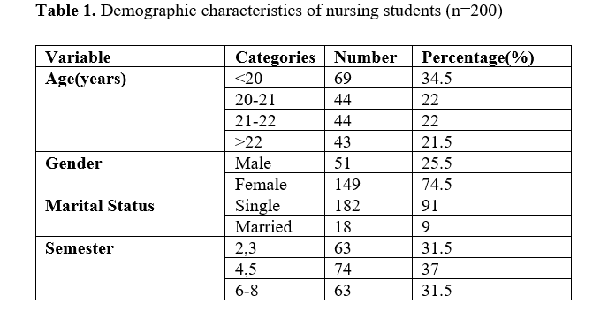
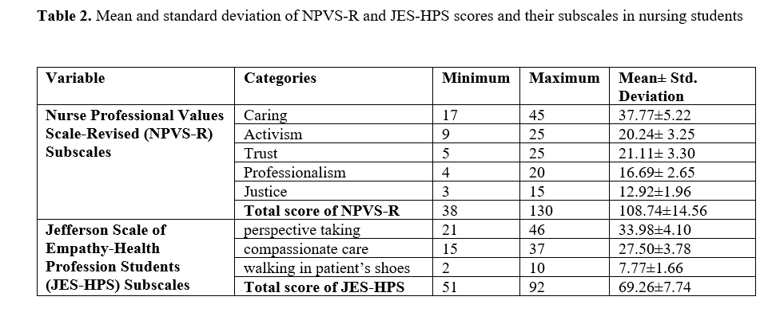
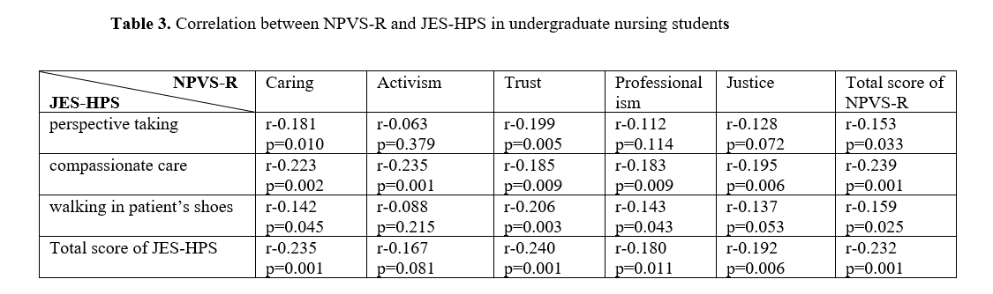
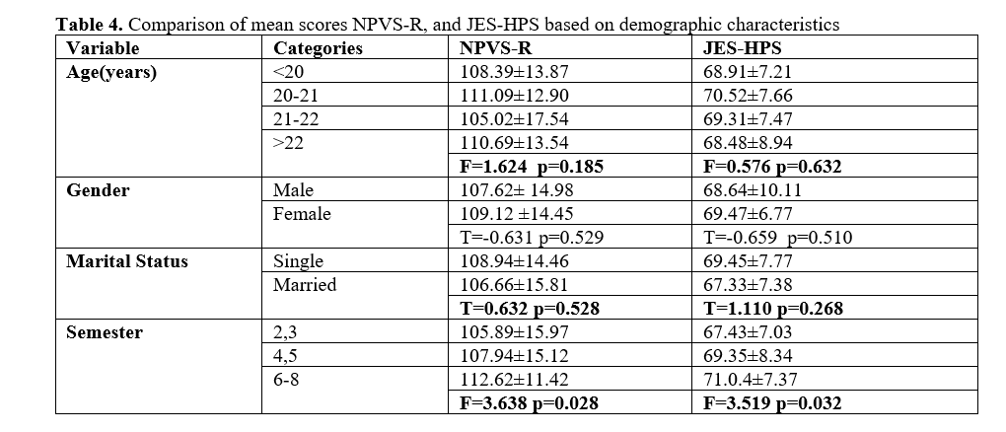
if available
Code:1650
The Relationship Between the Perception of Professional Values and Empathy in Nursing Students
Sharareh Zeighami Mohammadi¹
Clinical Cares and Health Promotion Research Center, Ka.C., Islamic Azad University, Karaj, Iran. 0000-0002-8738-9551, Tel:+98(912)5680679, Email: zeighami@kiau.ac.ir
Backgrounds
Findings
Conclusion
Empathy is an essential interpersonal skill during care. Therefore, it is important to identify factors related to empathy in nursing students. This study aimed to examine the relationship between the perception of professional values ​​and empathy in nursing students.
The mean scores for empathy and perception of professional values were 69.26 ± 7.74 and 108.74 ± 14.56, respectively. Pearson correlation analysis revealed a significant positive correlation between total empathy scores and total nursing students' perceptions of professional values scores (r=0.232, p=0.001).
This study found a positive association between nursing students' perceptions of professional values and their empathy levels. Enhancing professional values in the hidden curriculum and incorporating strategies into both theoretical and practical training may help cultivate higher levels of empathy among nursing students. This insight is valuable for educational policymakers and curriculum planners aiming to promote empathetic care in future nursing professionals.
Methods
A descriptive-correlational design was employed, involving 200 nursing students from the Islamic Azad University's Medical Sciences Faculty in Karaj, Iran. Data were collected between April 24 and June 10, 2023, using convenience sampling. Participants completed a demographic form, the Jefferson Scale of Empathy-Health Profession Students (JES-HPS), and the Nurse Professional Values Scale-Revised (NPVS-R) through self-report. Data were analyzed using an independent-samples t-test, ANOVA, and Pearson's correlation coefficient using the IBM Statistical Package for the Social Sciences (SPSS) version 26.
References
Zeighami Mohammadi S, Haghighi Khoskhoo N. Correlation between satisfaction with the field of study and clinical competence in nursing students. Mod Care J. 2022;19(3):e127692. https://doi.org/10.5812/modernc-127692.
Heidari A, Salehian M. Caring concept: an integrative review. Nursing and Midwifery Journal 2014; 12 (2) :129-135. URL: http://unmf.umsu.ac.ir/article-1-1831-fa.html
Ghanbari-Afra L, Adib-Hajbaghery M, Dianati M. Human caring: a concept analysis. J Caring Sci. 2022;11(4):246-254. [PMID: 36483689]. [ PMCID: PMC9720504] doi: 10.34172/jcs.2022.21.
Ferri P, Rovesti S, Padula MS, D'Amico R, Di Lorenzo R. Effect of expert-patient teaching on empathy in nursing students: a randomized controlled trial. Psychol Res Behav Manag. 2019;12:457-467. [PMID: 31417325].[ PMCID: PMC6602298] doi: 10.2147/PRBM.S208427.

