Slide 1


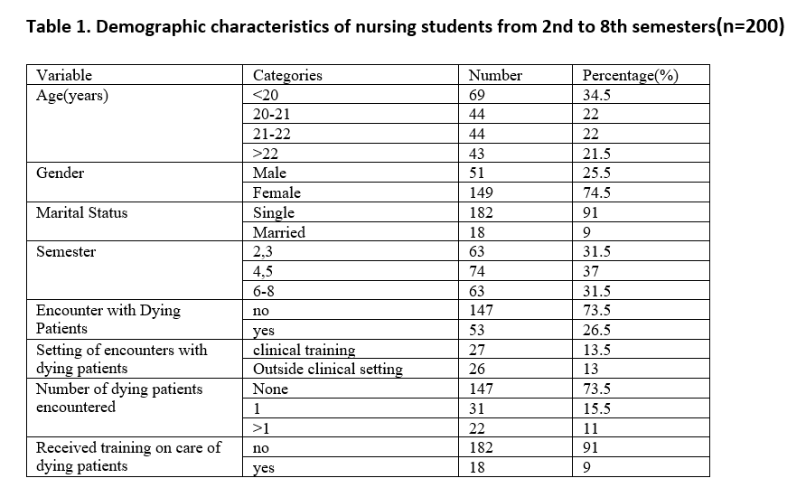
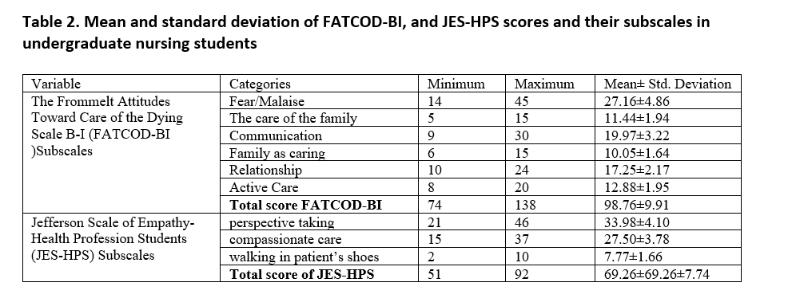
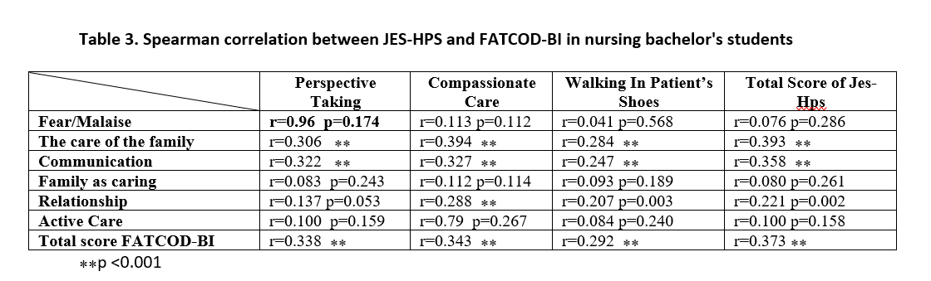
if available
Code:1651
Correlation between empathy and nursing students' attitudes toward care of dying patients
Sharareh Zeighami Mohammadi¹
Clinical Cares and Health Promotion Research Center, Ka.C., Islamic Azad University, Karaj, Iran. 0000-0002-8738-9551, Tel:+98(912)5680679, Email: zeighami@kiau.ac.ir
Backgrounds
Findings
Conclusion
End-of-life care is one of the vital areas of nursing science that deals with providing comprehensive and humane care to people who are in the final stages of their lives. Providing this care requires a positive attitude and proper empathy with the patient and family.
Objectives: This study aimed to investigate the correlation between empathy and nursing students' attitudes toward caring for dying patients.
The mean total score of FATCOD-BI, and JES-HPS was 98.76 ± 9.91 and 69.26 ± 7.74 respectively. Spearman's correlation coefficient test showed a positive and significant correlation between the total score of JES-HPS and FATCOD-BI (r=0.373 p < 0.001).
Our findings suggest that nursing students who demonstrated higher levels of empathy had a positive attitude toward the care of dying patients. Empathy leads to a deeper human connection and improves communication between the nurse and the patient in critical situations, which can help to form positive attitudes towards end-of-life care. Educational planners should employ strategies to enhance empathic skills to foster a positive attitude among nursing students toward caring for dying patients.
Methods
This was a correlational descriptive study. Among 200 nursing students of Islamic Azad University, the Karaj branch in Iran was selected as a convenience sampling method. The data collection tool was the demographic information form, Frommelt Attitudes toward Care of the Dying Scale form B-I(FATCOD-BI), and Jefferson Scale of Empathy-Health Profession Students version (JES-HPS, which completed self-reported.
References
1- Perez-de la Cruz S, Ramírez I, Maldonado C. factors and beliefs that condition the attitude of health science students towards end of life in Spain and Bolivia: a multicenter study. Int J Environ Res Public Health. 2020 1;17(17):6373. doi: 10.3390/ijerph17176373. PMID: 32882961; PMCID: PMC7504099.
2-Berndtsson IEK, Karlsson MG, Rejno ACU. Nursing students' attitudes toward care of dying patients: A pre- and post-palliative course study. Heliyon. 2019;5(10):e02578. doi: 10.1016/j.heliyon.2019.e02578. PMID: 31667412; PMCID: PMC6812234.
3-Alwawi AA, Abu-Odah H, Bayuo J. palliative care knowledge and attitudes towards end-of-life care among undergraduate nursing students at al-quds university: implications for palestinian education. Int J Environ Res Public Health. 2022;19(15):9563. doi: 10.3390/ijerph19159563. PMID: 35954917; PMCID: PMC9368292.

