Slide 1


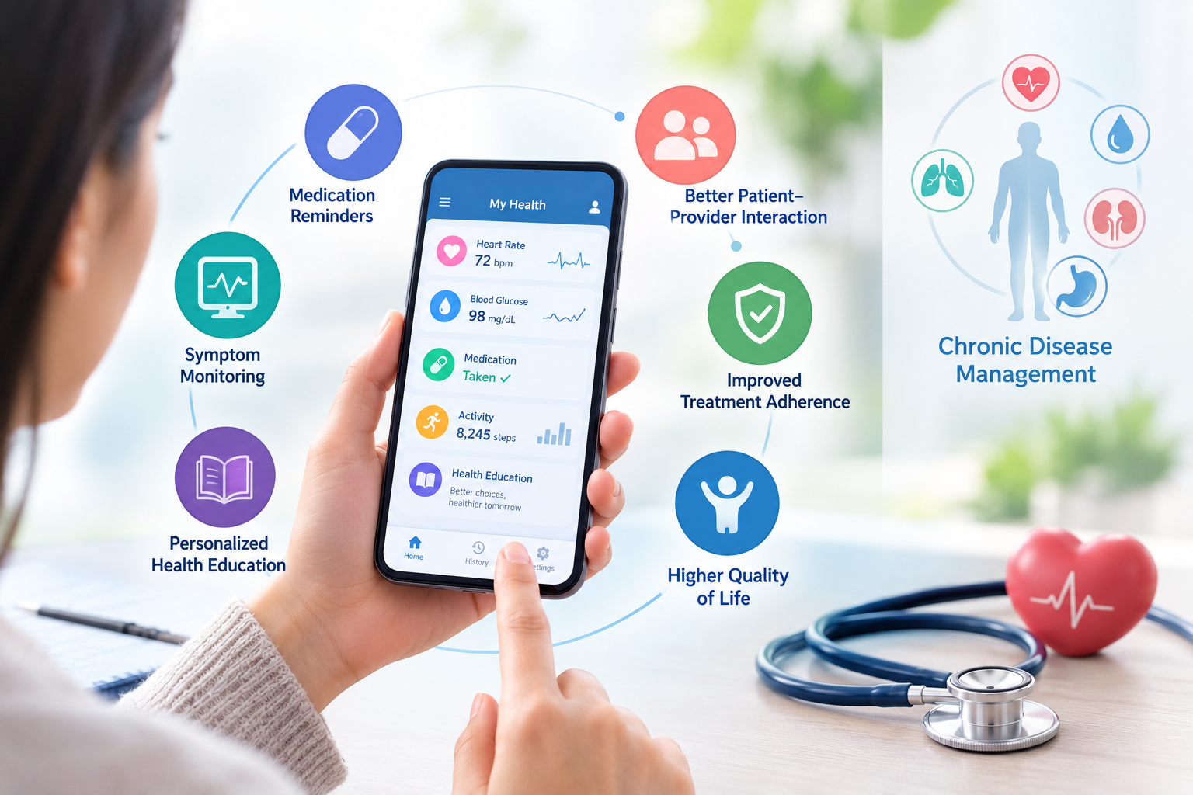
if available
Code:1074
Author’s photo
A Review of the Use of Mobile Applications in Chronic Disease Management
Hajaralsadat Hosseini-Dastgerdi
Assistant Professor of Physiology, Department of Basic Medical Sciences, Isf.C., Islamic Azad University, Isfahan, Iran
Backgrounds
Findings
Conclusion
With the increasing prevalence of chronic diseases, the need for effective tools for monitoring and daily management of patients is increasingly felt. Mobile applications, as new technologies, provide the possibility of recording symptoms, reminding patients of medication use, and providing personalized health education.
Given the reported positive effects, the integration of mobile apps into chronic disease management programs is recommended, provided that their design is based on the real needs of patients and scientific standards.
. The use of mobile applications improves patient interaction with the treatment team, increases adherence to treatment, and enhances the quality of life of patients. Daily symptom recording, real-time feedback, automatic medication reminders, and targeted education have reduced disease complications and empowered patients to manage their own health. Many studies have shown that apps play an effective role in clinical decision-making and reduce the burden on the health system by analyzing big data, predicting disease progression, identifying gaps in care, and creating personalized plans. Evidence also suggests that apps increase patient motivation and active participation and strengthen patient-provider relationships.
Methods
In this review study, articles published in the past decade that addressed the use of mobile applications in chronic disease management were reviewed. A search was conducted with the keywords "mobile application", "chronic disease", and "health management" in reputable scientific databases, and review and empirical articles with reliable data were selected..
References
Lee JA, Choi M, Lee SA, Jiang N, et al. Effective behavioral intervention strategies using mobile health applications for chronic disease management: a systematic review. BMC Med Inform Decis Mak. 2018;18:12
2. Peng Y, Wang H, Fang Q, Xie L, Shu L, Sun W, Liu Q. Effectiveness of Mobile Applications on Medication Adherence in Adults with Chronic Diseases: A Systematic Review and Meta-Analysis. J Manag Care Spec Pharm. 2020;26(4):550‑561

