Slide 1


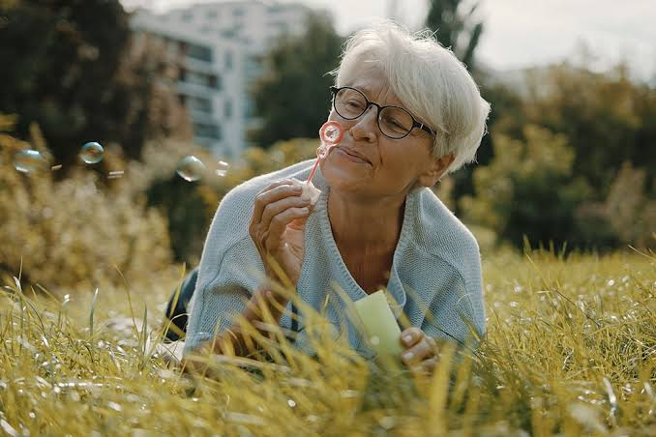

if available
Code:1079
Author’s photo
Improving the Quality of Life and Mental Health of the Elderly: New Approaches
Hajaralsadat Hosseini-Dastgerdi
Assistant Professor of Physiology, Department of Basic Medical Sciences, Isf.C., Islamic Azad University, Isfahan, Iran
Backgrounds
Findings
Conclusion
Mental health problems are a major public health problem and are experienced by most elderly people. Anxiety and depression are common among older people and are associated with decreased functioning and increased mortality, as well as increased healthcare costs. The aim of this study was to review the available evidence on effective interventions to improve the mental health of the elderly.
Evidence shows that older people who have social networks and take part in social activities have better mental and social health. Support from family members like help feeling valued and getting information is very important for good mental health. Also helping people understand themselves better encouraging views about getting older and promoting self-care habits help improve their lives. These should be part of programs. Telemedicine has also become a way to offer health care to this group of people.
Improving the mental health of the elderly requires a comprehensive approach. Combining new technology-based solutions with strengthening family support networks and individual awareness programs can be an effective step towards improving the quality of life and reducing the burden of mental disorders in this population.
References
Methods
1. Oliveira PBF, Dornelles TM, Gosmann NP, Camozzato A. Efficacy of telemedicine interventions for depression and anxiety in older people: a systematic review and meta-analysis. Int J Geriatr Psychiatry. 2023;38(5):e5920. doi:10.1002/gps.5920. PMID:37204341.
2. Velaithan V, Tan MM, Yu TF, Liem A, Teh PL, Su TT. The Association of Self‑Perception of Aging and Quality of Life in Older Adults: A Systematic Review. The Gerontologist. 2024 Apr;64(4):gnad041. doi:10.1093/geront/gnad041. PMID:37029753.
3. Aguilar FD, et al. Improving mental health and wellbeing in elderly people isolated at home due to architectural barriers: a community health intervention. Prim Care. 2021;27:102020. doi:10.1016/j.aprim.2021.102020.
A review was done using PubMed, Scopus and Web of Science. The search used combinations of the words "older adults," "elderly," "mental health," "quality of life " "social support " "psychosocial interventions," "community-based interventions," and "telemedicine." Studies in English that were relevant to the goals of the review were chosen.

