Slide 1



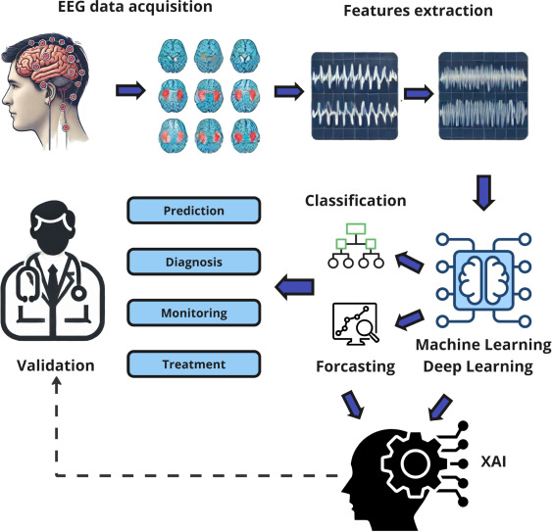
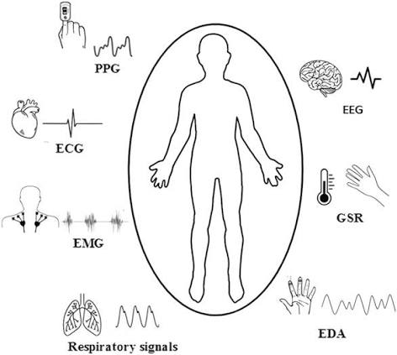
if available
Code:1351
Author’s photo
Artificial Intelligence in Physiological Signal Analysis for Autonomic Nervous System Monitoring in Digital Health
Hajaralsadat Hosseini-Dastgerdi (1), Azadehalsadat Hosseini Dastgerdi
Assistant Professor of Physiology, Department of Medical Basic Sciences, Isf.C., Islamic Azad University, Isfahan, Iran
Department of Medicine, Na.C., Islamic Azad University, Najafabad, Iran
(2)Clinical Research Development Center, Na.C., Islamic Azad University, Najafabad, Iran
Backgrounds
Findings
Conclusion
Digital health and artificial intelligence have been coupled in the past decade to allow for potentially continuous physiological monitoring while supporting advances in personalized care. Of these categories of data, signals such as electrocardiogram (ECG), heart rate variability (HRV), photoplethysmography (PPG), electroencephalogram (EEG) and electromyography (EMG) are given a priority position because they serve as the main source reflecting functions of multiple body systems, specifically those related to the autonomic nervous system.
.
Recent evidence indicates that artificial intelligence can improve the analysis of physiological signals, particularly ECG, HRV, PPG, EEG, and EMG, for assessing autonomic nervous system function. Machine learning and deep learning algorithms can identify complex patterns and subtle changes in sympathetic and parasympathetic activity that may precede clinical manifestations. CNN, LSTM, and Transformer-based models have demonstrated promising performance in physiological signal classification and prediction. Integration of AI with wearable sensors enables continuous, longitudinal monitoring of physiological changes in real-life settings. These technologies may support early detection, risk assessment, and personalized monitoring of cardiovascular, neurological, metabolic, and psychological disorders. However, data quality, limited labeled datasets, model interpretability, and privacy and security concerns remain important challenges for clinical implementation.
.
From the physiological standpoint, the changes in sympathetic and parasympathetic activity risk can be recognized within HRV and other biosignals well before any clinical manifestation presents itself, hence intelligent analysis can help provide early detection.
References
Methods
1. Steinhubl SR, Topol EJ. Moving From Digitalization to Digitization in Cardiovascular Care: Why Is it Important, and What Could it Mean for Patients and Providers? J Am Coll Cardiol. 2015;66(13):1489-96.
2. Patil SS, Jha GK, Mohsin N, Patel P, Ralte L, Shukla AK. Artificial Intelligence in Clinical Decision-Making: A Comprehensive Review of Diagnostic, Prognostic, and Therapeutic Applications, Validation Gaps, Bias, and Deployment Challenges. Cureus. 2026;18(5):e109905.
This review article is aimed at the application of AI in physiological signal analysis, highlights the evaluation of autonomic function, wearable-based digital health technologies in healthcare systems, algorithms used in clinical diagnosis as well as challenges and prospects for development.

