Slide 1


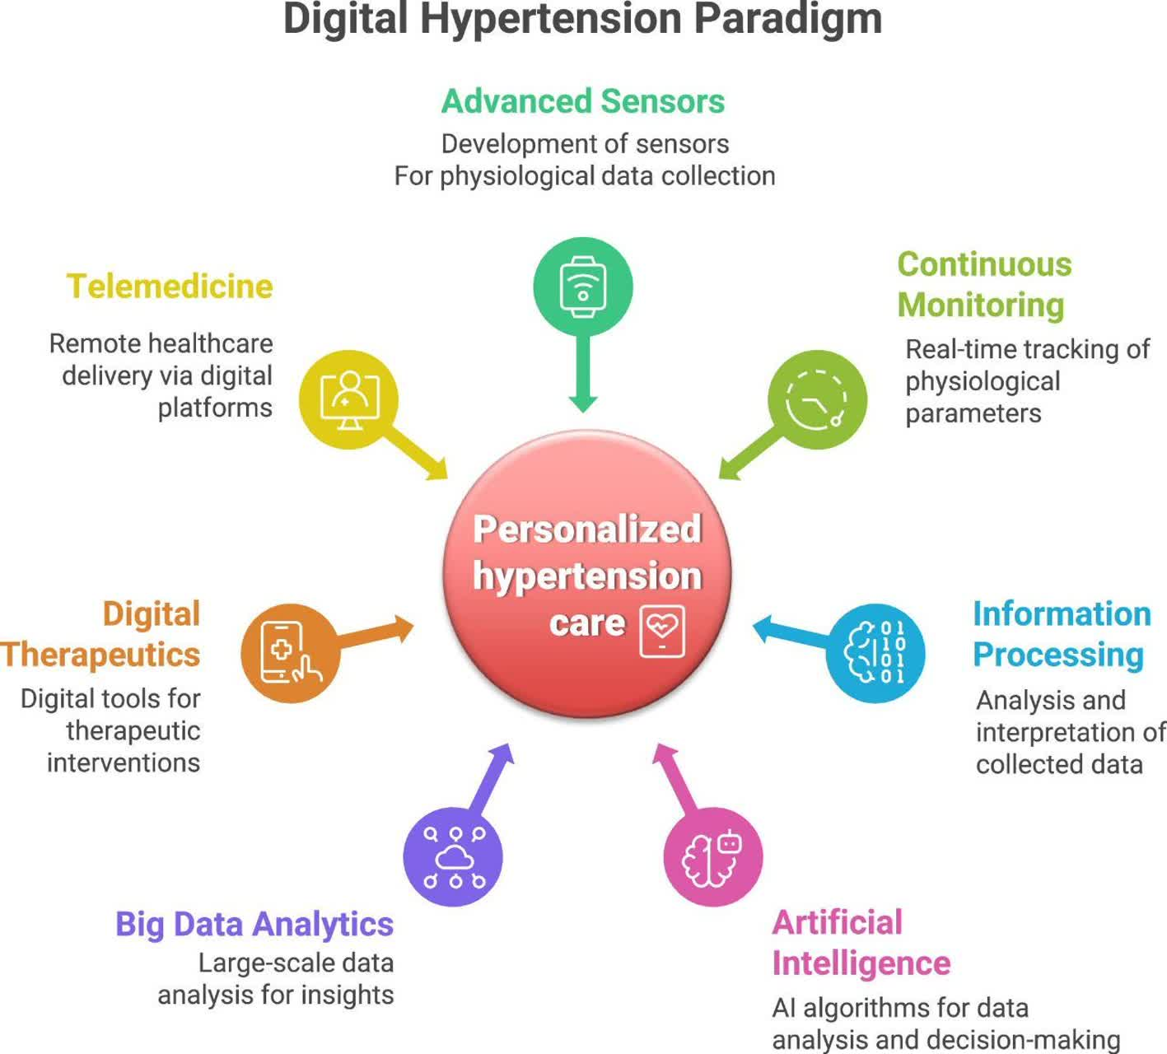
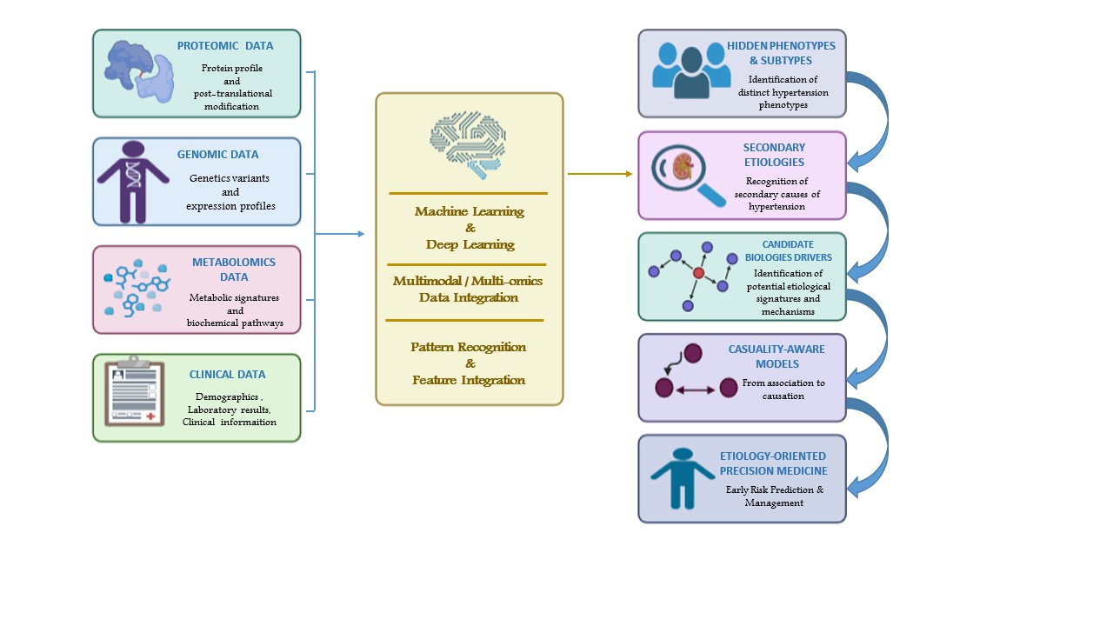
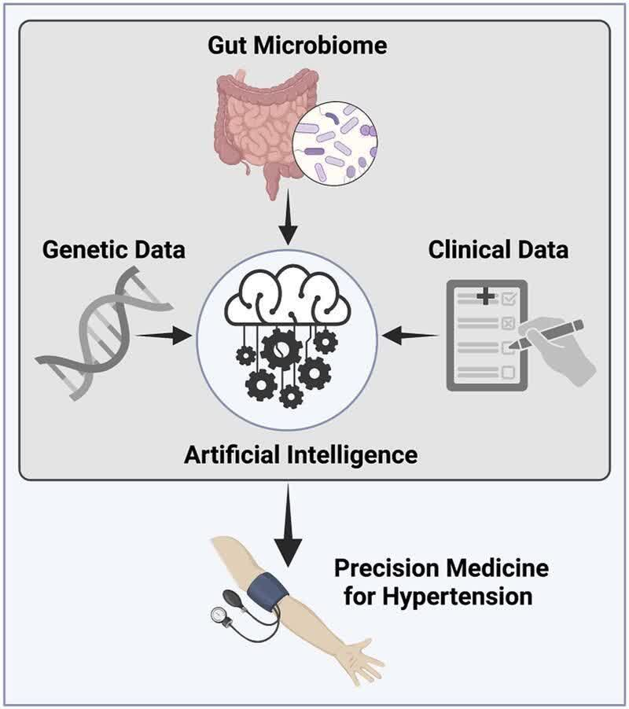
if available
Code:1437
Artificial Intelligence for Uncovering the Underlying Etiology of Hypertension
ali ataei kachooei (1), Samira Shariati Najafabadi (1,2)
Department of Medicine, Na.C., Islamic Azad University, Najafabad, Iran
Clinical Research Development Center, Na.C., Islamic Azad University, Najafabad, Iran
Backgrounds
Findings
Conclusion
Hypertension represents one of the most challenging diseases worldwide, as its underlying etiology remains complex and incompletely understood. Artificial intelligence (AI) enables the integration of diverse datasets, including genomic, proteomic, metabolomic, and clinical data, offering new opportunities to uncover hidden risk factors and disease phenotypes. This review highlights current evidence on the potential of AI to advance precision medicine in hypertension.
AI has the potential to shift hypertension research from conventional diagnosis toward etiology-oriented precision medicine. By integrating multi-omics data, AI may help identify hidden phenotypes, secondary causes, and candidate mechanisms of hypertension. Causality-aware models are needed to translate these discoveries into clinically actionable strategies for early risk prediction and management.
References
1-Chaikijurajai T, Laffin LJ, Tang WHW. Artificial intelligence and hypertension: recent advances and future outlook. American Journal of Hypertension. 2020;33
2-Reel PS, Reel S, Van Kralingen Jet al. Machine learning for classification of hypertension subtypes using multi-omics: a multi-centre, retrospective, data-driven study. EBioMedicine. 2022;84
3-Diao X, Huo Y, An application of machine learning to etiological diagnosis of secondary hypertension: retrospective study using electronic medical records. JMIR Medical Informatics. 2021;9
Methods
AI algorithms have demonstrated high performance in recognizing secondary etiologies of hypertension. Multi-omics approaches integrating genomic and metabolomic data may also improve the characterization of biologically distinct hypertension subtypes.AI can extend hypertension assessment beyond conventional blood pressure-based diagnosis by identifying complex disease patterns, distinct phenotypes, and potential etiological signatures.The integration of multimodal data provides an opportunity to uncover previously unrecognized associations and candidate biological drivers of hypertension
A narrative review was conducted by searching major scientific databases, such as PubMed. The search used keywords related to hypertension, artificial intelligence, machine learning, precision medicine, and etiology.

