Slide 1




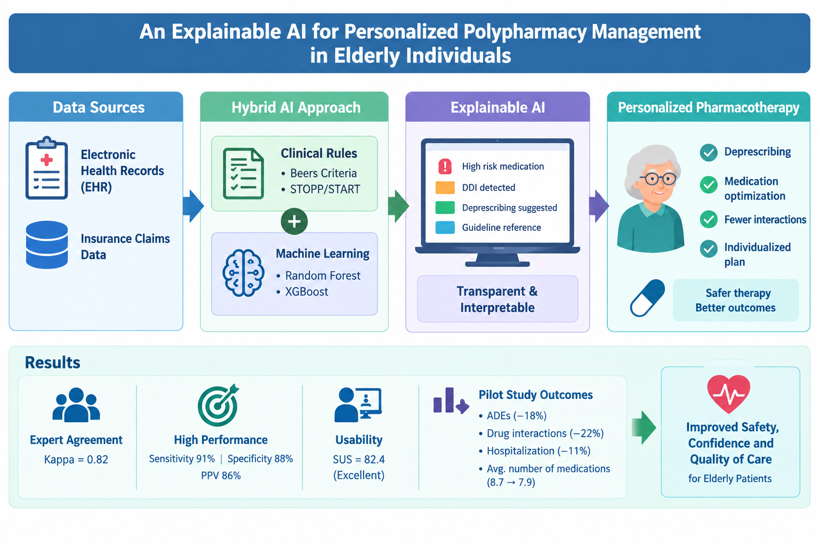
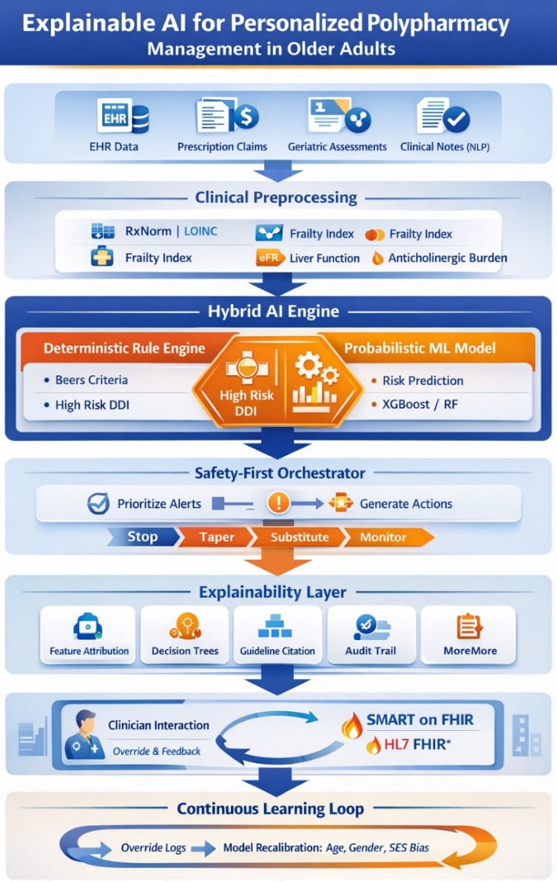
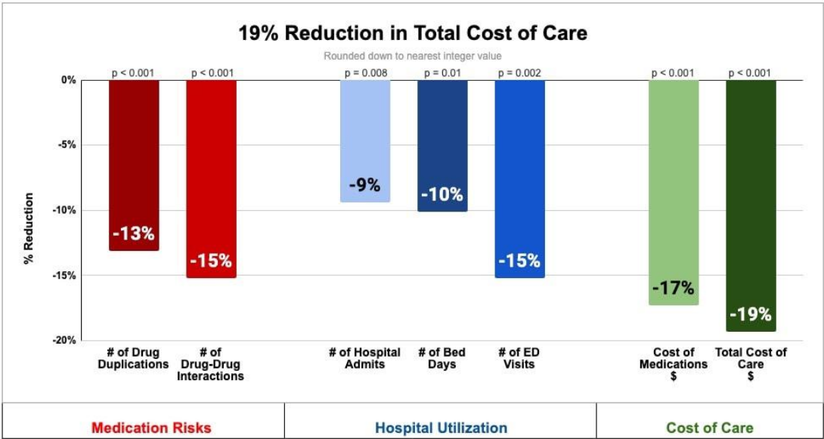
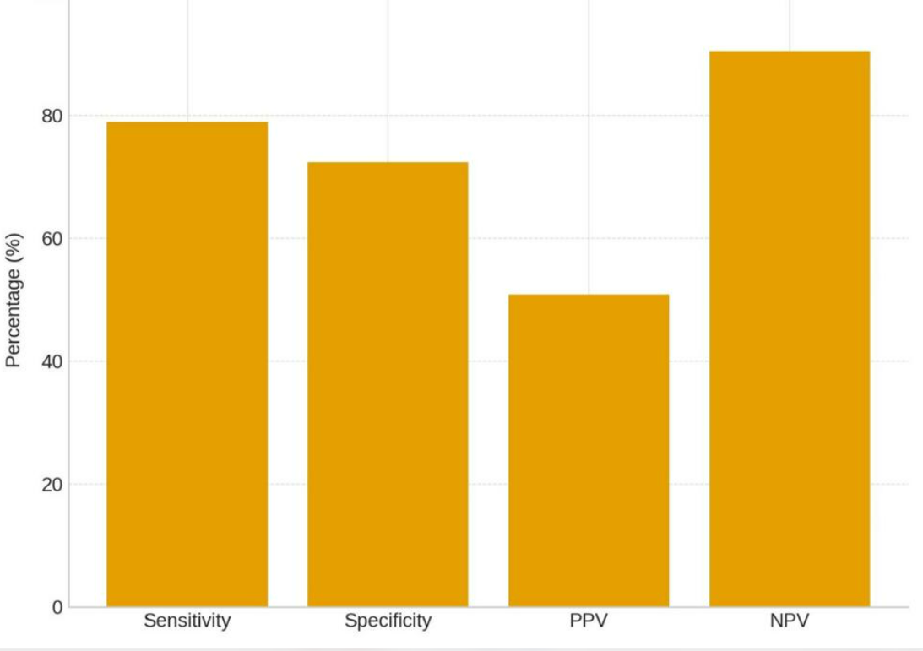
Code: 1129
An Explainable AI for Personalized Polypharmacy Management in Elderly Individuals
Farshid Nematzadeh(1), Samin Mirzapour(2), Sina Alizadeh Tabrizi(1)
Department of Computer Engineering, Ur. C., Islamic Azad University, Urmia, Iran
Department of Geriatric Health, Faculty of Health Sciences, Tabriz University of Medical Sciences, Tabriz, Iran.
Backgrounds
Findings
Conclusion
Polypharmacy is one of the most significant problems regarding medication safety among the aging population, with risks such as adverse drug events (ADEs), drug-drug interactions (DDIs), and medication-related admissions being highly prevalent. Clinical decision support systems typically prioritize detection rather than prevention and are generally inadequate in offering any reasoning for their suggestions. The aim of this research is to design and assess an explainable artificial intelligence (AI) system based on both clinical guidelines and machine learning for personalizing the medication regimen.
It demonstrated excellent levels of agreement with experts (Cohen’s κ = 0.82), showing 91% sensitivity, 88% specificity, and 86% positive predictive value in 420 medication reviews. User testing of the system yielded an average System Usability Scale (SUS) of 82.4. During the six-month trial period in two clinics, the frequency of adverse drug events dropped by 18%, serious drug-drug interactions by 22%, hospitalizations due to medications by 11%, and ED visits related to polypharmacy by 9%. The average number of medications per patient was reduced from 8.7 to 7.9, and 41% of patients had at least one deprescribed medication.
Explainable AI model combines the usage of clinical guidelines and machine learning and will help improve polypharmacy in elderly patients in a safer way. This method showed good agreement with clinical experts, had high diagnostic capacity and usability. During the pilot study that lasted for six months, introduction of the new model was connected to decreased cases of adverse drug events, drug interactions, and admissions due to medications. Also, the number of prescribed drugs was lower.
Methods
References
A multiphase mixed-methods approach was used to develop and evaluate the system. Clinical data were preprocessed and standardized, and a hybrid model combining Beers and STOPP/START criteria with Random Forest and XGBoost was developed. Explainable recommendations and HL7 FHIR interoperability were incorporated. Evaluation included expert validation, usability testing, and a six-month pilot at two clinical sites.
World Health Organization. Medication Safety in Polypharmacy. Geneva: WHO; 2019.
Hu Q, Zhang Y, Wang P, et al. Machine learning model for detecting potentially inappropriate medications in older adults. Journal of Clinical Medicine. 2023;12:2619.
Dil Nahlieli D, Ben Yehuda A, Souroujon D, et al. Validation of a novel Artificial Pharmacology Intelligence system for the management of patients with polypharmacy. Research in Social and Administrative Pharmacy. 2024;20:633–639. doi:10.1016/j.sapharm.2024.04.003.

