Slide 1
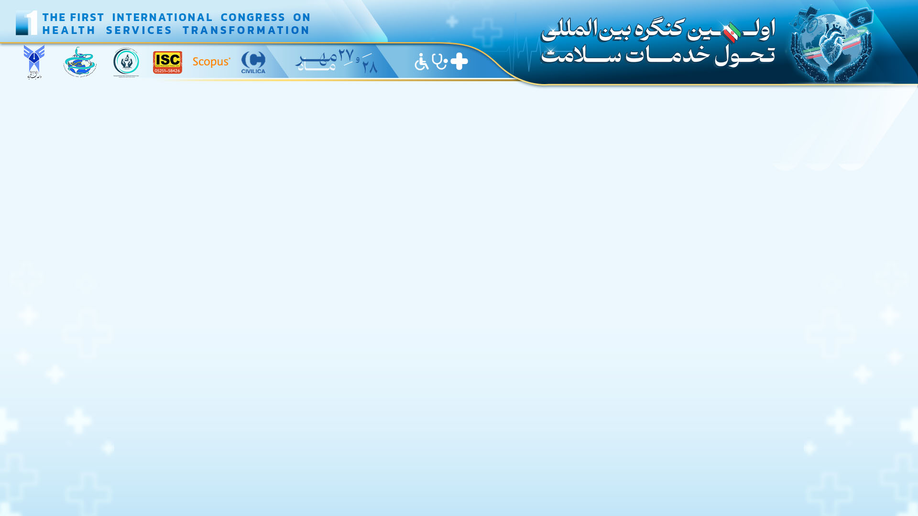

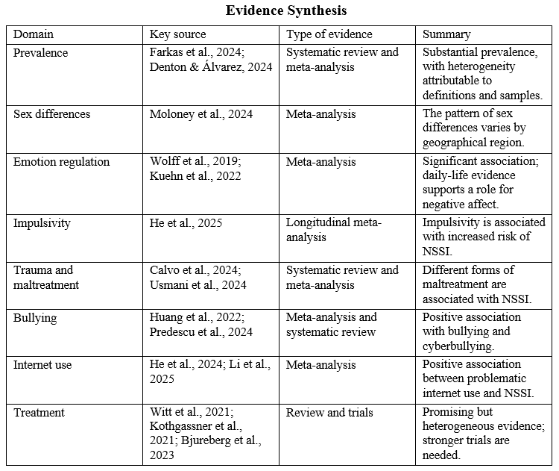
if available
Code: 1345
Author’s photo
Nonsuicidal Self-Injury in Adolescents: A Systematic Evidence Review of Risk Factors, Mechanisms, Assessment, and Interventions
Fatemeh Sadat Samsam Shariat (1), Gholamreza Talebi(2)
M.A. Student in Clinical Psychology, Department of Clinical Psychology, Na.C., Islamic Azad University, Najafabad, Iran
Assistant Professor of Health Psychology, Department of Health Psychology, Na.C., Islamic Azad University, Najafabad, Iran
Backgrounds
Findings
Conclusion
: Nonsuicidal self-injury (NSSI) is an important mental health concern during adolescence and is associated with emotional, cognitive, developmental, interpersonal, and environmental factors. This systematic review aimed to examine and synthesize evidence on risk and protective factors, psychological mechanisms, assessment approaches, and interventions related to NSSI in adolescents.
Evidence indicated that NSSI has a substantial prevalence among adolescents, with estimates influenced by behavioral definitions, measurement instruments, and population characteristics. Difficulties in emotion regulation, impulsivity, and rumination were associated with NSSI. Adverse childhood experiences, maltreatment, bullying, cyberbullying, interpersonal stress, and problematic internet use were also associated with this behavior. Evidence regarding dialectical behavior therapy and emotion regulation-focused interventions was promising but heterogeneous.
NSSI is a multifactorial phenomenon, and its assessment should address psychological, interpersonal, and environmental factors, behavioral function, and concurrent suicide risk. Evidence supports early identification of risk and protective factors and emotion regulation-focused interventions; however, larger studies with stronger designs and longer follow-up are needed.
References
Methods
Denton EG, Álvarez K. The global prevalence of nonsuicidal self-injury among adolescents. JAMA Netw Open. 2024;7(6):e2415406. doi:10.1001/jamanetworkopen.2024.15406.
Fang S, Chen F, Bian J, Zhang L, Wang Y. Interventions for adolescent depression comorbid with non-suicidal self-injury: a scoping review. Front Psychiatry. 2025;16:1601073.
doi:10.3389/fpsyt.2025.1601073.
Tang S, Hoye A, Slade A, Tang B, Holmes G, Fujimoto H, et al. Motivations for self-harm in young people and their correlates: a systematic review. Clin Child Fam Psychol Rev. 2025;28:171-208.
doi:10.1007/s10567-024-00511-5.
This systematic review with narrative synthesis was conducted according to the principles of the PRISMA 2020 statement. Studies published between 2020 and 2026 were searched in PubMed/MEDLINE, Scopus, Web of Science, and PsycINFO, as well as relevant Persian scientific sources. Studies with adolescent samples addressing risk or protective factors, mechanisms, assessment, or interventions were included; studies unrelated to NSSI, adults, case reports, editorials, abstracts without full text, and duplicates were excluded. In total, 51 scientific sources and reports were included in the final synthesis.

