Slide 1


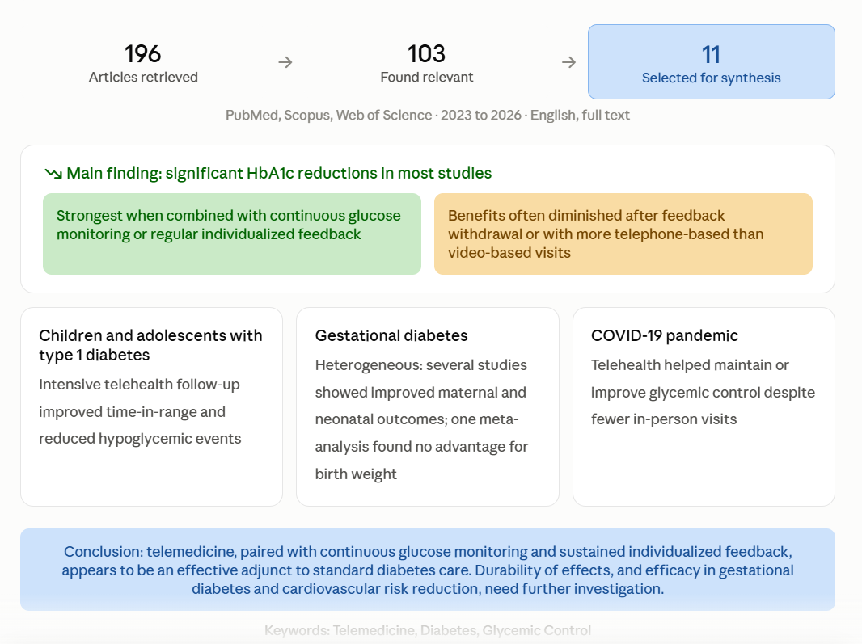

if available
Code: 1573
The Effect of Telemedicine on Glycemic Control in Patients with Diabetes: A Narrative Review
Alireza Raghimi Nashrudkoli¹, Majid Sammak², Setayesh Dehghannavaz Chokami³, Seyed Mohammad Hossein Hosseini⁴
Student Research Committee, School of Nursing and Midwifery, Guilan University of Medical Sciences, Rasht, Iran
Backgrounds
Findings
Conclusion
Diabetes management requires continuous monitoring, yet access to clinical care is limited. Telemedicine may improve glycemic control, but evidence remains inconsistent. This narrative review examines telemedicine's effect on glycemic control.
Most studies reported significant reductions in HbA1c associated with telemedicine interventions, particularly when combined with continuous glucose monitoring or regular individualized feedback; however, these benefits often diminished after feedback withdrawal or with greater reliance on telephone-based rather than video-based visits. In children and adolescents with type 1 diabetes, intensive telehealth follow-up improved time-in-range and reduced hypoglycemic events. Findings in gestational diabetes were heterogeneous: several studies demonstrated improved maternal and neonatal outcomes, whereas one meta-analysis found no significant advantage of telemedicine for birth weight. During the COVID-19 pandemic, telehealth played a supportive role in maintaining or improving glycemic control despite reduced in-person visits.
Telemedicine, particularly when paired with continuous glucose monitoring and sustained individualized feedback, appears to be an effective adjunct to standard diabetes care for improving glycemic control. However, the durability of these effects and telemedicine's efficacy in gestational diabetes and cardiovascular risk reduction warrant further investigation.
References
Zhang K, Huang Q, Wang Q, Li C, Zheng Q, Li Z, Xu D, Xie C, Zhang M, Lin R. Telemedicine in Improving Glycemic Control Among Children and Adolescents With Type 1 Diabetes Mellitus: Systematic Review and Meta-Analysis. J Med Internet Res. 2024 Jul 9;26:e51538. doi: 10.2196/51538. PMID: 38981114; PMCID: PMC11267117.
De Groot J, Wu D, Flynn D, Robertson D, Grant G, Sun J. Efficacy of telemedicine on glycaemic control in patients with type 2 diabetes: A meta-analysis. World J Diabetes. 2021 Feb 15;12(2):170-197. doi: 10.4239/wjd.v12.i2.170. PMID: 33594336; PMCID: PMC7839169.
Lau D, Manca DP, Singh P, Perry T, Olu-Jordan I, Ryan Zhang J, Rahim G, Hagen EM, Yeung RO. The effectiveness of continuous glucose monitoring with remote telemonitoring-enabled virtual educator visits in adults with non-insulin dependent type 2 diabetes: A randomized trial. Diabetes Res Clin Pract. 2024 Nov;217:111899. doi: 10.1016/j.diabres.2024.111899. Epub 2024 Oct 19. PMID: 39433218.
Methods
In this review, a systematic literature search was conducted across PubMed, Scopus and Web of Science. Studies published between 2023 and 2026 were identified using the keywords: Telemedicine, Diabetes and Glycemic Control. Only studies published in English and available in full text were included. A total of 196 articles were retrieved, of which 103 were found relevant, and 11 were finally selected for synthesis and analysis.

