Slide 1


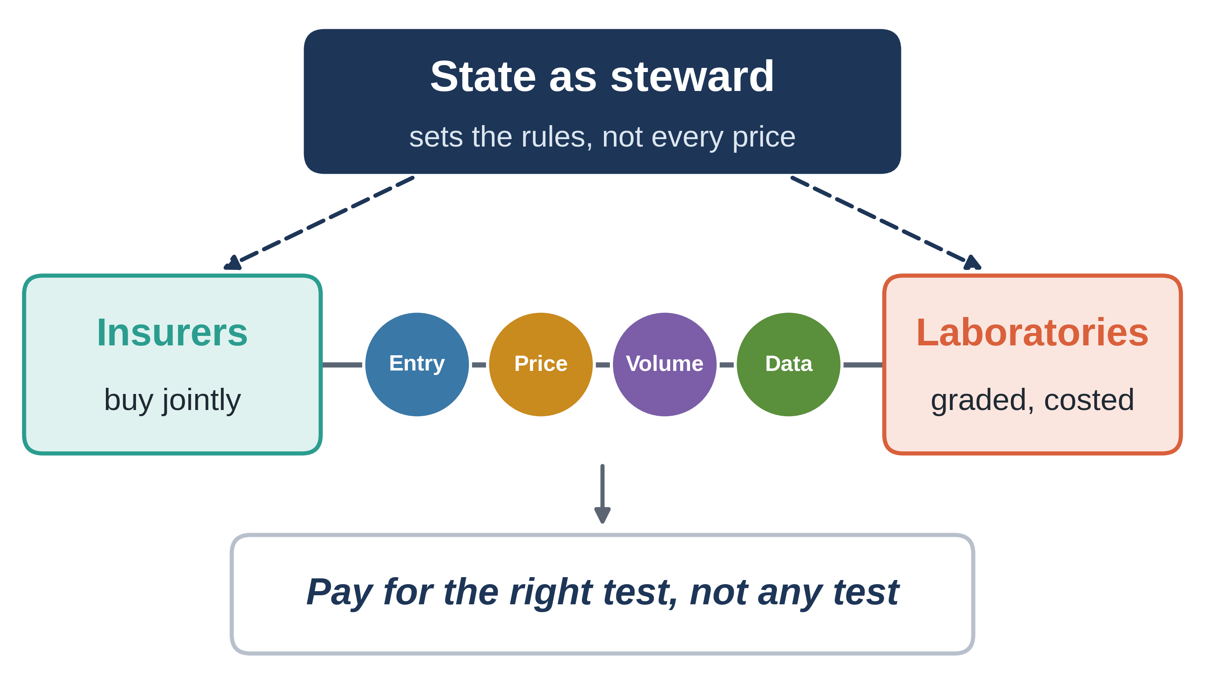
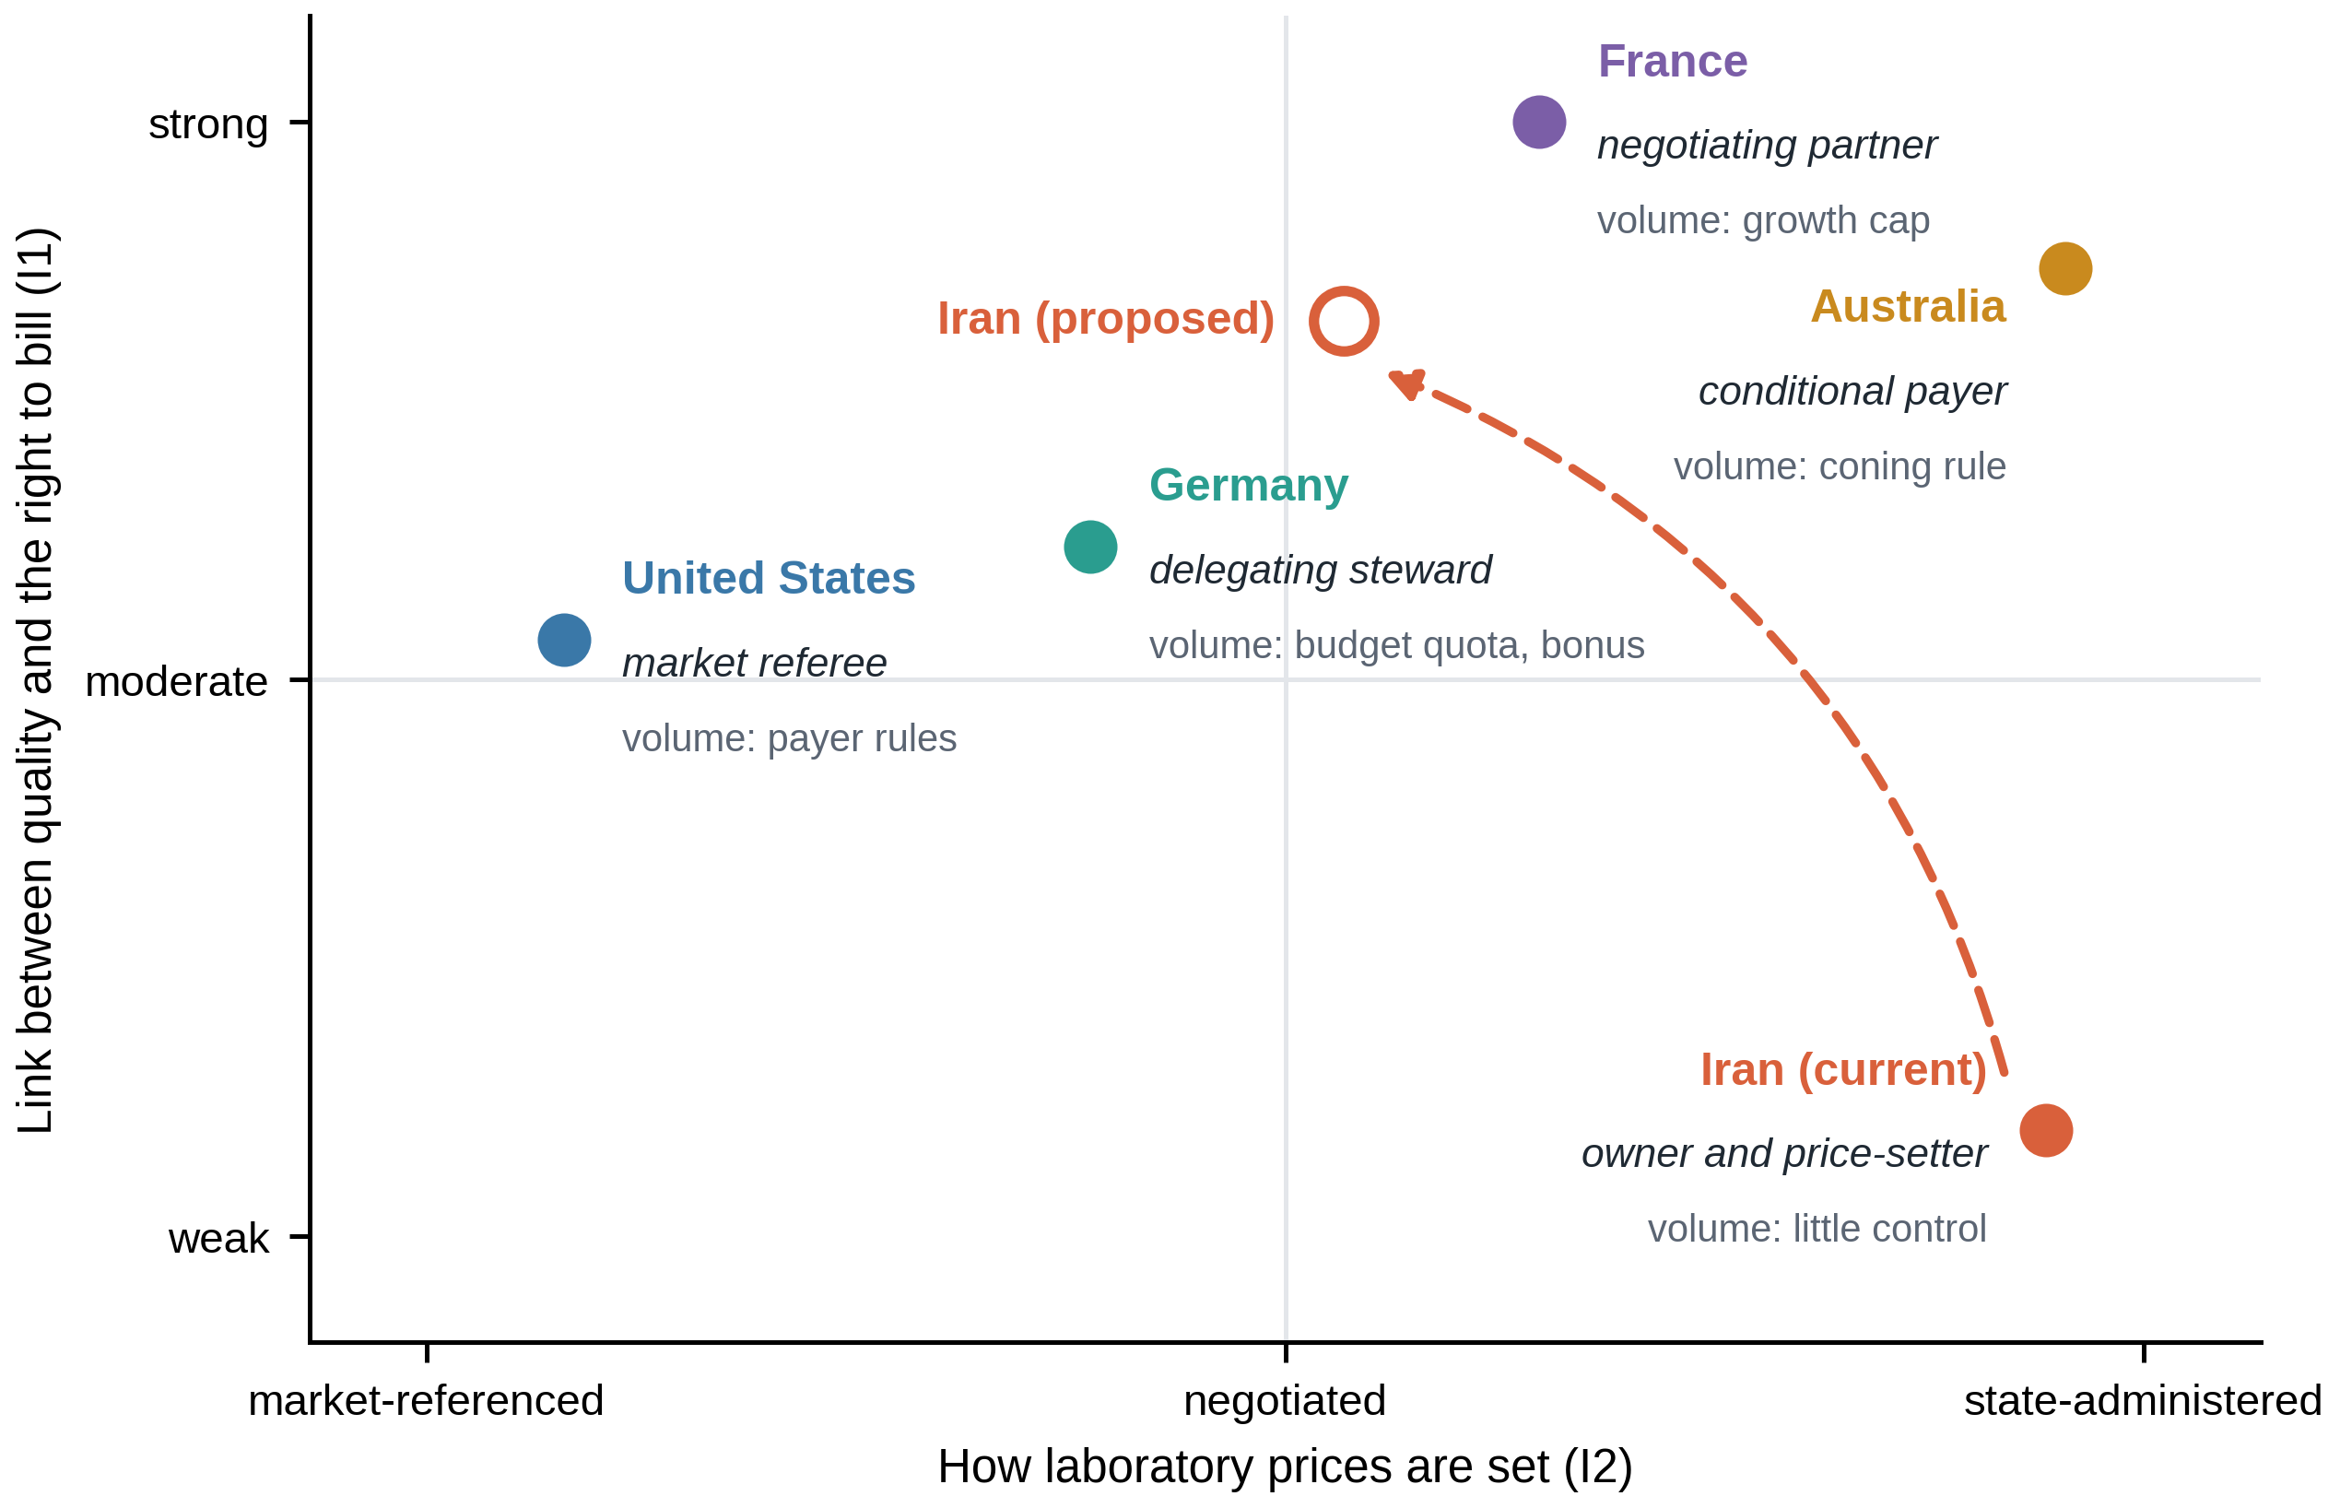
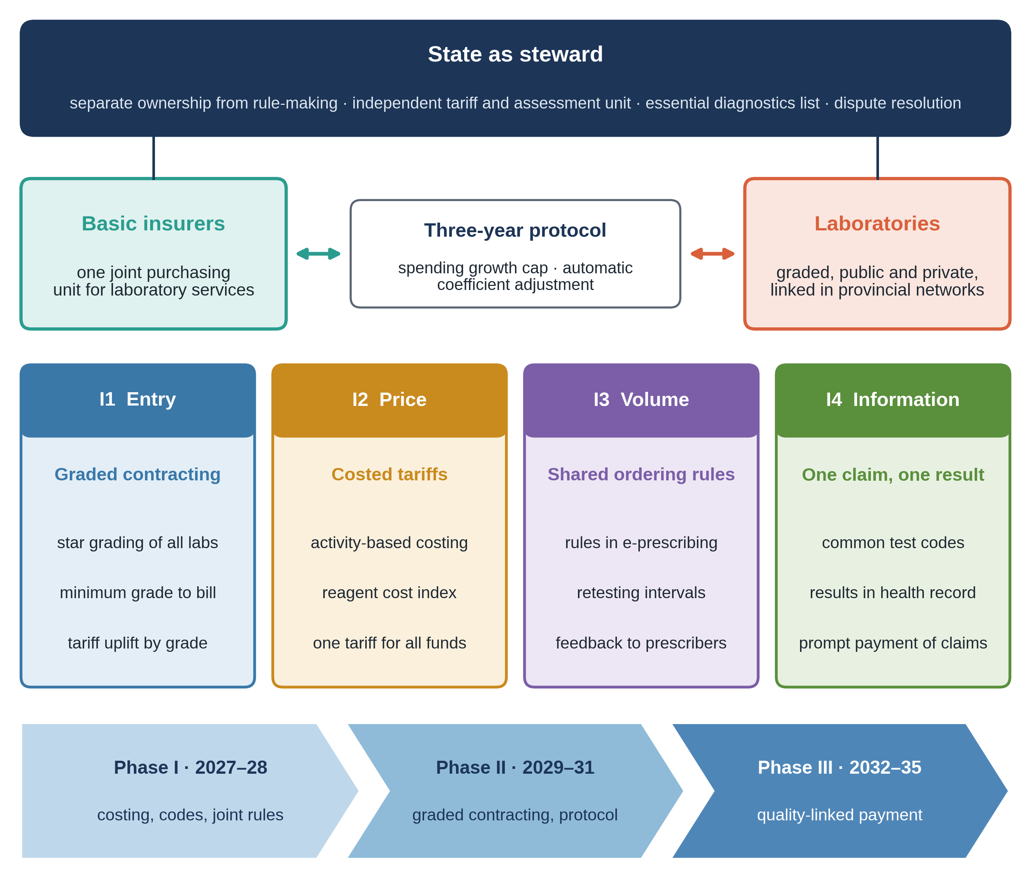
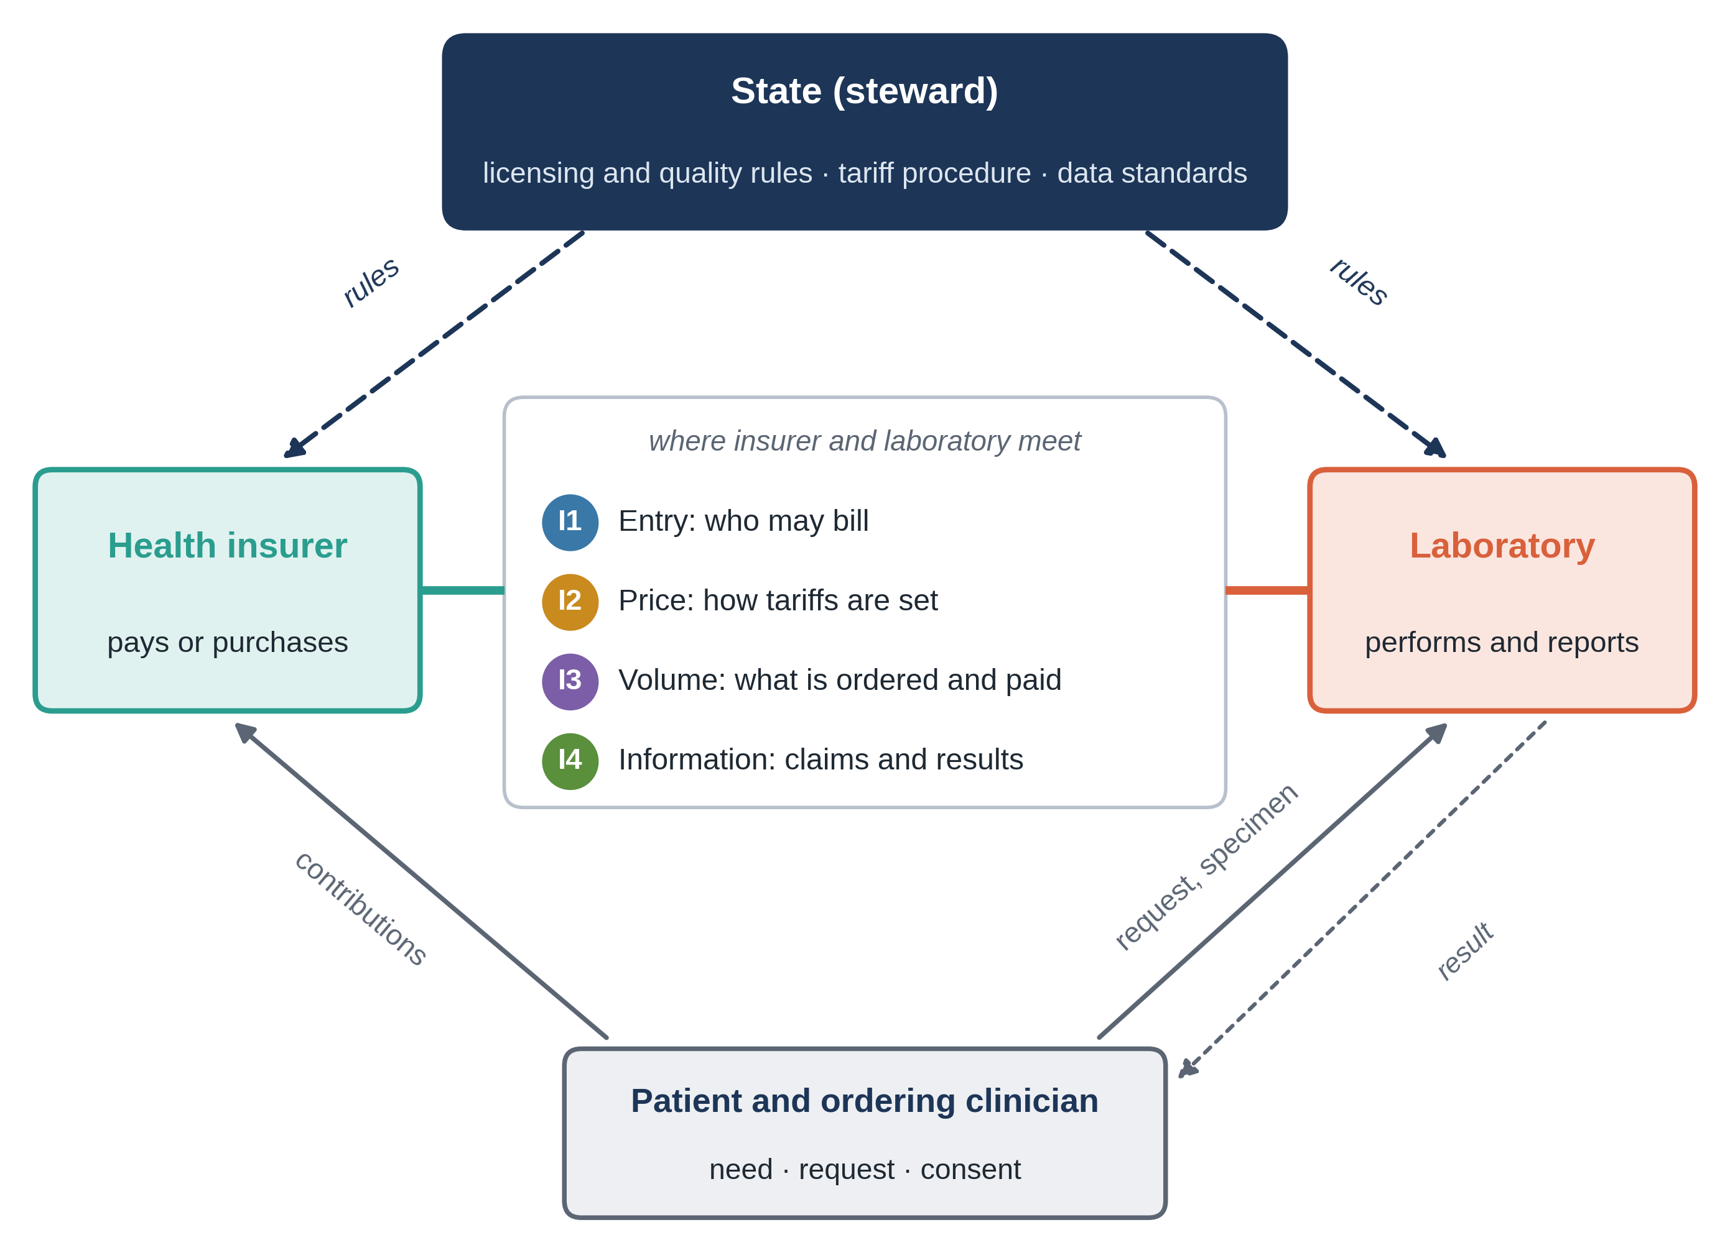
Paying for the Right Test: Laboratories, Health Insurers and the State,
and a Strategic Purchasing Model for Iran
Code:
DOR: 20.1001.2.0525158426.1404.1.1.588.8
Mehdi Mahdavian Sadr (1), Fatemeh Sadeghi (2)
(1) PhD in Public Administration, Science and Research Branch, Islamic Azad University, Tehran, Iran; ORCID: 0009-0004-3747-3749
(2) R&D Manager, Shafa Azmay Parsian Company
Graphical Abstract
Backgrounds
Findings
Conclusion
Laboratory results guide most clinical decisions, and in most health systems an insurer pays for them. How laboratories, insurers and the state meet decides which tests are done, at what price and to what standard. Diagnostics remain out of reach for nearly half of the world's population [1]. Iran has more than 8,200 laboratories and several basic insurance funds, and its tariffs are approved centrally every year [2], yet it has no explicit model for this relationship.
Four roles for the state
Proposed model for Iran
Systems that manage laboratories well link quality to the right to bill and control price and volume together.
Iran already has central tariffs, licensing and e-prescription, but they are connected neither to each other nor to payment.
Phased in from 2027 to 2035, the model lets Iran pay for the right test rather than for any test.
Next step: a Delphi study with insurers, regulators and laboratory associations, then a pilot in selected provinces.
Methods
Comparative narrative review (2016-2026) of laws, payer documents, audits and studies; four countries and Iran read against four interfaces [3]:
References
Iran today
1. Fleming KA, Horton S, Wilson ML, et al. The Lancet Commission on diagnostics: transforming access to diagnostics. Lancet. 2021;398:1997-2050.
2. Doshmangir L, Rashidian A, Kouhi F, Gordeev VS. Setting health care services tariffs in Iran: half a century quest for a window of opportunity. Int J Equity Health. 2020;19:112.
3. Mathauer I, Dale E, Meessen B. Strategic purchasing for universal health coverage: key policy issues and questions. Geneva: WHO; 2017.
8,200+
clinical laboratories
43%
out-of-pocket share of health spending, 2023
The state moves from owner and price-setter to steward; the basic insurers buy jointly and on quality; laboratories are paid costed tariffs within a budget agreed every three years.
Tariffs are approved centrally without systematic costing [2]; laboratories are not graded; insurers pay rather than purchase; e-prescription serves claims, not ordering.

